Slide 1
Psalms
Lesson 1
How to Read the Psalms

Slide 2
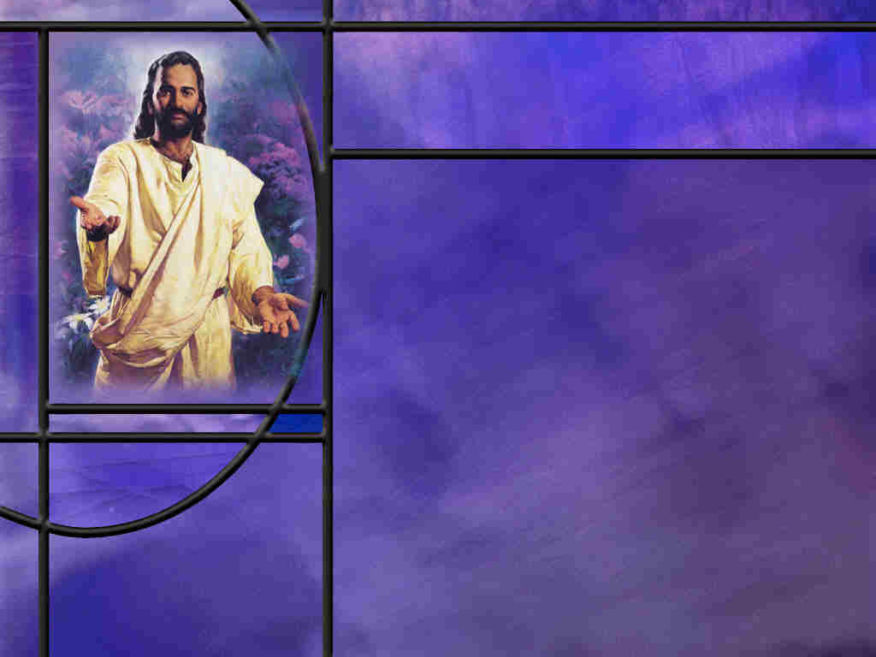
Memory Text
Luke 24:44-45 NKJV
Then He said to them, "These are the words which I spoke to you while I was still with you, that all things must be fulfilled which were written in the Law of Moses and the Prophets and the Psalms concerning Me." ⁴⁵ And He opened their understanding, that they might comprehend the Scriptures.
To whom did Jesus speak these words and on what occasion?
How does Jesus here refer to the Scriptures?
How much of Scripture did Paul say was inspired? (2 Tim 3:16)
Notes:
B2:
1. These words were spoken to His disciples who were gathered together behind closed doors on the Sunday evening of His resurrection.
2. The disciples on the road to Emmaus had run back to Jerusalem and informed the disciple that they had seen the risen Lord and talked with Him on the road.
3. And while they were talking, the resurrected Lord appeared in their midst and greeted them, showed them His hands and feet, ate a piece of broiled fish in their presence, and then spoke these words in our memory text today.
B3:
1. He refers to them as the Law of Moses, the Prophets, and the Psalms.
2. So Jesus specifically includes the Psalms along with the other inspired writings of the OT: The Law of Moses and the writings of the Prophets.
3. Some may be tempted to consider the Psalms as the work of musicians and songwriters and question whether or not all the psalms are fully inspired.
4. But that was not the view of Jesus.
5. He pointed to the Psalms as containing prophesies concerning Himself.
6. And indeed there are a number of Messianic Psalms.
7. Psalm 22 is a Messianic prophecy concerning His crucifixion which had just been fulfilled a few days before.
8. Jesus prayed from the cross the very words that begin this psalm: “My God, My God, Why hast Thou forsaken Me?”
9. This psalm goes on to give a vivid description of the crucifixion even though it was written nearly 1,000 years before that event.
10. Here’s David’s prophetic description of the crucifixion from Ps 22:14-18
Psalm 22:14-18 NIV - I am poured out like water, and all my bones are out of joint. My heart has turned to wax; it has melted within me. ¹⁵ My mouth is dried up like a potsherd, and my tongue sticks to the roof of my mouth; you lay me in the dust of death. ¹⁶ Dogs surround me, a pack of villains encircles me; they pierce my hands and my feet. ¹⁷ All my bones are on display; people stare and gloat over me. ¹⁸ They divide my clothes among them and cast lots for my garment.
11. Amazing prophecies recorded in the Psalms centuries before they were fulfilled in Christ.
B4:
2 Timothy 3:16 KJV - All scripture is given by inspiration of God, and is profitable for doctrine, for reproof, for correction, for instruction in righteousness:
1. By the time of Jesus and the apostles, the entire OT was collected together and was accepted by Jesus and the apostles as inspired Scripture.
2. This included the 150 psalms in our modern Bibles today.
3. So as we study this book of the Bible this quarter, let us be assured that “holy men of God spake as they were moved by the Holy Ghost.” (2 Peter 1:21)

Slide 3
Overview
In the Psalms, we will find a wide range of emotions from sublime reverence to abject sorrow. In these inspired prayers and hymns, every man on every occasion can find something which fits his needs and brings him daily into the presence of God.
  Background and Organization
  Types of Psalms
  Collections
  Summary

Slide 4
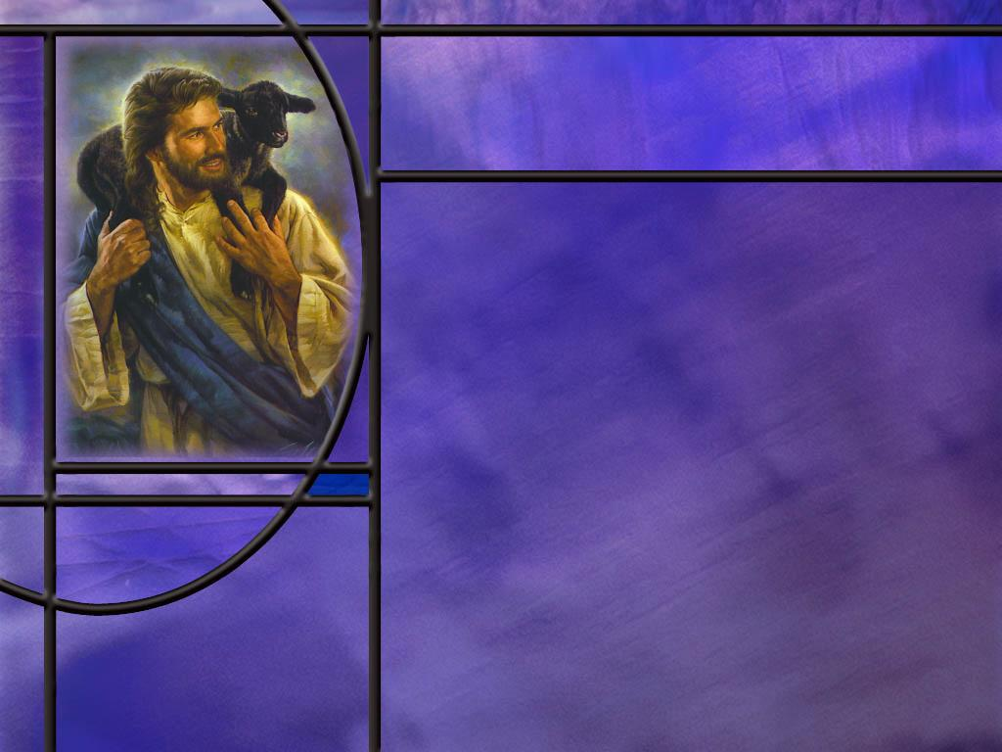
Background and Organization
What does the word “Psalms” mean?
What NT authors refer to the Psalms?
When were the Psalms written?
Who wrote the Psalms? [Authors]
How are the Psalms organized?
Notes:
B1:
1. The word “Psalms” in English comes from the Greek word Psalmos (psal-mos’)
2. It has the meaning of the striking of strings or chords of a musical instrument or the accompanying of instruments with a pious song or hymn.
3. The book of Psalms is a collection of 150 Hebrew poems set to music.
4. We will look at some of the features of Hebrew poetry as we study the Psalms.
B2:
1. Luke refers to the book of Psalms 5 times in His gospel and the book of Acts; the apostle Paul 3 times in his letters; and James once in his.
2. So we have 9 total references to the book of Psalms indicating that Jesus, as well as the NT writers, considered this book inspired.
B3:
1. The psalms were mostly written over a period of about 500 years beginning with King David and the united monarchy in about 1,000 BC and extending through the return from Babylon in the 400’s BC.
2. However, Psalm 90 is attributed to Moses which would go back to the time of the Exodus about 450 years before David.
3. So the Psalms could extend over the history of the Israelites from the Exodus to the Babylonian exile.
4. It is believed by many Bible scholars that Ezra the scribe compiled and arranged the psalms into their present order sometime after the return from the Babylonian captivity.
B4:
[No notes.]
B5:
1. The Psalms are organized into 5 major divisions of 5 smaller books.
2. Scholars believe it was Ezra the scribe that is responsible for the organization of the various psalms following the restoration of the temple after the Babylonian captivity.
3. Some have noted that the five divisions seem to repeat the five books of Moses in some of their content.
4. This is illustrated on the next slide.

Slide 5
Psalms as a Mirror of the Torah
Book | Doxology | Torah Match
I. Ps 1 – Ps 41 | 41:13 | Genesis
II. Ps 42 – 72 | 72:18-19 | Exodus
III. Ps 73 – 89 | 89:52 | Leviticus
IV. Ps 90 – 106 | 106:48 | Numbers
V. Ps 107 - 150 |  | Deuteronomy
[Link to Doxology Verses]
Notes:
1. The four divisions between these five books have a very similar praise to God called a Doxology in this slide.
2. The third column gives the book of the Torah, the writings of Moses, that corresponds to the 5 divisions of the Psalms.
3. For example: The account of creation is found in Genesis.
4. So in this first book (Book I) we find David’s Psalm 19 which begins with the words:
Psalm 19:1 KJV - The heavens declare the glory of God; and the firmament sheweth his handywork.
5. Psalms 8, 19, 24, and 33 all give glory to God as creator.
6. However, there are also later psalms that extol God as creator also.
7. Each of these first four divisions ends with a doxology or a hymn of praise to God.
8. So let’s take a look at these doxology verses.
[Click link to Doxology verses.]

Slide 6
Organization of Psalms Part 1
Book | Psalms | Theme | Content
Introduction | 1 and 2 | Obedience and faithfulness | Blessed are those who keep the Law, and put their trust in the Messiah.
1
Notes:
1. The first two psalms provide a fitting introduction to the book of Psalms.
2. The author of these psalms is unknown, but Psalm 3 is clearly attributed to David.
3. So we look to these first two psalms to provide themes that will be repeated in later sections.
4. Remember how Psalm 1 begins:
Psalm 1:1-6 KJV - 1 Blessed is the man that walketh not in the counsel of the ungodly, nor standeth in the way of sinners, nor sitteth in the seat of the scornful. 2 But his delight is in the law of the LORD; and in his law doth he meditate day and night. [3 And he shall be like a tree planted by the rivers of water, that bringeth forth his fruit in his season; his leaf also shall not wither; and whatsoever he doeth shall prosper. 4 The ungodly are not so: but are like the chaff which the wind driveth away. 5 Therefore the ungodly shall not stand in the judgment, nor sinners in the congregation of the righteous. 6 For the LORD knoweth the way of the righteous: but the way of the ungodly shall perish.]
5. So here at the very outset of the book of Psalms, the focus is on the Torah, the Law of Moses, the first five books of the Bible.
6. So the complier of the Psalms organizes the book into 5 parts.
7. The message is that the Psalms are calling God’s people to obedience to His Commandments in the Torah by giving them these poetic songs and prayers to strengthen their relationship with God.
8. Psalm 2 is clearly a Messianic psalm which ends with these words:
Psalm 2:11-12 ESV - Serve the LORD with fear, and rejoice with trembling. 12 Kiss the Son, lest he be angry, and you perish in the way, for his wrath is quickly kindled. Blessed are all who take refuge in him.
9. So here is a call to live in hope of the coming Messianic King, the Son, who will defeat evil and establish His eternal kingdom.
10. So the book of Psalms is then a call to use these inspired prayers and hymns to be faithful to God’s commandments and live in anticipation of the Messianic kingdom.
Q1: Is that relevant to us today? Do we need to be faithful to God’s commandments and live in anticipation of the Messianic kingdom?
1. Absolutely.
2. So these hymns and prayers from the heart can be used by us as we seek to be honest with the Lord as we come before Him in prayer and praise, confessing our sins and reaching out to Him as our source of salvation and hope.

Slide 7
Organization of Psalms Part 2
Book | Psalms | Theme | Content
1 | 3-41 | Conflict between David and Saul | Prayers for deliverance and protection against “my enemies.” Notable Psalm: Psalm 24:7-10 and Psalm 23.
2
Notes:
1. This is the first of the 5 divisions or 5 smaller books that make up the Psalms.
2. To a large extent the psalms are arranged chronologically and historically, but with many exceptions.
3. David starts out with many psalms in this section calling for deliverance from Saul who is intent on killing him.
4. We all know and love the 23rd Psalm: The Lord is my Shepherd…
5. We see in it the deliverance of David from his enemies and also the Messianic hope as he ends the psalm with these words:
Psalm 23:6 KJV - 6 … and I will dwell in the house of the LORD for ever.
6. Let’s also take a look at Ps. 24:7-10. [Click link]

Slide 8
Organization of Psalms Part 3
Book | Psalms | Theme | Content
2 | 42-72 | Kingship of David | More prayers for deliverance from different enemies. Confession of sin. Notable Psalms: 45, 48, 51, 54-64
3
Notes:
1. This is the second of the 5 divisions or smaller books that make up the Psalms.
2. The Psalms appear to arranged more or less chronologically.
3. Book 1 dealt mainly with the conflict between David and Saul which took place before David was king.
4. Now Book 2 looks at psalms from the time of David’s kingship.
5. Here again we see many of the psalms calling for protection from his enemies.
6. Ps 45 celebrates the kings marriage
7. Ps 48 celebrates the glory of Zion.
8. Ps 51 is Davids confession after his sin with Bathsheba
9. Ps 54-64 are psalms of praise for deliverance and fellowship with the Lord.
10. Let’s take just a quick look at his psalm of confession in Ps 51. [Click link]

Slide 9
Organization of Psalms Part 4
Book | Psalms | Theme | Content
3 | 73-89 | Assyrian crisis during eighth century BC | Collections from the sons of Asaph and Korah. Notable Psalms: 78
4
Notes:
1. Psalm 78 is a psalm of Asaph that describes God’s deliverance from Egypt and the rebelliousness of His chosen people.

Slide 10
Organization of Psalms Part 5
Book | Psalms | Theme | Content
4 | 90 - 106 | Theological evaluation after destruction of Jerusalem in 586 BC | Collection of praise psalms 95 – 100. Key Psalms: 90, 103 - 105
5
Notes:
1. This section contains some beautiful praise and worship psalms.
2. Psalm 90 is the prayer of Moses that focuses on the immortality of God and the frailty of man.
3. Remember his words:
Psalm 90:12 NKJV - 12 So teach us to number our days, That we may gain a heart of wisdom.
4. Psalm 103 is a favorite of many from beginning to end.
5. It opens and closes with the words: “Bless the Lord, O my soul.”
6. Let’s take a quick look at just a few of the verses of this wonderful psalm.
[Click link to Ps 103]

Slide 11
Organization of Psalms Part 6
Book | Psalms | Theme | Content
5 | 107- 145 | Praise and reflection after the Exile – a new era | The Hallelujah Collection. 111 – 118; pilgrimage: 120 – 134. Key Psalms: 107, 110, 119.
Epilog
Notes:
Q1: What is notable about Psalm 119?
1. Psalm 119 is the longest Psalm and the longest chapter in the Bible.
2. It is called an alphabetic acrostic poem because each section of the psalm begins with the next letter of the Hebrew alphabet in sequence.
3. So there are 22 sections of this psalm each containing 8 verses, each starting with a different letter of the Hebrew alphabet.
4. That gives 176 verses total for this Psalm.
Q2: And what is the theme of this psalm?
1. It focuses on the all-sufficiency of the word of God.
2. Remember:
Psalm 119:11 KJV - 11 Thy word have I hid in mine heart, that I might not sin against thee.
3. The Word of God is sufficient to make us wise, train us in righteousness, and equip us for every good work (2 Tim 3:15-17).
4. The Scriptures are a reflection of God’s nature, and from them we learn that we can trust His character and His plan and purposes for mankind, even when those plans include affliction and persecution.

Slide 12
Organization of Psalms Part 7
Book | Psalms | Theme | Content
Epilog | 146-150 | Praise to the God of Israel. The “hallelujah chorus” | Each psalm begins and ends with the word “Hallelujah.” Key Psalm: 150
Notes:
1. The epilog is the concluding portion that draws the conclusions.
2. It is the counterpart of the introduction that comes at the end instead of the beginning.
Q1: What is the meaning of “Hallelujah”?
1. Hallelujah is a command in Hebrew to tell a group of people to praise Yah the shortened form of Yahweh.
2. Hallelujah means praise Yahweh or praise God.
3. So in the English translation of these psalms, they all begin and end with the words: “Praise ye the LORD.”
Let’s look briefly at the very last Psalm in the book. [Click link to Ps 150]

Slide 13
Types of Psalms
Hymns
  General Hymns
  Historical Hymns
  Zion Hymns
  Kingship Hymns
Laments
  Individual Laments
  Communal Laments
Miscellaneous Forms
  Royal Psalms
  Individual thanksgiving
  Communal thanksgiving
  Individual psalms of confidence
  Communal psalms of confidence
  Liturgies
  Prophetic exhortations
  Didactic psalms
Notes:
1. Didactic psalms simply mean a teaching psalm.
2. It is a psalm intended to teach us a particular truth.
3. Psalm 1 is a didactic psalm: it teaches us the blessedness of the godly and the cursedness of the ungodly.
4. It ends with these words:
Psalm 1:6 KJV - 6 For the LORD knoweth the way of the righteous: but the way of the ungodly shall perish.

Slide 14

Collections of Psalms
The Psalms give evidence in their titles to certain collections.
  Psalms of Korah and sons (42-49; 84-85; 87-88)
  Psalms of Asaph and sons (73-83)
  Songs of Ascent (120 – 134)
  Hallelujah Psalms (111 – 118; 146 – 150)
  The Egyptian Hallel (113-118)
Notes:
Q1: Most of these we can understand indicate the authors or the theme, but what are the Songs of Ascent?
1. In the Hebrew calendar, there were three feasts that all men of age were required to attend in Jerusalem: Passover, Pentecost, and Tabernacles.
2. Jerusalem was built on a hill and is often referred to as Mt. Zion.
3. So people coming to Jerusalem for these holidays had to climb or ascend up the mountain to get to the temple.
4. The songs of ascent would be the particular psalms that they would sing as they climbed toward Jerusalem.
Q2: What is the Egyptian Hallel?
1. Hallel simply means praise.
2. These are a collection of psalms that mention the deliverance from Egypt and so are recited or sung at Passover.

Slide 15

Summary
Book of Psalms Summary: A Complete Animated Overview - YouTube
Notes:
1. Our summary this morning is a bit different.
2. It consists of a 9-minute animated video by The BibleProject that gives an excellent summary of the Book of Psalms.
[If you are in slide show presenter view and have an internet connection, simply click the link to go to YouTube and view the video.]
[If you are not in slide show presenter view and have an internet connection, control+click to follow the link above.]
[If you have no internet connection at church or where you are presenting this lesson, you must download the file from YouTube at home and add it to this presentation. You can download the file using 4K Video Downloader which is a free app. Use it to download the Psalms Summary from YouTube. Then in this presentation, click the Insert tab, the dropdown menu on the Video icon, click Insert video from this device, and navigate to select the Psalms Summary video file.]

Slide 16
Summary
Notes:
[This is the display slide for the video link to the Psalms Summary on my computer. Skip this slide if you can use the link in the previous slide.]

Slide 17
Summary
The important point of this overview is to whet your appetite for using the Psalms in your own devotional life.
These inspired words can become our words of praise, thanksgiving, and joy of repentance and sorrow for sin, of honest anger and feelings of defeat and despair, of faith and hope in the goodness of our God and the ultimate certainty of His promises.
Will you pray this week for God’s guidance in making the Psalms a source of revival and renewal in developing a deeper heart-to-heart relationship with God?

Slide 19
Authors of the Psalms
David: 73 psalms
Sons of Korah (Ps 42-49; 84-85; 87-88)
Asaph (Ps 50; 73-83)
Solomon (Ps 72; 127)
Herman the Ezrahite (Ps 88)
Ethan the Ezrahite (Ps 89)
Moses (Ps 90)
Unknown (49 psalms) [R]

Slide 20
Doxology Verses
Psalm 41:13 KJV - 13 Blessed be the LORD God of Israel from everlasting, and to everlasting. Amen, and Amen.
Psalm 72:18-19 KJV - 18 Blessed be the LORD God, the God of Israel, who only doeth wondrous things. 19 And blessed be his glorious name for ever: and let the whole earth be filled with his glory; Amen, and Amen.
Psalm 89:52 KJV - 52 Blessed be the LORD for evermore. Amen, and Amen.
Psalm 106:48 KJV - 48 Blessed be the LORD God of Israel from everlasting to everlasting: and let all the people say, Amen. Praise ye the LORD. [R]
Notes:
Q1: What similarities do you notice about all of these doxologies?
1. They all say “Blessed be the Lord.” and they all end with “Amen.”
2. So these verses are taken as the end of the first four divisions of the book of Psalms.
3. Since there is nothing following Psalm 150, its ending is a little different, but still speaking words of praise to the Lord.
4. Now within each of these major divisions there are many different psalms with many different themes.
5. So depending on what psalms you pick out to emphasize, you can come up with different themes for each of these five divisions.

Slide 21
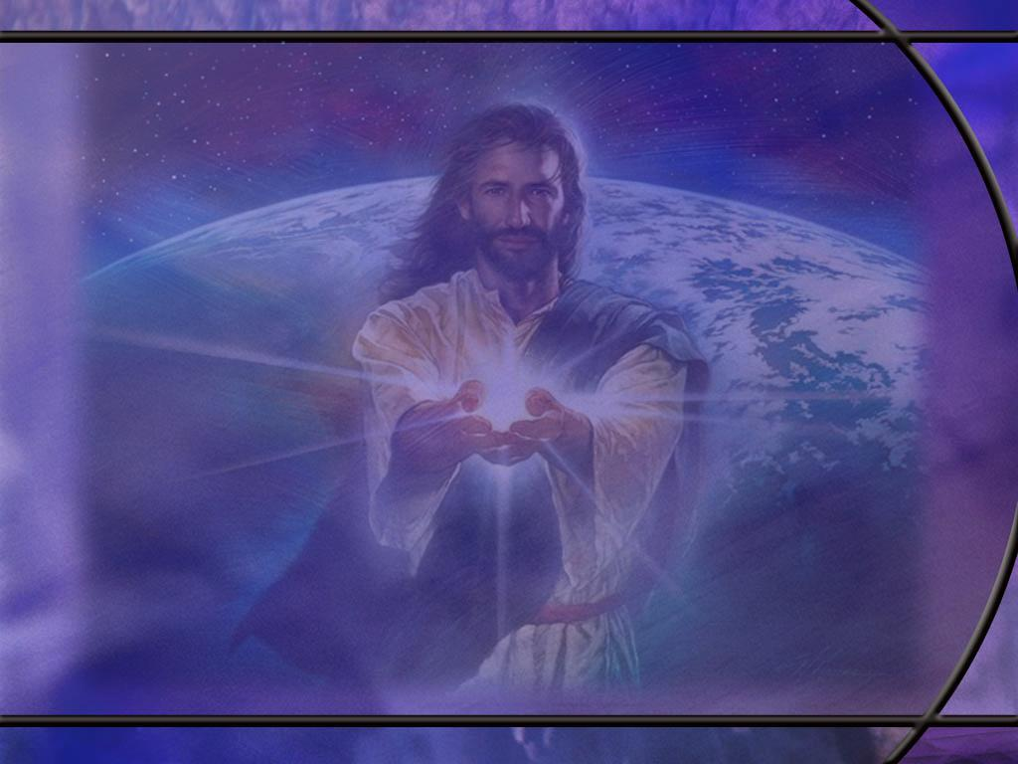
Psalm 24:7-10 KJV
Lift up your heads, O ye gates; and be ye lift up, ye everlasting doors; and the King of glory shall come in. 8 Who is this King of glory? The LORD strong and mighty, the LORD mighty in battle. 9 Lift up your heads, O ye gates; even lift them up, ye everlasting doors; and the King of glory shall come in. 10 Who is this King of glory? The LORD of hosts, he is the King of glory. Selah. [R]
Notes:
Q1: What are these gates and everlasting doors?
1. Most likely they are a personification of the temple gates and doors.
2. The imagery is that of a returning conquering king and the reception of praise and exaltation he receives.
3. Here the idea is that our victorious King is the King of glory, the Lord of hosts, the Lord mighty in battle: Yahweh our God.
Q2: How could we apply these words to ourselves in our own prayer life to strengthen our relationship with the Lord of host?
1. We can see our bodies as the temple of the Holy Spirit as the NT teaches.
2. We can see this as a call to open the gates of our hearts and welcome in our sovereign King, the Lord of hosts, the King of glory.
3. We can thank Him for the victory that is sure to be ours when He comes into our hearts and saves us in His kingdom.
4. Hallelujah!

Slide 22
Psalm 51:1-3, 7 NKJV
Have mercy upon me, O God, According to Your lovingkindness; According to the multitude of Your tender mercies, Blot out my transgressions. ² Wash me thoroughly from my iniquity, And cleanse me from my sin. ³ For I acknowledge my transgressions, And my sin is always before me. ... 7 Purge me with hyssop, and I shall be clean; Wash me, and I shall be whiter than snow. [R]
Notes:
Q1: How is David confessing his sin of adultery here?
1. He is taking responsibility for his actions.
2. He is not blaming it on the devil, or his inherited tendencies.
3. He’s not blaming it on Bathsheba for taking a bath where he could see her.
4. He is saying “mia culpa:” it’s my fault.
Q2: What do you make of his request to “purge me with hyssop?”
1. It could be a reference to the sacrificial blood.
2. At the Passover, the angel instructed the Israelites to use hyssop to apply the blood of the Passover lamb to the doorposts of their homes.
3. That Passover lamb would point to Jesus the Lamb of God who takes away the sins of the world.

Slide 23
Psalm 103:11-12 NKJV
For as the heavens are high above the earth, So great is His mercy toward those who fear Him; ¹² As far as the east is from the west, So far has He removed our transgressions from us. [R]
Notes:
Q1: How high are the heavens above the earth?
1. So if you go to the reaches of outer space, the distance is some 13 billion light years.
2. That’s a long way!
3. And it describes God’s mercy to those that love Him.
Q2: And how far is the east from the west?
1. The distance is infinite.
2. Randy Roberts pointed this out in one of his sermons.
3. If the psalmist had said as far as the north is from the south, that would be a finite distance no grater than the distance from the south pole to the north pole.
4. Once you pass the north pole, you are not going north anymore, you are going south.
5. But east and west, there is no point where someone traveling east starts traveling west.
6. Going east you are always going east and going west, you are always going west.

Slide 24
Psalm 150:1, 6 KJV
Praise ye the LORD. Praise God in his sanctuary: praise him in the firmament of his power. ... 6 Let every thing that hath breath praise the LORD. Praise ye the LORD. [R]
Notes:
1. On this slide we have just the first and last verses of Psalm 150.
2. Notice how the psalm opens and how it closes.
3. Both are “Praise ye the Lord.”
4. The same is true of each of the psalms 146 through 150.
5. So these form a cohesive unit that we can look at as a fitting conclusion to the book of Psalms.

