Slide 1
Psalms
Lesson 5
Singing the Lord’s Song in a Strange Land

Slide 2
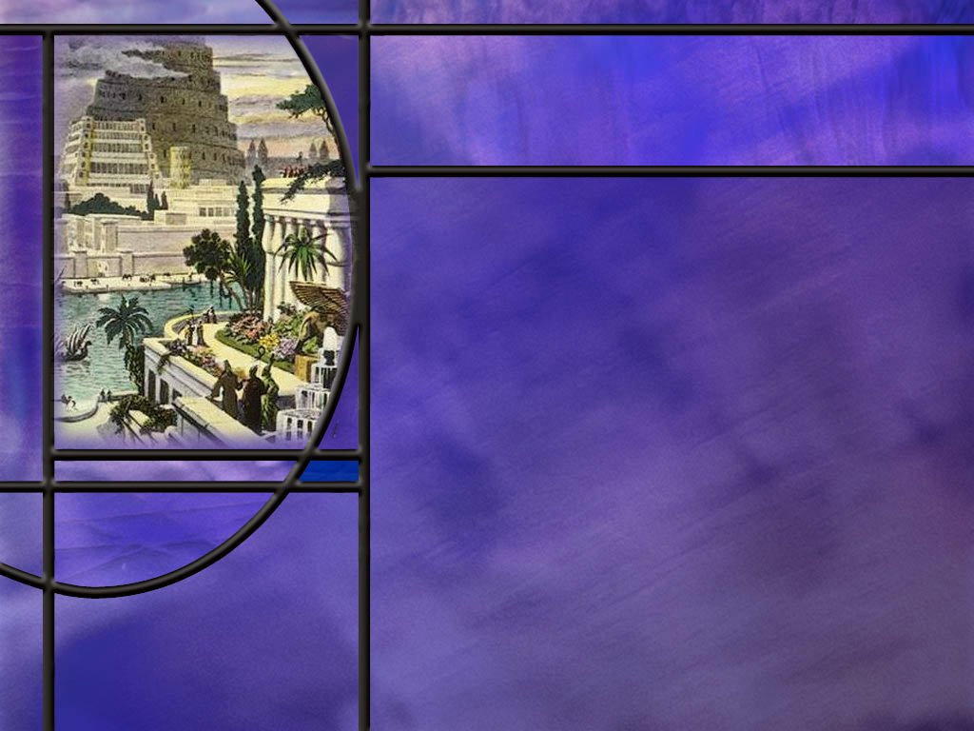
Memory Text
Psalm 137:4 KJV
How shall we sing the LORD'S song in a strange land?
What do you think might have been the circumstances of the psalmist who wrote these words?
What consolation do you think the psalmist arrives at in this difficult situation?
As you think about our own culture, how is our land becoming increasingly strange?
Notes:
B2:
1. This psalm appears to be composed by one of the Jewish captives in the land of Babylon.
2. Let’s go back and read the first three verses of this psalm:
Psalm 137:1-3 NLT - Beside the rivers of Babylon, we sat and wept as we thought of Jerusalem. 2 We put away our harps, hanging them on the branches of poplar trees. 3 For our captors demanded a song from us. Our tormentors insisted on a joyful hymn: "Sing us one of those songs of Jerusalem!“
3. And then our memory text: “How shall we sing the Lord’s song in a strange land?”
4. Here they are in the land of Babylon, surrounded by Babylonians, who were now their masters.
5. They were in a pagan culture surrounded by pagan religions, seeing temples constructed to the pagan gods.
6. And the implication of the Babylonians was that their pagan gods were more powerful than Yahweh because they had destroyed Yahweh’s temple, had removed the sacred vessels, and had carried off Yahweh’s people into captivity.
7. So the Babylonians mocked them: “Sing us a happy song about Jerusalem and the temple of Yahweh.”
8. And the psalmist laments, “How can we sing Yahweh’s song in a pagan land that has overthrown Yahweh’s temple?”
B3:
1. Do you think he’s ready to give up on Yahweh and accept one of the Babylonian gods as superior?
2. Is he going to blame Yahweh for allowing the Babylonians to be victorious?
3. What does he know from prophecy that will happen to Babylon?
4. Babylon will not rule forever.
5. Their day of defeat will soon come at the hands of the Medes and Persian.
6. The captivity is only for 70 years.
7. God has not given up on His covenant people.
8. He is disciplining them as a loving father disciplines his son.
9. He will restore them and restore Jerusalem and the temple.
10. The psalmist may remember:
Psalm 30:5 NKJV - 5 For His anger is but for a moment, His favor is for life; Weeping may endure for a night, But joy comes in the morning.
11. So we see the consolation of the captives in verse 8 of this same psalm
Psalm 137:8 NLT - 8 O Babylon, you will be destroyed. Happy is the one who pays you back for what you have done to us.
B4:
1. Our land is becoming increasingly secular.
2. While most of our land still believes in God, the institutions of power are becoming increasingly atheistic.
3. The government, legacy media, big tech, educational institutions, corporations are all pushing a secular, godless worldview that promotes individual autonomy, sexual perversion, and evil in contrast to Christian morality.
4. And even those who say they believe in God often don’t believe in the God of the Bible.
5. Take a look at the graphic on the next slide.

Slide 3
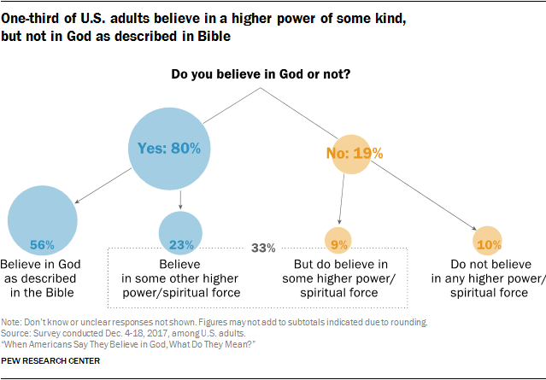
Notes:
1. Here we have a breakdown of the beliefs of adults in the USA.
2. These data are from surveys in 2017 by the Pew research center.
3. So 80% say they believe in God, and about 20% say they do not.
4. But of the 80% who say they believe in God, only 56% believe in the God of the Bible: 23% say they believe in some higher power or spiritual force.
5. Of the 19% who say they don’t believe in God, almost half, 9%, say they believe in some higher power or spiritual force.
6. Only about 10% are atheists in the traditional sense that do not believe in any higher power or spiritual force.
7. So the point is: here in our country, only a little over half, 56%, believe in the God of the Bible while 33% believe in some higher power or spiritual force.
8. Five and a half people out of ten believe in the God of the Bible; 4.5 people out of ten do not believe in the God of the Bible.
9. This is a far cry from the Christian Pilgrims that came to our shores seeking religious liberty and believing in the God of the Bible.
10. One more point here: This is what people say they believe in a survey.
11. In practice, there are many people who claim to believe in God but live as if there is no God.
12. These are what I would call practical atheists.
13. And I think that the practical atheists in our country probably account for the majority of people.
14. Our country is becoming increasingly secular as the anti-Christian woke left has taken over the levers of power in our government and educational institutions.
15. To cite just one example from this week: Six peaceful pro-life protesters at an abortion clinic have been charged with a federal felony for praying and singing hymns and asking moms not to abort their babies. These pro-life activists have now been found guilty of a misdemeanor FACE Act charge, as well as a felony “conspiracy against rights” charge, which carries with it the possibility of up to 11 years in prison and fines up to $250,000.
16. Our land is becoming increasingly strange to Christian morality and values.

Slide 4
Overview
The psalms in our lesson this week cry out with honest questions to God. Why do the innocent suffer? Why does God seem so far from me? Why do the wicked prosper? Have the promises of God failed? All of these questions can be answered by recalling that we live in a fallen world under the curse of sin. But have faith: God is working our His plan of redemption.
  Why do the wicked prosper?
  Why does God tolerate dishonor?
  Does God’s Goodness Change?
  Summary
Notes:
We will look at Ps. 73, 74, 79, and 77 in our lesson today.
All of these psalms were written by Asaph.

Slide 5

Prosperity of the Wicked
What does Asaph see as he looks at the life of the wicked in Psalm 73? (Ps 73:3-12)
Do you see instances in our own time where the wicked seem to prosper more than the righteous?
Where did the psalmist Asaph go to get a divine perspective on the wicked who prospered and the righteous who suffered? (Ps 73:16-19)
What do you think Asaph saw in the sanctuary that convinced him that God’s justice would prevail in the end?
How does Asaph contrast his own end with the end of the wicked? (Ps 73:24-28)
Notes:
B1:
[See notes on linked slide.]
B2:
1. Examples abound of those who are wicked profiting by their wickedness
2. Bernie Madoff ran a Ponzi scheme that netted him millions from his investors before he ended up in jail.
3. Sam Bankman-Fried did the same thing with crypto currency before he was indited and convicted on seven counts of fraud including wire fraud, commodities fraud, securities fraud, money laundering, and campaign finance law violations.
4. Drug lords, pimps, and human traffickers profit off of illicit trade.
5. Murderers and mobsters like Whitey Bulger live a life of ease for years.
6. Bank robbers have money they don’t have to work for.
7. Hugh Heffner lived in the Playboy Mansion with a lot of beautiful sexy girls before he died in 2017.
8. The Mexican drug cartels are making millions off of the crisis at our southern boarder while 100,000 Americans die of drug overdoses each year.
9. Our society is full of scammers trying to make money off of the elderly and the unsuspecting, to say nothing of scams to steal government money for hard working taxpayers.
B3:
[See notes on linked slide.]
B4:
1. In the sanctuary, he saw that God does not ignore sin, but holds sinners accountable.
2. The sanctuary service taught that the wages of sin is death.
3. In His grace and mercy, God has provided a substitute to bear our sins and pay the penalty for sin.
4. But on the Day of Atonement, those who refused to repent and have their sins atoned for by the blood of the Lord’s goat were cut off from God’s people.

Slide 6
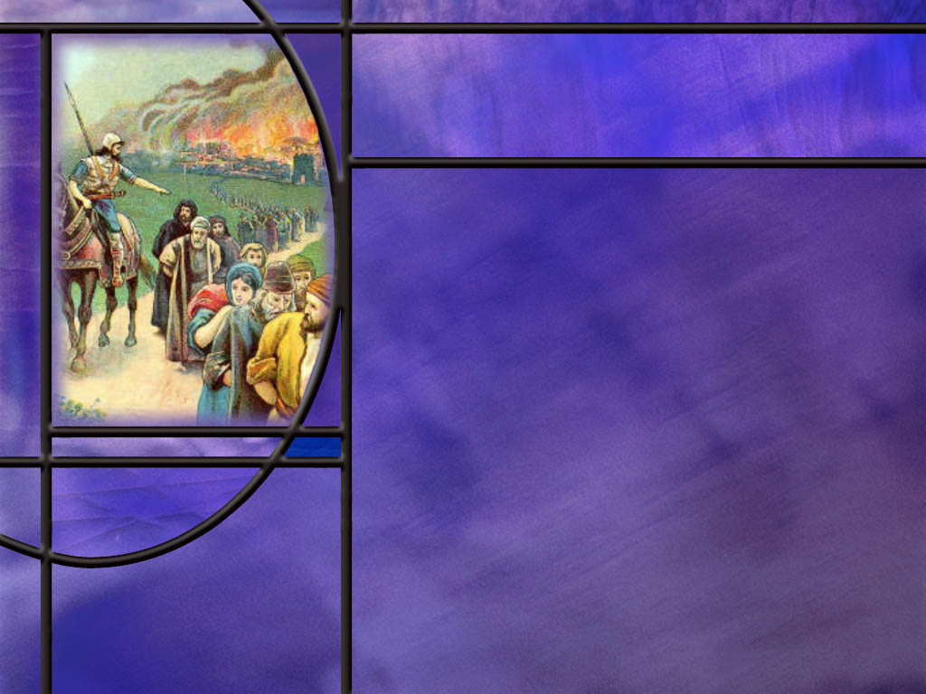
Damage to God’s Reputation
What is the condition of) God’s sanctuary in Psalms 74 and 79? (Ps 74:3-7; 79:1-4)
What question does this destruction raise in Asaph’s mind? (Ps 74:10-11; Ps 79:5-7)
What insight to God’s inaction does Asaph consider in Ps 79? (Ps 79:8-9)
How concerned should we be for the glory and honor of God’s name?
How does Asaph come to grips with his unanswered questions? (Ps 74:12-17; Ps 79:11)
Notes:
B1:
[See notes on linked slide.]
B2:
[See notes on linked slide.]
B3:
[See notes on linked slide.]
B4:
1. We would do well to take a cue from Asaph in his desire to see God’s name glorified.
2. The chief end of man is to glorify God and enjoy Him forever.
3. Paul instructs us:
1 Corinthians 10:31 ESV - 31 So, whether you eat or drink, or whatever you do, do all to the glory of God.
4. In all of our actions and words, we want to make God look good to those who are watching.
5. Let you light so shine before men that they may see your good works and glorify your Father which is in heaven. (Matt 5:16)

Slide 7

A Consistent God
What questions arise in Asaph’s mind when it seems that God is not there to help in his distress? (Ps 77:7-9)
Where does Asaph find the answer to his questions on the immutability of God? (Ps 77:10-13)
Notes:
B1:
[See notes on linked slide.]
B2:
[See notes on linked slide.]

Slide 8

Summary
As our country becomes increasingly secular, we can identify with the writer of Ps 137 finding it difficult to Sing the Lord’s song in a strange land.
But like the psalmist, we can take consolation in the fact that Babylon will be destroyed, and God’s people will celebrate victory in the end.
In Ps 73, Asaph is troubled by the prosperity of the proud and wicked.
While the blessings and curses of Deut 28 applied specifically to Israel as a nation, we would expect it to apply generally to individuals, but Asaph was seeing many exceptions.
We see the same in our society today. Many are profiting from sinful acts.

Slide 9
Summary
Asaph’s perspective changed when he entered the sanctuary.
There he saw that God does not ignore sin, but holds sinners accountable: the wages of sin is death, and the only way of forgiveness is to lay our sins on the Substitute.
In the sanctuary Asaph sees that the destiny of the wicked is destruction.
This he contrasts with the righteous who know the Lord and have a glorious destiny with Him forever.
Psalms 74 and 79 are similar in theme: they lament the destruction of the sanctuary and Jerusalem and question how long God will tolerate the dishonor this destruction brings to His name.

Slide 10
Summary
Asaph recognizes the need for corporate repentance and asks for forgiveness and restoration and ends both of these psalms by trusting in God to keep His covenant and restore His honor in His time.
In Psalm 77, Asaph is feeling abandoned by God and questions if God has changed.
His perspective changes when he begins to focus on the things God has done and specifically on God’s deliverance of His people from Egypt.
We too need anchors for our faith that we can return to when we are tempted to doubt.
When doubts arise for you, will you follow Asaph’s words: “I will consider all your works and meditate on all your mighty deeds."

Slide 12
Psalm 73:3-5, 7, 12 NLT
For I envied the proud when I saw them prosper despite their wickedness. ⁴ They seem to live such painless lives; their bodies are so healthy and strong. ⁵ They don't have troubles like other people; they're not plagued with problems like everyone else. ... ⁷ These fat cats have everything their hearts could ever wish for! ... ¹² Look at these wicked people--enjoying a life of ease while their riches multiply. [R]
Notes:
Q1: How does Asaph describe those he envied?
1. He describes them as proud but wicked in verse 3.
2. Again in verse 12 he refers to them as wicked people.
Q2: What characterizes the proud but wicked? How do they relate to God?
1. The proud do not fear God.
2. They do not respect Him or show reverence for Him.
3. They are not submissive to Him as Lord.
4. In fact, they take God’s place on the thrones of their own hearts.
5. The proud see themselves as God and worship themselves instead of God.
6. As a result, they have no respect for the commandments of God and do evil rather than good.
Q3: Why should the prosperity of the wicked raise questions in Asaph’s mind?
1. What did Moses record in Deut 28 about blessings and curses?
Deuteronomy 28:2, 15 NLT - 2 You will experience all these blessings if you obey the LORD your God: ... 15 "But if you refuse to listen to the LORD your God and do not obey all the commands and decrees I am giving you today, all these curses will come and overwhelm you:
2. So for Israel as a nation, God promised blessings for obedience and curses for disobedience.
3. Now for individuals, we noted that the same is generally true.
4. Blessings come with obedience and troubles and difficulties come with disobedience.
5. But that is only generally true.
6. Asaph is looking at many apparent exceptions to this general rule.
7. And he’s questioning God, “What’s going on here?”

Slide 13
Psalm 73:16-19 NLT
So I tried to understand why the wicked prosper. But what a difficult task it is! ¹⁷ Then I went into your sanctuary, O God, and I finally understood the destiny of the wicked. ¹⁸ Truly, you put them on a slippery path and send them sliding over the cliff to destruction. ¹⁹ In an instant they are destroyed, completely swept away by terrors. [R]
Notes:
Q1: What did Asaph understand about the final destiny of the wicked in the sanctuary?
1. Their final destiny is destruction.
2. They are destroyed, completely swept away by terrors.
3. And I believe the terror he is referring to here is the terror of death without hope.
4. The wicked may prosper for a time, but judgment is coming.
5. As the writer to the Hebrews put it:
Hebrews 9:27 KJV - 27 … it is appointed unto men once to die, but after this the judgment:
6. Facing the judgment without the blood of Christ to cover your sins is a terrifying prospect.
7. Without forgiveness, the wicked finally come to nothing.
8. They bear their own sins in the lake of fire.

Slide 14
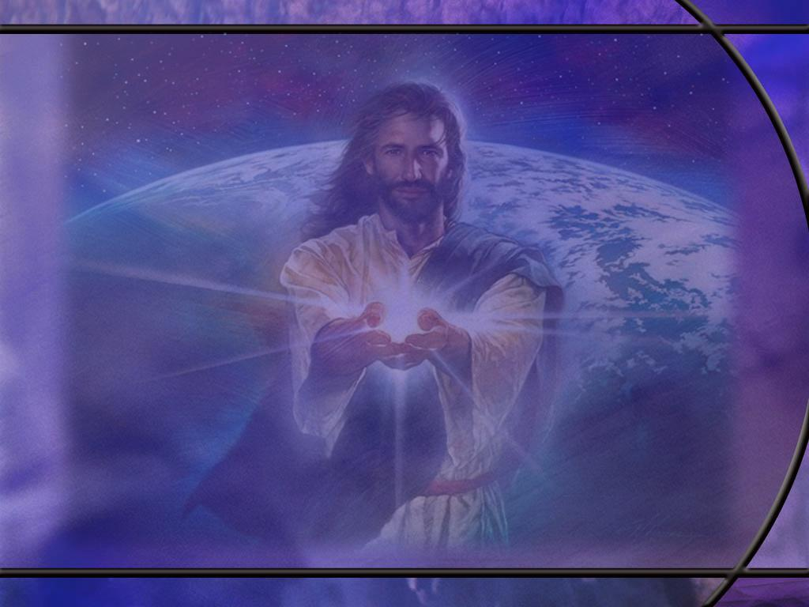
Psalm 73:24-28 NLT
You guide me with your counsel, leading me to a glorious destiny. ²⁵ Whom have I in heaven but you? I desire you more than anything on earth. ²⁶ My health may fail, and my spirit may grow weak, but God remains the strength of my heart; he is mine forever. ²⁷ Those who desert him will perish, for you destroy those who abandon you. ²⁸ But as for me, how good it is to be near God! I have made the Sovereign LORD my shelter, and I will tell everyone about the wonderful things you do. [R]
Notes:
Q1: What destiny is Asaph looking forward to as opposed to the destiny of the wicked, which is destruction.
1. He is confident that the Lord is leading him to a “glorious destiny.”
2. That would be a destiny in glory rather than in the lake of fire.
3. He is confident that “He [the LORD] is mine forever.”
4. He has a saving relationship with the Lord.
5. He is walking with God saying “How good it is to be near God!”
6. The sovereign Lord is his shelter.
7. Those who abandon God will perish, but those who are faithful to Him will enjoy a glorious destiny forever.

Slide 15
Psalm 74:3-7 NLT
Walk through the awful ruins of the city; see how the enemy has destroyed your sanctuary. ⁴ There your enemies shouted their victorious battle cries; there they set up their battle standards. ⁵ They swung their axes like woodcutters in a forest. ⁶ With axes and picks, they smashed the carved paneling. ⁷ They burned your sanctuary to the ground. They defiled the place that bears your name.
Notes:
Q1: What is Asaph’s lament in the opening verses of this psalm?
1. God’s sanctuary in Jerusalem has been destroyed.
2. In fact, the whole city lies in ruins.
3. The Babylonians have destroyed the temple and Jerusalem.
4. They have defiled that place that bears the name of Yahweh.
5. And the unspoken question is, Lord, how could you let this happen?
6. How could you allow your reputation as the sovereign God to take such a hit?
7. Let’s see how Asaph expresses it in Ps 79.
[Go to next slide.]

Slide 16
Psalm 79:1-4 NLT
O God, pagan nations have conquered your land, your special possession. They have defiled your holy Temple and made Jerusalem a heap of ruins. ² They have left the bodies of your servants as food for the birds of heaven. The flesh of your godly ones has become food for the wild animals. ³ Blood has flowed like water all around Jerusalem; no one is left to bury the dead. ⁴ We are mocked by our neighbors, an object of scorn and derision to those around us. [R]
Notes:
Q1: What graphic details does Asaph add in this psalm?
1. Not just the temple and the buildings of Jerusalem destroyed, but dead bodies all around.
2. Blood flowing in the streets like water.
3. Nobody left to bury the dead.
4. Birds and wild animals feeding on the flesh of God’s people.
5. Neighbors mocking them that their God did not save them.

Slide 17
Psalm 74:10-11 NLT
How long, O God, will you allow our enemies to insult you? Will you let them dishonor your name forever? 11 Why do you hold back your strong right hand? Unleash your powerful fist and destroy them.
Notes:
Q1: What is Asaph’s concern in these questions? What is God allowing to happen by not defeating His enemies?
1. God is allowing the enemies of His people, these pagan Babylonians, to insult Him and bring dishonor upon His name and reputation.
2. Why would God do that?
3. Asaph knows that God has the power to defeat them.
4. But for now, God is willing to live with the dishonor that these pagans have conquered His chosen people.
5. And Asaph cries out, “How long?”
Q2: Could you answer Asaph’s question of how long?
1. Jeremiah answered it: 70 years?
2. Then would come the handwriting on the wall that would bring down Belshazzar’s kingdom with a crash.
3. Now let’s check out Ps. 79
[Go to next slide.]

Slide 18
Psalm 79:5-7 NLT
O LORD, how long will you be angry with us? Forever? How long will your jealousy burn like fire? ⁶ Pour out your wrath on the nations that refuse to acknowledge you--on kingdoms that do not call upon your name. ⁷ For they have devoured your people Israel, making the land a desolate wilderness. [R]
Notes:
Q1: What similarities do you see here with Ps 74?
1. Same questions: How long? Forever?
2. Same call for God to rise up and destroy their enemies.
3. But here in this Psalm, a little more insight into the cause of God’s inaction.
4. Instead of “How long will you let your enemies insult you,” it is “How long will you be angry with us?”
5. So here we see Asaph beginning to assign some responsibility to his people.
6. We see this trend continue in the next few verses of Ps 79 but not in Ps 74.

Slide 19
Psalm 79:8-9 NLT
Do not hold us guilty for the sins of our ancestors! Let your compassion quickly meet our needs, for we are on the brink of despair. ⁹ Help us, O God of our salvation! Help us for the glory of your name. Save us and forgive our sins for the honor of your name. [R]
Notes:
Q1: How do these verses get to the root of the problem of the Babylonian captivity?
1. The reason that God allowed the Babylonians to defeat His chosen people is because of their persistent idolatry over the centuries.
2. This was discipline to teach them that God is a jealous God and will not share His sovereign authority with any false gods.
Q2: How does Asaph try to distance the current generation from their ancestors?
1. He asks the Lord not to hold the current generation guilty for the sins of their ancestors.
2. But in dealing with Israel, there is such a thing as corporate guilt.
3. While not all are guilty, the entire nation is punished for the unfaithfulness of the leaders and the majority.
4. In describing His character to Moses on Mt. Sinai, God said this:
Exodus 34:7 ESV - 7 keeping steadfast love for thousands [of generations], forgiving iniquity and transgression and sin, but who will by no means clear the guilty, visiting the iniquity of the fathers on the children and the children's children, to the third and the fourth generation."
5. Perhaps the accumulation of corporate guilt is what the Lord meant by visiting the iniquity of the fathers upon the children.
6. When the nation fills the cup of iniquity, God acts even if there are some righteous who get caught up in the punishment.
7. So Asaph gets to the root of the problem when he prays, “Save us and forgive our sins.”
8. Here he is admitting that this is corporate guilt because he prays for the forgiveness of “our sins” rather than “my sins.”
9. So God will forgive and restore, but they will have to suffer the consequences of their iniquity.
Q3: What is Asaph’s concern for the name of God?
1. Asaph is concerned for the glory and honor of God’s name.
2. He wants God to reverse the damage and dishonor that His name has suffered.
3. And here he realizes that God has allowed His name to be dishonored, not because God is weak, but because His people have sinned.

Slide 20
Psalm 74:12, 20, 22-23 NLT
You, O God, are my king from ages past, bringing salvation to the earth. ... 20 Remember your covenant promises, for the land is full of darkness and violence! ... 22 Arise, O God, and defend your cause. Remember how these fools insult you all day long. ²³ Don't overlook what your enemies have said …
Notes:
Q1: Where does Asaph put his trust to resolve the problem that God’s name has been dishonored?
1. He is still trusting in God as his king and savior.
2. He reminds himself and his readers of God’s covenant promises, and trusts in God to make good on those promises.
3. He trusts that God will defend His own cause in His own time.
4. And indeed, He will.
5. Now let’s look at Psalm 79
[Go to next slide.]

Slide 21
Psalm 79:12-13 NLT
O Lord, pay back our neighbors seven times for the scorn they have hurled at you. ¹³ Then we your people, the sheep of your pasture, will thank you forever and ever, praising your greatness from generation to generation. [R]
Notes:
Q1: Where does Asaph leave his questions about returning honor and glory to the name of Yahweh.
1. He trusts in the Lord to restore His people, His city, His temple, His promised land, and remove the scorn of their neighbors.
2. He is confident that eventually the Lord will act to restore all that has been lost and receive the praise of His restored people from generation to generation.

Slide 22
Psalm 77:7-9 NLT
Has the Lord rejected me forever? Will he never again be kind to me? ⁸ Is his unfailing love gone forever? Have his promises permanently failed? ⁹ Has God forgotten to be gracious? Has he slammed the door on his compassion? [R]
Notes:
Q1: What is going through Asaph’s mind here when it seems that God is not present in times of distress?
1. He is questioning, “Has God changed?”
2. The God he has known in the past is accepting, kind, loving, gracious, compassionate, and He keeps His promises.
3. Now in his distress, he questions if God’s character has changed.
4. Because he doesn’t feel the acceptance, kindness, love and compassion of God in his current situation he wonders if God is the same yesterday, today, and forever.
5. So his question is, God have you changed?

Slide 23
Psalm 77:10-13 NIV
Then I thought, "To this I will appeal: the years when the Most High stretched out his right hand. ¹¹ I will remember the deeds of the LORD; yes, I will remember your miracles of long ago. ¹² I will consider all your works and meditate on all your mighty deeds." ¹³ Your ways, God, are holy. What god is as great as our God? [R]
Notes:
1. And then in the rest of the psalm, Asaph launches into the miraculous way that Yahweh led His people out of Egyptian bondage and across the Red Sea into the Promised Land.
Q1: When you are tempted to doubt the goodness of God, what anchors of faith do you recall?
1. My two anchors are the word of God and the order, complexity, design, beauty, and precision of the creation He put together.
2. When it comes to the immutability of God, the Bible is clear that His character does not change.
3. He is a God of holiness and love from beginning to end.
Malachi 3:6 KJV - For I am the LORD, I change not.
4. God is not capricious. He is consistent.
5. Jesus reflects the fulness of the Fathers character.
6. He is described in:
Hebrews 13:8 KJV - Jesus Christ the same yesterday, and to day, and for ever.
7. The same God that created the universe and led His people out of Egypt is the same God to whom we pray today.
8. He has a plan and purpose for this Creation and He is working out our redemption through Jesus Christ our Lord.
9. So let’s hang onto Jesus because God’s promises are sure and are all “yes” in Christ. (2 Cor 1:20)
10. So hear this Asaph:
Has the Lord rejected me forever? No! (He accepts me in Christ)
Will He never again be kind to me? No! (He invites me to be His Friend)
Is His unfailing love gone forever? No! (For God so loved the world.)
Have His promises permanently failed? No! (All His promises are yes in Christ)
Has God forgotten to be gracious? No! (His amazing grace justifies me by faith)
Has He slammed the door on His compassion? No! (His mercies are new every morning.)

