Slide 1
Psalms
Lesson 6
I Will Arise

Slide 2
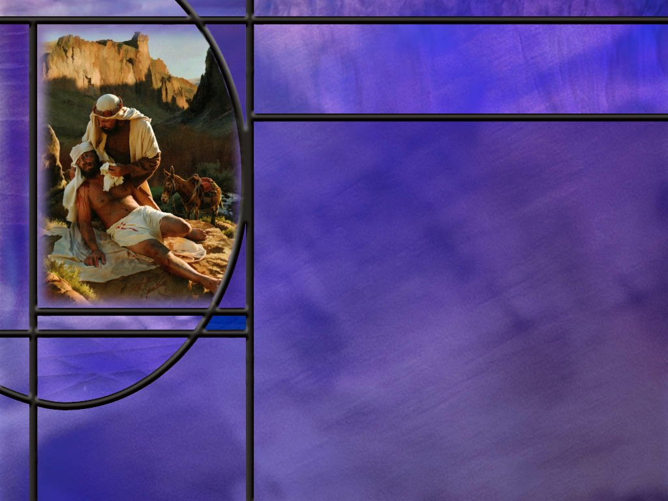
Memory Text
Psalm 12:5 NKJV
"For the oppression of the poor, for the sighing of the needy, Now I will arise," says the LORD; "I will set him in the safety for which he yearns.“
For whom is the Lord particularly concerned in this verse?
Who is it that will act on their behalf?
How can we understand the “poor and needy” to include more than just those who are financially strapped?
What is the promise of this verse?
Notes:
B2:
1. The first two lines of this psalm identify the poor and the needy.
2. Hebrew poetry, including the psalms, is written in parallelisms.
3. One type of parallelism that we see here is synonymous parallelism where the two phrases say the same thing but in different words.
4. The poor and the needy are synonymous.
5. They are different nouns that refer generally to the same group of people.
6. In the first phrase, the poor and needy are oppressed; in the second phrase they sigh in distress because of their oppression.
7. And we see that the LORD (Yahweh) has a special concern for this group of people.
B3:
1. The LORD, Yahweh, takes it upon Himself to arise and act on their behalf.
2. How do you think the Lord does that?
3. How does the Lord stop the oppression of the downtrodden?
4. What does He do to intervene?
5. Does He send down Gabriel or Michael to strong arm the opposition?
6. That is usually not how God intervenes in the affairs of men, although at times, I am sure that He has, as we see in the book of Daniel.
7. More often, God uses human instrumentalities to accomplish His plans.
8. We get a hint of this from the way Isaiah describes how God fulfills His prophetic declarations.
Isaiah 46:10-11 ESV - 10 declaring the end from the beginning and from ancient times things not yet done, saying, 'My counsel shall stand, and I will accomplish all my purpose,' 11 calling a bird of prey from the east, the man of my counsel from a far country. I have spoken, and I will bring it to pass; I have purposed, and I will do it.
9. So here we get the hint that God impresses people, or at times, even animals, to bring about the things that he has declared will happen.
10. The same can be true in acting on behalf of the poor and the needy.
11. He can impress another person to take up their case and oppose the evil forces that are seeking to oppress them.
12. We see God’s concern for the poor and needy all through Scripture.
13. So this is inspired council to all those who fear God, to look out for the widows and the orphans, the powerless and the marginalized, the poor and the needy, and make sure they are not being unjustly oppressed.
14. God is using His people to help meet their needs and fight on their behalf against those who would oppress them.
B4:
1. Can we actually be poor and needy?
2. What are we if we don’t have Jesus?
3. We may have all the riches of the world, but if we don’t have Jesus we are poor and needy.
4. Can we be oppressed by the devil? Can we be sighing for something better than the life of sin he offers us?
5. Remember how Jesus started the beatitudes?
6. “Blessed are the poor in spirit for theirs is the kingdom of heaven.”
7. In other words, blessed are those who recognize their spiritual need and hunger and thirst for righteousness, for they shall be filled.
8. Blessed are those who recognize their need of Jesus and come to Him for their righteousness.
9. Theirs will be the kingdom of heaven.
B5:
1. “I will set him in the safety for which he yearns.”
2. Is this true particularly for the poor and needy in spirit?
3. If we find our righteousness in Jesus Christ, the Lord will set us in the safety of His kingdom for which we yearn.
4. Forever secure in the arms of Jesus.
5. Are you interested?

Slide 3
Overview
The psalms in our lesson this week refuse to accept evil and cry out against human indifference and injustice. They call for God to rise up and act against the enemies and oppressors of God’s people and call for judgment upon the wicked. These calls for judgment are a prelude to God’s final judgment in which the righteous are vindicated and the wicked are destroyed.
  Justice for the Oppressed
  Calls for Judgment
  Judgment Coming
  Summary

Slide 4
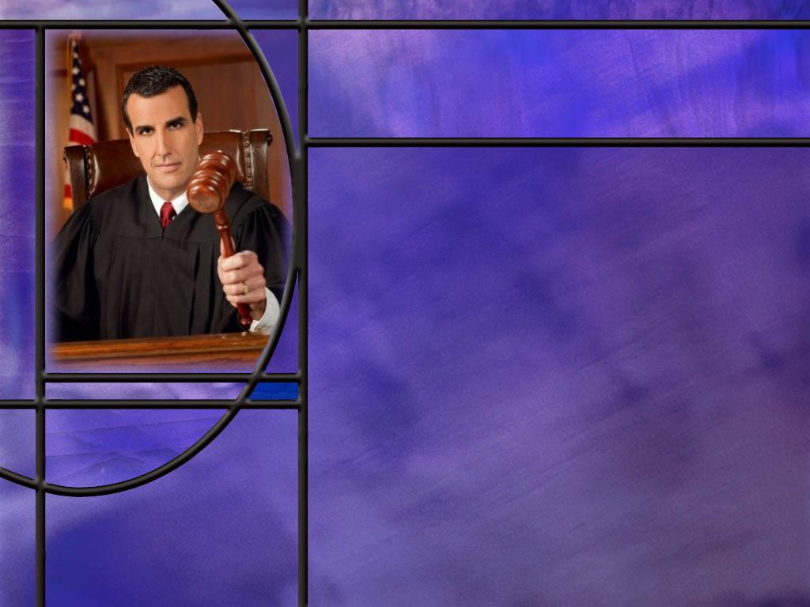
Justice for the Oppressed
How do the psalms reflect God’s care for the poor and needy? (Ps 9:18; 40:17; 113:7)
How do these psalms reflect the same concern as expressed in the Law God gave to Israel? (Ex 22:21-23)
How did Jesus use Isaiah’s words of deliverance for the downtrodden to inaugurate His ministry in the synagogue at Nazareth? (Luke 4:16-19)
How can we understand Jesus’ mission statement here in Luke in a more inclusive way?
Notes:
B1:
[See notes on linked slide.]
B2:
[See notes on linked slide.]
B3:
[See notes on linked slide.]
B4:
1. How did Jesus begin the beatitudes in Matthew 5?
Matthew 5:3 King James Version (KJV)
³ Blessed are the poor in spirit: for theirs is the kingdom of heaven.
2. What does it mean to be “poor in spirit?”
3. It means to recognize you’re a sinner, that you are not righteous, that you have nothing to recommend yourself to God.
4. It means to recognize that you cannot save yourself: you need a Savior.
5. The next beatitude says “Blessed are they that mourn.”
6. When we recognize our spiritual poverty, we mourn because of our sins and separation from God.
7. So Jesus came to preach the gospel to the poor in spirit, everyone who recognizes their sinfulness and need of a Savior.
8. He came to heal the brokenhearted, everyone who repented and was sorry for their sins.
9. He came to free the captives, everyone who was imprisoned by sin and Satan.
10. He came to open the eyes of all those blinded by the darkness of this world to the glorious light of the gospel.
11. He came to set at liberty those who were oppressed by the devil, to free them from the penalty of sin, the power of sin, and someday soon, the presence of sin.
12. Understood in this way, the poor, the brokenhearted, the captive, the blind, the oppressed become a metaphor for our spiritual condition apart from a saving relationship with Christ.
13. Jesus came to deliver everyone who was willing to recognize their need of a Savior.
14. This included not only the physically poor and needy but the rich as well.
15. He ministered to Zacchaeus, to Nicodemus, to the rich young ruler, to Matthew His disciple (a tax collector).
2 Peter 3:9 New King James Version (NKJV)
⁹ The Lord is not willing that any should perish but that all should come to repentance.
1 Timothy 2:4 King James Version (KJV)
[God] ⁴ Who will have all men to be saved, and to come unto the knowledge of the truth.

Slide 5
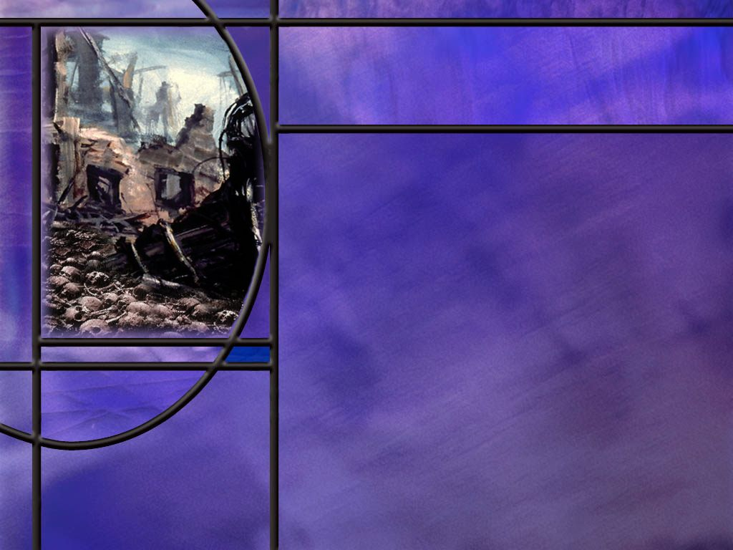
Calls for Judgment
How do the psalmists express their outrage at evil in the following psalms?
  Ps 58:6-8
  Ps 94:1-2,22-23
Whose glory is foremost in David’s mind when he calls for divine vengeance? (Ps 139:20-21)
How did David pass up the opportunity to take revenge on one of his most persistent enemies? (1 Sam 24:12)
How did the apostle Paul council us as Christians to deal with our enemies? (Rom 12:17-21)
Notes:
B1:
[See notes on linked slide.]
B2:
[See notes on linked slide.]
B3:
[See notes on linked slide.]
B4:
[See notes on linked slide.]

Slide 6
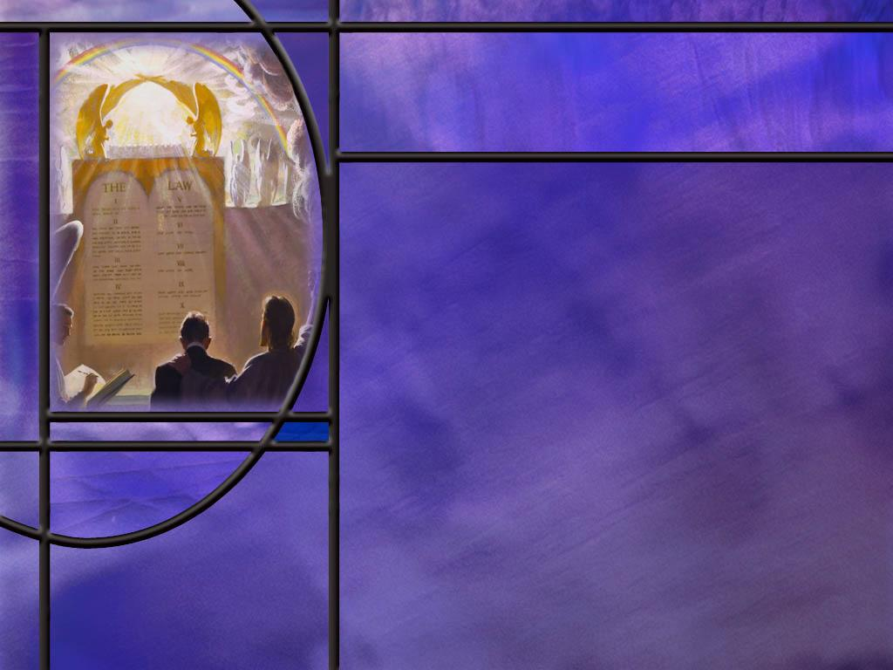
Judgment Coming
How does the first petition of the Lord’s prayer look forward to judgment?
What did the OT sanctuary service teach people about judgment and the wages of sin?
Notes:
B1:
1. The first petition of the Lord’s prayer is “thy kingdom come.”
2. What is going to happen when God’s kingdom comes?
3. Right away we begin to see God’s judgment made manifest.
4. The righteous dead are resurrected; the righteous living are translated.
5. The wicked living are slain by the brightness of His coming; the wicked dead remain dead until the great white throne judgment.
6. We have the millennial judgment during the 1000 years.
7. And finally we have the executive judgment at the great white throne where the wicked are condemned and destroyed.
8. So praying for God’s kingdom to come is the equivalent of praying in the psalms for God’s judgment to come.
B2:
1. The sanctuary service in the OT taught the gospel of how our sins can be forgiven.
2. Our sins can be transferred to a sinless substitute who pays the penalty for our sins, which is death.
3. Without our sins being transferred, we pay the penalty for sin ourselves, which is eternal death.
4. This process of transferring sin is called substitutionary atonement.
5. And the sacrifices pointed forward to Christ, our sinless Substitute who would take our sins and pay the wages of those sins by His death on the cross.
6. So the sanctuary service taught that sin is deadly and we need to be forgiven in order to live.
7. The Day of Atonement was seen as a day of judgment when the confessed and forgiven sins of God’s people were disposed of and remembered no more.
8. This annual event prefigured the pre-advent judgment that we believe began in 1844 and is continuing today.
9. And soon, we believe, Jesus will come to redeem the righteous and destroy the wicked.
10. Then we will see the ultimate fulfillment of all the calls for God to arise and act on behalf of His people.
11. The righteous will be vindicated and saved; the wicked will be condemned and destroyed.

Slide 7

Summary
All through His word, God expresses a special concern for the poor and needy, the widows and orphans, the sojourners and the oppressed, and the psalms pick up this concern by pointing to the Lord as the source of their help.
God helps those who call upon Him by impressing His people to be compassionate to them and lift up those who are in need.
So David can write in Ps 37:5: I was young and now I am old, yet I have never seen the righteous forsaken or their children begging bread.
In a spiritual sense, we all start out poor and needy, poor in spirit, recognizing our sinfulness, in need of forgiveness, oppressed by the devil, blind to the truth.

Slide 8
Summary
But it is just such people that Jesus declared He had come to deliver as He inaugurated His ministry.
Many of the imprecatory psalms seem to be calling for revenge upon the wicked and the enemies of God’s people.
But it is important to remember that these are all calls for God’s vengeance not for permission to take vengeance ourselves.
David, the writer of many of these psalms, refused to take revenge on Saul, his most persistent enemy, even when he had a golden opportunity to do so.
David had a greater concern for the honor and glory of God than for his own. The hatred he expresses for his enemies is because of their hatred for God.

Slide 9
Summary
While the imprecatory psalms call for God’s judgment upon the wicked often in ways that seem to lack compassion, there is nothing compassionate about God’s final judgment and destruction of the wicked.
In essence these psalms are often prayers for God to carry out what He has already promised to do.
When we pray for God’s kingdom to come and His will to be done, that includes the final judgment that vindicates the saints and destroys the wicked.
Until that time, we, as Christians, are to love our enemies, to pray for them, and return good for their evil.
Will you seek the Lord’s help this week to live in love, resisting the temptation of revenge, leaving vengeance to the Lord?

Slide 11
Poor and Needy
Psalm 9:18 ESV - 18 For the needy shall not always be forgotten, and the hope of the poor shall not perish forever.
Psalm 113:7 ESV - 7 He raises the poor from the dust and lifts the needy from the ash heap,
Psalm 40:17 ESV - 17 As for me, I am poor and needy, but the Lord takes thought for me. You are my help and my deliverer; do not delay, O my God!
Notes:
Q1: (Ps 9:18) What do you think the psalmist is saying here? Who will remember the poor and needy?
1. The Lord is the one who will remember the poor and needy.
2. He sees their plight.
3. He is always ready to connect with them in prayer and meet their need.
4. They always have hope in the Lord.
5. God is always ready to meet our greatest need.
6. What happens when we seek first the kingdom of God and His righteousness?
7. (All these things, the necessities of life, will be added unto us.)
8. The way to be remembered and have hope is the seek the Lord and His righteousness.
Q2: (Ps 113:7) Does this verse remind you of any biblical patriarch that sat in dust and ashes because all of a sudden he became poor and needy?
1. Job ended up in the ash heap
Job 2:8-9 ESV - 8 And he took a piece of broken pottery with which to scrape himself while he sat in the ashes. 9 Then his wife said to him, "Do you still hold fast your integrity? Curse God and die.“
2. Job was poor and needy, but he didn’t need to curse God and die.
3. He needed to hold onto God and prove Satan wrong in the Great Controversy.
4. And when he did, God restored to him more than he had at the beginning.
5. When we turn to God and are faithful to Him, we don’t need to sit in the ash heap.
6. When we’re in Christ, we can claim all of God’s promises and allow Him to lift us up.
Q3: (Ps 40:17) What does the writer of this psalm claim for himself?
1. “I am poor and needy.”
2. Who do you think wrote this psalm?
3. If we look back to Ps 40:1 it is a psalm of David.
Q4: In what sense was David poor and needy?
1. It is very doubtful that he was talking about his financial situation.
2. So, again, there are other ways to be poor and needy other than finances.
3. David’s usual need for deliverance is from his enemies who are trying to kill him.
4. But in this psalm, we see he also has a need for deliverance from sin.
Psalm 40:12-13 ESV - For evils have encompassed me beyond number; my iniquities have overtaken me, and I cannot see; they are more than the hairs of my head; my heart fails me. ¹³ Be pleased, O LORD, to deliver me! O LORD, make haste to help me!
5. So here David expresses his condition as poor and needy because of his iniquities that are more than the hairs of his head!
6. And he trusts God for the deliverance from sin.
7. Are we poor and needy in the same sense as David here? (Absolutely)
8. Our greatest need is the forgiveness of our sins that brings us justification and eternal life in the kingdom of heaven.
[Go to next slide.]

Slide 12
Psalm 146:7-9 ESV
[The LORD] who executes justice for the oppressed, who gives food to the hungry. The LORD sets the prisoners free; ⁸ the LORD opens the eyes of the blind. The LORD lifts up those who are bowed down; the LORD loves the righteous. ⁹ The LORD watches over the sojourners; he upholds the widow and the fatherless, but the way of the wicked he brings to ruin. [R]
Notes:
Q1: How do these verses expand on the idea of the poor and needy?
1. It gives us insight into some of the ways we can be poor and needy.
2. Heaven has a special concern for the oppressed, the hungry, the prisoners, the blind, those bowed down or afflicted, the sojourners or foreigners, the widows, and the orphans.
3. These are all presented in these verses in contrast to the wicked.
4. So the implication is that these are people whose troubles in life have brought them to the point where they fear the Lord and call upon Him.
5. And perhaps this is why this list of the downtrodden includes the phrase that “the LORD loves the righteous.”

Slide 13
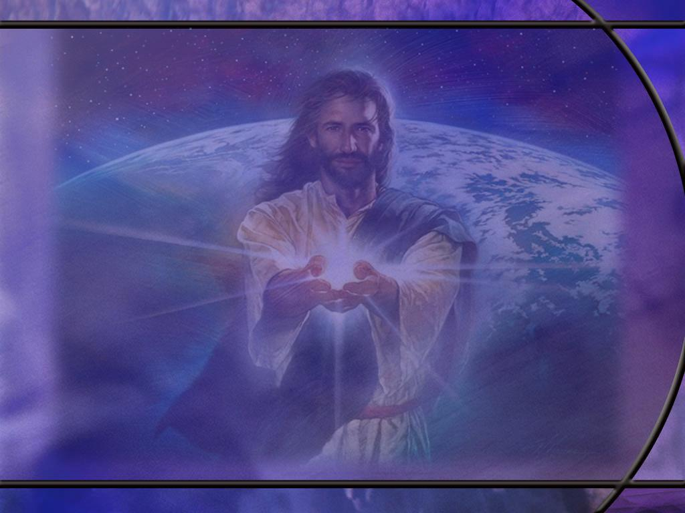
Exodus 22:21-23 ESV
"You shall not wrong a sojourner or oppress him, for you were sojourners in the land of Egypt. ²² You shall not mistreat any widow or fatherless child. ²³ If you do mistreat them, and they cry out to me, I will surely hear their cry, [R]
Notes:
Q1: This is God speaking to Moses on Mt. Sinai. For whom in particular does God require protection?
1. These were additional laws given by God to regulate social justice in the Israelite community.
2. Here He mentions specifically the sojourners or temporary foreigners, widows and orphans.
3. These vulnerable neighbors should not be oppressed or mistreated.
Q2: What is the promise of verse 23?
1. God will hear their cry if they cry out to Him.
2. We serve a God who hears us when we pray.
3. And when we are His children, He answers us in a way that is for our eternal good.

Slide 14
Luke 4:16-19 ESV
And he came to Nazareth, where he had been brought up. And as was his custom, he went to the synagogue on the Sabbath day, and he stood up to read. ¹⁷ And the scroll of the prophet Isaiah was given to him. He unrolled the scroll and found the place where it was written, ¹⁸ "The Spirit of the Lord is upon me, because he has anointed me to proclaim good news to the poor. He has sent me to proclaim liberty to the captives and recovering of sight to the blind, to set at liberty those who are oppressed, ¹⁹ to proclaim the year of the Lord's favor.“ [R]
Notes:
Q1: What habit did Jesus have?
1. He attended worship service at the synagogue on the Sabbath day in His home town of Nazareth.
2. If we are going to be followers of Jesus, what do we need to do?
3. We need to form the custom or the habit of worshipping in our church on the Sabbath day.
4. We have a lot of empty pews that need to be filled up.
5. Let’s encourage one another to be here each Sabbath day like Jesus.
Q2: What did Jesus say when he finished reading this text from Isaiah?
1. He handed the scroll back to the attendant, sat down, and began His exposition with the words, “Today this scripture is fulfilled in your hearing.”
2. That was the beginning of the sermon, but Luke only whets our appetites for the words of Jesus.
Q3: In applying this scripture to Himself, what is Jesus saying about Himself?
1. First He says that the Spirit of the Lord has anointed Him.
2. Jesus claimed to be the anointed of God.
3. What does the word Messiah mean? (The anointed one.)
4. So here Jesus is claiming to be the Messiah by fulfilling this scripture.
5. He is also quoting from one of the five Suffering Servant songs from Isaiah.
6. This is the fifth Song. The fourth is Isa 52-53 which presents the Suffering Servant as the atoning sacrifice for our sins: “The Lord has laid on Him the iniquity of us all.”
7. Without directly saying so, Jesus is claiming to be the fulfillment of the Messianic prophecies of the OT.
Q4: To whom is the mission of Jesus directed in this scripture?
1. The poor, the brokenhearted, the captives or prisoners, the blind, and the oppressed.
2. These are some of the same words used in the book of Psalms to describe the poor and needy.

Slide 15
Psalm 58:6-8 NIV
Break the teeth in their mouths, O God; LORD, tear out the fangs of those lions! ⁷ Let them vanish like water that flows away; when they draw the bow, let their arrows fall short. ⁸ May they be like a slug that melts away as it moves along, like a stillborn child that never sees the sun. [R]
Notes:
1. This is a psalm of David. Let’s look back to verse 1 for the context.
Psalm 58:1-2 NIV - Do you rulers indeed speak justly? Do you judge people with equity? 2 No, in your heart you devise injustice, and your hands mete out violence on the earth.
2. So David here is upset at rulers who devise injustice and mete out violence.
Q1: To whom is David calling for divine justice against the injustice of human rulers?
1. He calls out to God for justice; to the LORD, Yahweh.
2. It is important to note that David is not calling for God to allow him to take vengeance upon these rulers himself.
3. He is asking God to take the vengeance.
4. And God will eventually take vengeance on all evil in the judgment.
Q2: What would David like to see as the end of those who pervert justice and promote violence?
1. Basically that they would vanish, that they would melt away, that they would be dead as a stillborn child.
Q3: What does scripture say is the end of the wicked?
Ezekiel 18:20 KJV - The soul that sinneth, it shall die.
Romans 6:23 KJV - For the wages of sin is death;
1. David’s psalm is a little more colorful, but the end result is the same.
2. David is simply calling for God’s will to be done.
3. So many of these psalms are simply calling on God to do what He has promised to do.

Slide 16
Psalm 94:1-2, 22-23 NIV
- 1 The LORD is a God who avenges. O God who avenges, shine forth. 2 Rise up, Judge of the earth; pay back to the proud what they deserve. ... 22 But the LORD has become my fortress, and my God the rock in whom I take refuge. 23 He will repay them for their sins and destroy them for their wickedness; the LORD our God will destroy them. [R]
Notes:
Q1: Who does the avenging here?
1. Again, it is Yahweh, the God who avenges.
2. He is the judge of the earth.
3. He will pay back the proud as they deserve.
4. This is not a call for permission to take vengeance ourselves on our enemies.
5. This is a call for God to take vengeance for us.
6. And God will do it as the Judge of all the world, who will judge righteously.
Q2: What end for the wicked does the psalmist see in verse 23?
1. He sees the just judgment of God on wickedness and sin.
2. They will be destroyed.
3. They will not be punished forever in the flames of an eternally burning hell.
4. They will be destroyed. The will perish. They will die without hope of resurrection.

Slide 17
Psalm 139:20-21, 23-24 NIV
They [the evil] speak of you [God] with evil intent; your adversaries misuse your name. ²¹ Do I not hate those who hate you, LORD, and abhor those who are in rebellion against you? ... 23 Search me, God, and know my heart; test me and know my anxious thoughts. ²⁴ See if there is any offensive way in me, and lead me in the way everlasting. [R]
Notes:
Q1: Whose honor and glory are uppermost I David’s mind here?
1. He is zealous for the glory and honor of God.
2. He hates those who hate the Lord.
3. You get the idea here that he is not so concerned for the fact that his enemies hate him as he is for the fact that they hate his God.
4. And just to make sure his heart in in the right place, he pens these last two verses that end this psalm.
5. He deems it proper and just to be upset at those who denigrate the God of the universe more than any slight suffered by him personally.
Q2: As God’s anointed, what position did David occupy as king?
1. King David was God’s representative on earth.
2. Thus, an attack on David was, in effect, an attack on God.
3. David sees his enemies not so much as his private opponents but adversaries of God.
4. His hatred for them is not the result of personal animosity but is a result of their hatred of God.

Slide 18
1 Samuel 24:11-12 NIV
See, my father, look at this piece of your robe in my hand! I cut off the corner of your robe but did not kill you. See that there is nothing in my hand to indicate that I am guilty of wrongdoing or rebellion. I have not wronged you, but you are hunting me down to take my life. ¹² May the LORD judge between you and me. And may the LORD avenge the wrongs you have done to me, but my hand will not touch you. [R]
Notes:
Q1: What do these verses tell you about David’s desire to take vengeance upon his enemies?
1. David had the opportunity to take Saul’s life while Saul entered a cave where David and his men were hiding.
2. But instead, he cut off a corner of the king’s robe to prove he was not a threat to the kingship of Saul.
3. So even though many of David’s psalms call for vengeance against his enemies or against the wicked in general, it is divine vengeance, not personal vengeance that he seeks.

Slide 19
Romans 12:17-21 NIV
Do not repay anyone evil for evil. Be careful to do what is right in the eyes of everyone. ¹⁸ If it is possible, as far as it depends on you, live at peace with everyone. ¹⁹ Do not take revenge, my dear friends, but leave room for God's wrath, for it is written: "It is mine to avenge; I will repay," says the Lord. ²⁰ On the contrary: "If your enemy is hungry, feed him; if he is thirsty, give him something to drink. In doing this, you will heap burning coals on his head." ²¹ Do not be overcome by evil, but overcome evil with good. [R]
Notes:
Q1: To whom can we leave our revenge?
1. We don’t have to repay evil for evil.
2. We don’t have to get revenge on those who have wronged us.
3. The Lord sees all and knows all.
4. Leave room for His vengeance; He will repay.
5. So this goes right along with these psalms that call for God’s vengeance, not ours.
6. And they all go back to Deut 32:35 which is quoted by Paul here:
Deuteronomy 32:35 NIV - “It is mine to avenge; I will repay. In due time their foot will slip; their day of disaster is near and their doom rushes upon them."
Q2: How should we treat those who have wronged us?
1. Be a blessing to them.
2. Love them, care for them, pray for them.
3. This passage is a wonderful description of agape love.
4. Agape love acts in someone else’s eternal best interest without regard to how that person responds.
5. It doesn’t mean you have to feel affection for them; but act in their best interest.
6. Jesus said:
Matthew 5:44 NIV - 44 But I tell you, love your enemies and pray for those who persecute you,
7. We can always pray for our enemies.
Q3: What are the burning coals that get heaped on their head?
1. The most reasonable explanation is that your acts of kindness will bring to his mind a burning remorse or sense of shame for the way he has treated you.
2. This goes along with v 21 in which your good in return for his evil overcomes his evil.
3. The best way to destroy an enemy is to make him a friend.

