Slide 1
Psalms
Lesson 11
Longing for God in Zion

Slide 2
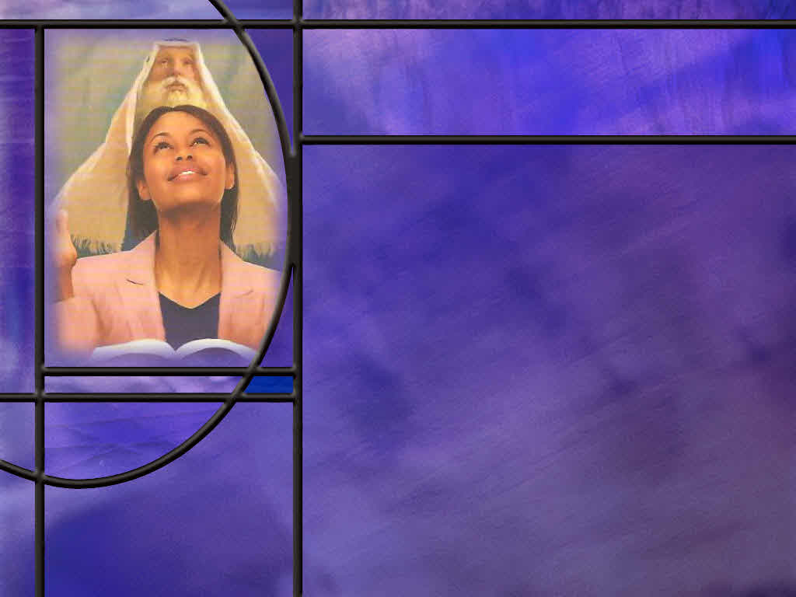
Memory Text
Psalm 84:2 NKJV
My soul longs, yes, even faints For the courts of the LORD; My heart and my flesh cry out for the living God.
For what is the psalmist longing in this verse?
How intense is that longing?
How does the second line of this synonymous parallelism help to clarify the first?
What application of these words can we make to our own desire for worship?
Notes:
B2:
1. He longs for the courts of the Lord.
2. What are the courts of the Lord?
3. These would be the courts of the temple in Jerusalem.
4. The Hebrew Lexicon defines a court as “an enclosure before a building…especially before the holy tabernacle and temple.”
5. Here the psalmist is longing for the entrance to go into the temple to worship the Lord.
B3:
1. It is a longing of his soul, of his inner being.
2. It comes from the depth of who he is and the life that God has given him.
3. He describes it as fainting and losing conscientiousness if that longing goes unfulfilled.
4. It is what we might call today an existential longing, one that threatens his very existence.
B4:
1. “My heart and my flesh” in the second line are synonymous with “my soul” in the first.
2. “Cry out for” in the second line is synonymous with “longs for and even faints for” in the first.
3. And “the living God” in the second line is synonymous with “the court of the Lord” in the first.
4. This second line helps to clarify what it is that the psalmist is really longing for.
5. He is really longing for the presence of the living God.
6. He longs to be in God’s dwelling place to be close to the living God, to praise Him and worship Him and have a relationship with Him.
7. Coming back to our lesson title: Longing for God in Zion.
8. Zion represents the dwelling place of God, and our longing is really for a relationship with Him.
B5:
1. I look at all the empty pews and wonder: What happened to us?
2. Do our souls long, yes, even faint, for the courts of the Lord?
3. Do our hearts cry out for the opportunity to worship the living God and bask in the sunshine of His presence?
4. What would make sincere believers stay home Sabbath morning rather than being here in the presence of the Lord?
5. Jesus said:
Matthew 18:20 KJV - For where two or three are gathered together in my name, there am I in the midst of them.
6. The Holy Spirit is here as we gather for worship and SS each week.
7. If we can’t stand up and worship publicly now while we still have the freedom of worship, what will we do when we no longer have that freedom.
8. Luke 4:16 tells us what Jesus’ custom was for the Sabbath day.
Luke 4:16 KJV - And he came to Nazareth, where he had been brought up: and, as his custom was, he went into the synagogue on the sabbath day, and stood up for to read.
9. Jesus was there every Sabbath to worship His Father and to participate in the worship service.
10. How much more do we need to be here each Sabbath to worship our amazing God and encourage each other in the faith.

Slide 3
Overview
The psalms in our lesson this week focus on Zion as the location of God’s dwelling place and the hope of safety and security that we can find in a saving relationship with our Lord.
  Marching to Zion
  Worshipping in Zion
  Safety and Peace in Zion
  Summary

Slide 4
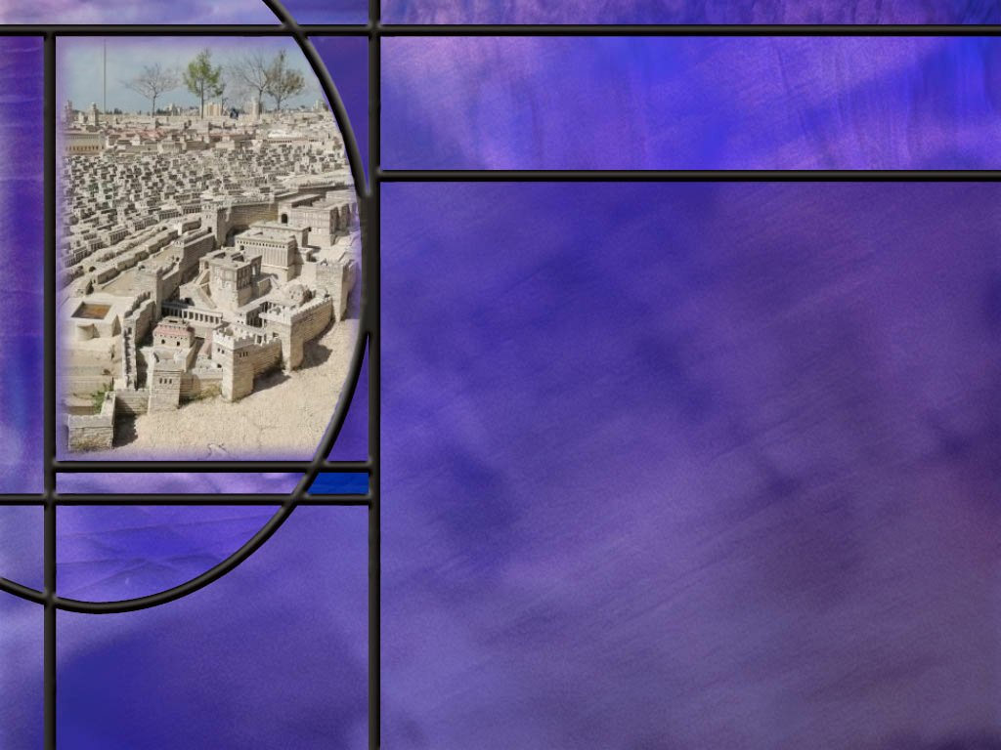
Marching to Zion
What is Zion and where is it located? [Map]
How does the psalmist describe those who come to Zion to worship God there? (Ps 84:5-7)
What priority does the psalmist place on the time he can spend in the presence of the Lord? (Ps 84:10)
Notes:
B1:
[See notes on linked slide.]
B2:
[See notes on linked slide.]
B3:
[See notes on linked slide.]

Slide 5
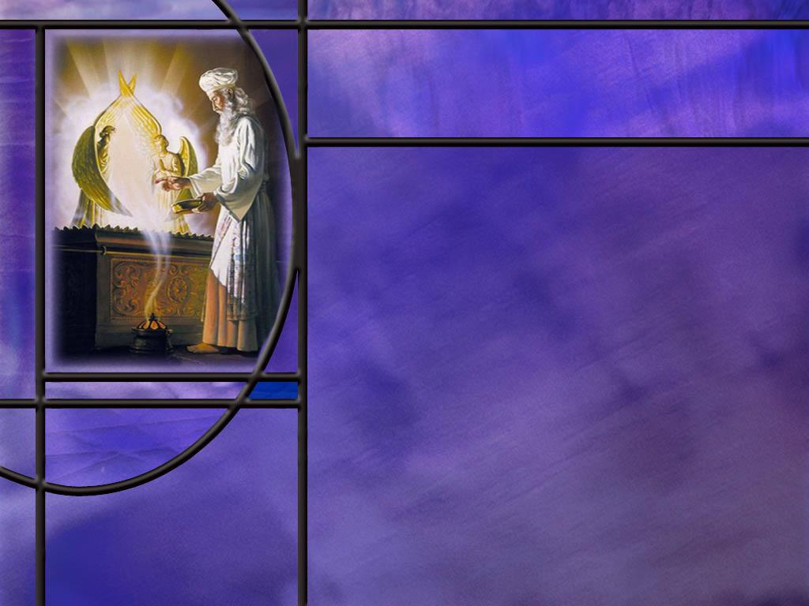
Worshipping in Zion
How did David feel about the call to worship in Zion? (Ps 122:1-4)
What did David encourage the worshippers to pray for as they worshipped? (Ps 122:6-9)
What makes Zion attractive to more than just the Israelite people? (Ps 87:3-6)
Notes:
B1:
[See notes on linked slide.]
B2:
[See notes on linked slide.]
B3:
[See notes on linked slide.]

Slide 6
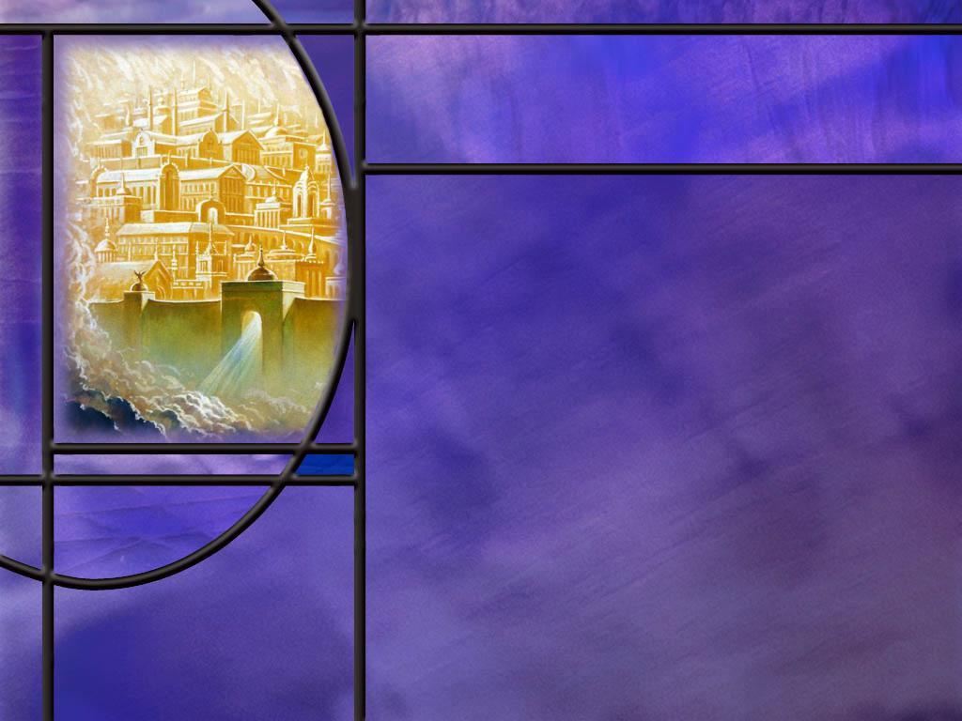
Safety and Peace in Zion
How does the psalmist describe the uncertainty and turmoil possible in our fallen world? (Ps 46:1-3,6)
How does the psalmist describe the peace and safety that comes from a relationship with the Lord? (Ps 46:7-11)
How long does the psalmist see Mt. Zion enduring? (Ps 125:1-2)
What does the ending of Ps 125 look forward to in the heavenly kingdom? (Ps 125:3-5)
Notes:
B1:
[See notes on linked slide.]
B2:
[See notes on linked slide.]
B3:
[See notes on linked slide.]
B4:
[See notes on linked slide.]

Slide 7

Summary
Zion was originally the Jebusite fortress on a hilltop near Jerusalem that David captured and called the City of David.
The name Zion has been used in various ways in Scripture to refer just to the original City of David, to all of Jerusalem, to all of Israel, to the temple mount, as a symbol of God’s kingdom on earth, to the heavenly New Jerusalem, and to the assembly of believers in Christ.
Zion is God’s city, representing His dwelling place.
As Christians, we are marching to Zion, the beautiful city of God, the New Jerusalem.
Ps 84 expresses an existential longing for God in Zion, to be close to the living God, to praise Him and worship Him.

Slide 8
Summary
This longing of the soul challenges us to look forward with the same anticipation to our devotional time and corporate worship.
The psalmist sets a 1000 to 1 priority on time spent with the Lord.
This challenges us to question our own priorities and move in the direction of seeking God’s presence moment by moment.
In psalm 122, David was glad to be invited into the house of the Lord because it was there he could give thanks.
Our worship as well should express our thanksgiving and praise to God and include prayers for peace, with God and others as we march toward our heavenly Mt. Zion.

Slide 9
Summary
Ps 87 is a reminder that, regardless of our country or origin, if we are the Lord’s we have dual citizenship, and our most important citizenship is in heaven.
In Ps 46 God reminds us “to be still and know that I am God.” He is our mighty fortress and there is nothing that can separate us from His love.
Ps 125 begins with a promise that those who trust in the Lord are like Mt. Zion which endures forever. As Mt. Zion endures forever as the New Jerusalem, so will those who trust in the Lord and live there in His presence.
Knowing that Jesus is preparing a place for us in the New Jerusalem, will you trust in the Lord to give you strength to keep marching to Zion, the beautiful city of God?

Slide 11
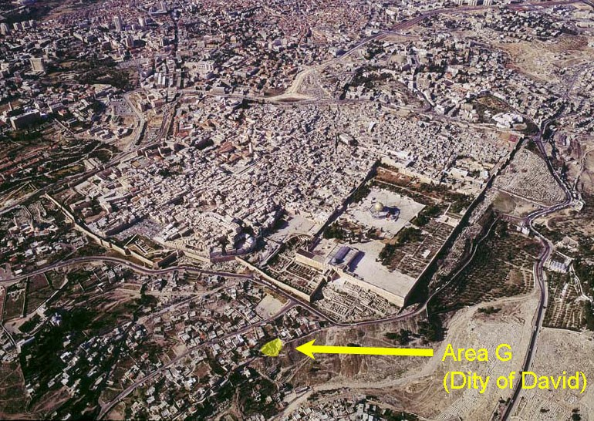
Aerial View of Jerusalem
Notes:
1. This is an aerial view of what is called today, the old city of Jerusalem.
2. The Muslim Dome of the Rock stands on the place where the old temple stood in Bible times.
[Trace the walls around the city]
3. This Area G shown in yellow is the City of David.
4. This is the highest hill or mountain in Jerusalem and was the site of the old Jebusite fortress that David conquered,
2 Samuel 5:7 NIV - 7 Nevertheless, David captured the fortress of Zion--which is the City of David.
5. So Zion was originally a Jebusite fortress that David captured and called it the City of David.
6. The city of Jerusalem in the days of David and Solomon included within its walls this City of David called Zion.
7. We can have a look at those borders in the topographical map on the next slide.
[Go to next slide.]

Slide 12
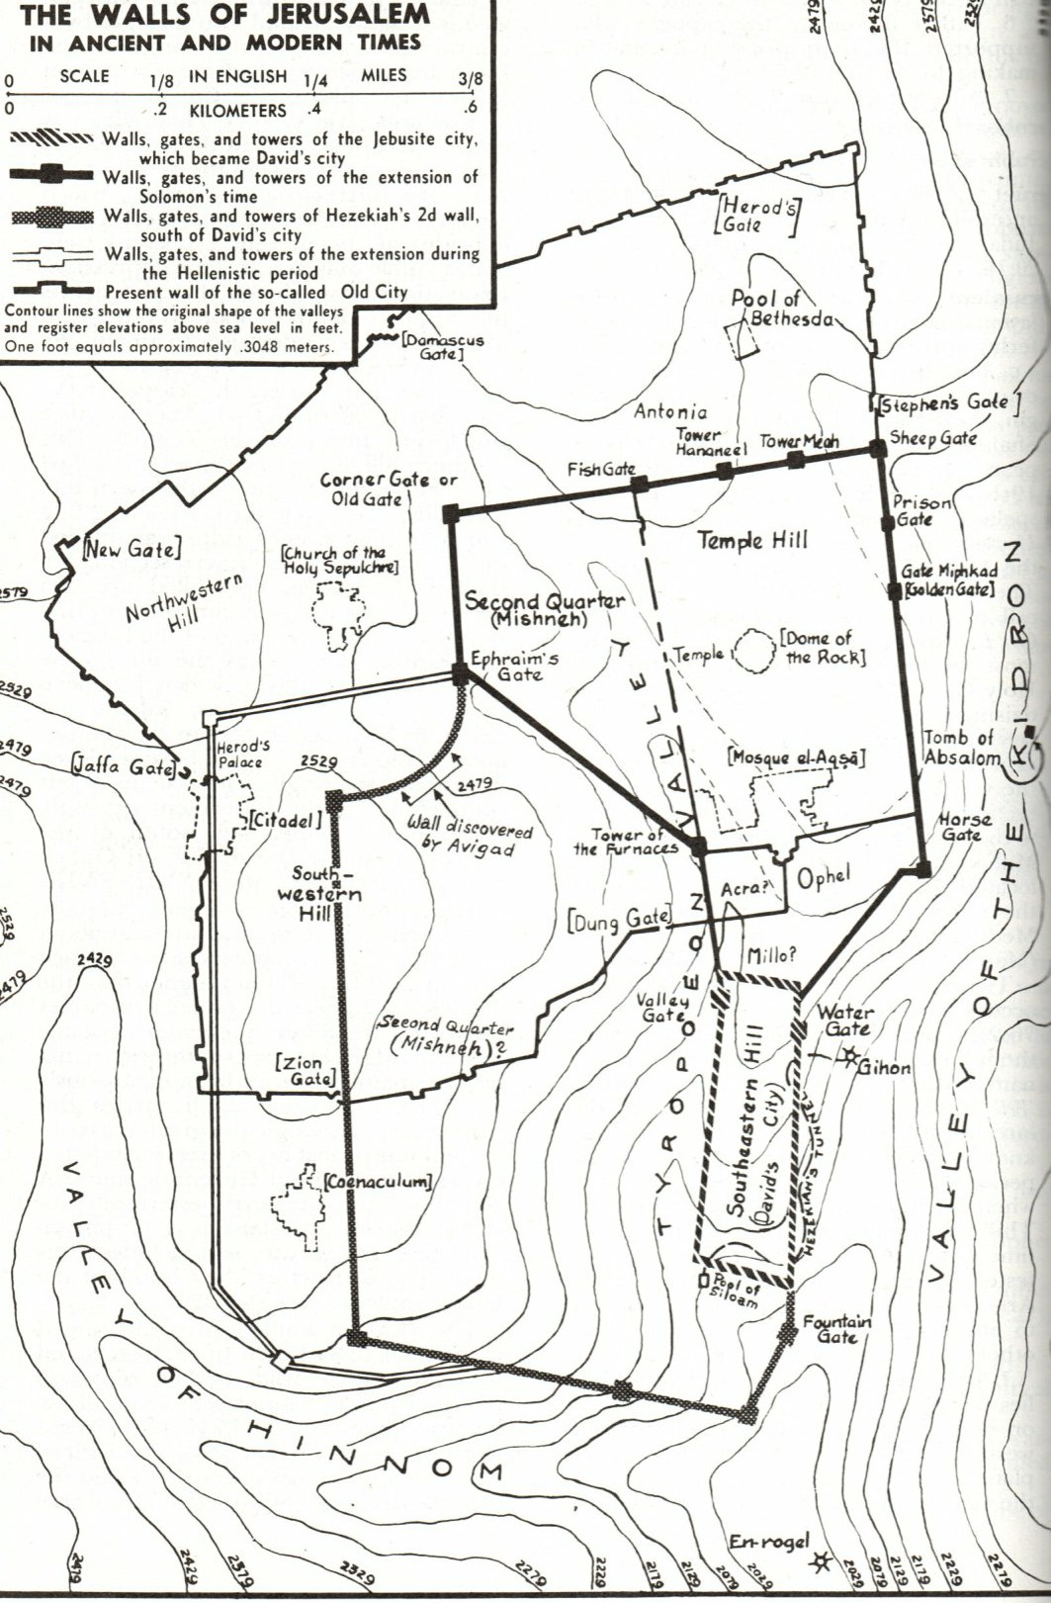
Jerusa;em ma[
[R]
Notes:
[Use magnifier in presenter view to magnify and scroll around the map.]
1. The thin wavy lines are lines of constant elevation.
2. The closer the lines the steeper the grade.
[Point out the Kidron Valley on the right, to the east of Jerusalem and the valley of Hinnom to the south of Jerusalem.]
[Point out the two highest peaks: the City of David, the original Zion, in the south east of the city and the temple mount in the north east of the city.
3. Note the so called Old City walls of today shown by the thin black line.
4. They exclude the city of David on the south east side.
5. And these thick black lines show the outline of the walls in the time of David and Solomon.
6. So in Bible times, the city of Jerusalem included the City of David also known as Zion.
7. The name Zion has been used in various ways in Scripture to refer just to the city of David, to all of Jerusalem, to all of Israel, to the temple mount as the place of God’s dwelling, as a symbol of God’s kingdom on earth, to the heavenly New Jerusalem and the assembly of believers in Christ.
8. So we can sing we are marching to Zion the beautiful city of God referring to the New Jerusalem where we find eternal rest and peace in God’s presence.
9. Regardless of the connotation, Zion is God’s city, the place of His dwelling.

Slide 13
Psalm 84:5-7 NLT
What joy for those whose strength comes from the LORD, who have set their minds on a pilgrimage to Jerusalem. ⁶ When they walk through the Valley of Weeping, it will become a place of refreshing springs. The autumn rains will clothe it with blessings. ⁷ They will continue to grow stronger, and each of them will appear before God in Zion. [R]
Notes:
1. This is the same psalm as in our memory text where the psalmist longed and fainted for the courts of the Lord and his heart cried out for the living God.
2. Now we find out that he is on a pilgrimage to Jerusalem.
3. For those Jews who lived far away, this happened only three times in the year, at Passover, at Pentecost, and at Tabernacles.
4. No wonder he was starved for worship in the presence of God.
Q1: How do these verses describe the trip of those who are making a pilgrimage to Jerusalem.
1. They have strength from the Lord.
2. The dark valleys of weeping that they may have gone through become refreshing springs.
3. Instead of getting weaker with their trip, they get stronger.
4. They are anticipating their arrival in Zion and worshipping in the temple.
Q2: Where should they have been worshipping in the mean time?
1. They should be worshipping in their local synagogue during the time between trips to Jerusalem.
2. But there is something special about worship in Jerusalem, because, in their dispensation, Jerusalem or Zion was the place where God dwelt in the most holy place of the temple.
3. Perhaps the closest we come to this is our one week at camp meeting when our whole conference makes a pilgrimage to So. Lancaster to worship and fellowship together.
4. Do you appreciate the worship at Camp Meeting?
5. It is truly a moving experience and well worth the trip.
6. As we renew our resolve to keep marching to Zion, God blesses us with His presence through the Holy Spirit.
7. May we all continue to grow stronger in that march ‘til we all appear before God in Zion.

Slide 14
Psalm 84:10 ESV
For a day in your courts is better than a thousand elsewhere. I would rather be a doorkeeper in the house of my God than dwell in the tents of wickedness. [R]
Notes:
Q1: What priority does the psalmist place on time spent with God?
1. 1000 to 1.
2. A day with the Lord is better than 1000 days without Him.
3. Doing the most menial task in the service of God is better than a life of wickedness serving the devil.
Q2: What priority do we place on time spent with God?
1. Even if not 1000 to 1, how about 2 to 1?
2. Maybe we need to reevaluate our devotional life in the light of this psalm.
3. Do we devote our first hours to prayer and meditation on the word of God?
4. There is no better way to start the day.
5. And how often during the day do we stop and reconnect with God?
6. If you’re like me, not nearly often enough.
7. How much better our lives would be if we could live in the presence of God, sharing our thoughts with Him moment by moment.
8. Paul writes in:
Galatians 5:16 KJV - This I say then, Walk in the Spirit, and ye shall not fulfil the lust of the flesh.
9. We have a Helper, the HS, who leads us and guides us and lives right inside us.
10. And when we are aware and thankful for His presence, we are spending time in the presence of our God.

Slide 15
Psalm 122:1-4 ESV
I was glad when they said to me, "Let us go to the house of the LORD!" ² Our feet have been standing within your gates, O Jerusalem! ³ Jerusalem--built as a city that is bound firmly together, ⁴ to which the tribes go up, the tribes of the LORD, as was decreed for Israel, to give thanks to the name of the LORD. [R]
Notes:
Q1: How did David react to the invitation to go to the house of the Lord?
1. He was glad, happy, filled with joy at the prospect of worshipping in the temple.
2. And, of course, he points to Jerusalem, the city of peace, Mt. Zion, where the worship is to take place.
Q2: What specific thing does David mention here that would be included in the temple worship service?
1. It would include giving “thanks to the name of the Lord.”
Q3: Is that a valid reason for our worship service as well?
1. Our worship service provides us the opportunity to give thanks to the Lord.
2. In prayer, in praise, in the proclamation of the word, in testimonies, in giving of tithes and offerings, we give thanks to our Lord and praise His name.

Slide 16
Psalm 122:6-9 ESV
Pray for the peace of Jerusalem! "May they be secure who love you! 7 Peace be within your walls and security within your towers!" 8 For my brothers and companions' sake I will say, "Peace be within you!" 9 For the sake of the house of the LORD our God, I will seek your good. [R]
Notes:
Q2: What word does David use repeatedly in these verses?
1. Peace: three times.
2. In the Hebrew: Shalom.
3. Our weekly family greeting as we open the Sabbath is “Shabbat Shalom.”
Q2: How would you describe the peace of Shalom.
1. Shalom describes more than the absence of conflict.
2. It describes a contentment and blessedness in life.
3. Shalom can mean healthy and sound, safe and secure, tranquil, content, prosperous, and the absence of conflict in human relationships, in war, and with God.
Q3: How can we make this prayer for peace our prayer?
1. This is a prayer for peace and security for the inhabitants of Jerusalem, for family and friends and inhabitants of Zion.
2. For us as Christians, we think of the heavenly Zion.
Hebrews 12:22 ESV - 22 But you have come to Mount Zion and to the city of the living God, the heavenly Jerusalem, and to innumerable angels in festal gathering,
3. And it is with this heavenly Jerusalem in view that John saw in vision the 144,000.
Revelation 14:1 ESV - 1 Then I looked, and behold, on Mount Zion stood the Lamb, and with him 144,000 who had his name and his Father's name written on their foreheads.
4. So when we, as Christians, pray for the peace of Jerusalem, we should pray for our fellow believers in the Lord Jesus, who are headed for the heavenly Mt. Zion.
5. We worship the Prince of peace who brings to us the peace of justification by His shed blood.
Romans 5:1 ESV - 1 Therefore, since we have been justified by faith, we have peace with God through our Lord Jesus Christ.
6. That is the most important peace for which we should pray for our fellow believers and our families.
7. And then peace for one another that there may be unity and love within the household of God.
8. And then we need to put peace in action in our own lives.
Romans 12:18 ESV - If possible, so far as it depends on you, live peaceably with all.

Slide 17
Psalm 87:3-6 NLT
O city of God, what glorious things are said of you! ⁴ I will count Egypt and Babylon among those who know me--also Philistia and Tyre, and even distant Ethiopia. They have all become citizens of Jerusalem! ⁵ Regarding Zion it will be said, "Everyone enjoys the rights of citizenship there." And the Most High will personally bless this city. ⁶ When the LORD registers the nations, he will say, "They have all become citizens of Jerusalem." [R]
Notes:
Q1: What do you think the psalmist is saying in these verses?
1. The psalmist is looking far beyond the land of Israel to those who will become citizens of the New Jerusalem.
2. Here we see one more place in the OT where inspired Scripture indicates a harvest of Gentiles in the Kingdom of God.
3. In the heavenly Zion, “Everyone enjoys the rights of citizenship there.”
4. No matter their country of origin, they are all citizens of the New Jerusalem.
5. All those who are in Christ, even though a wild olive branch, they will be grafted into the olive tree of Israel.
6. And so all of Israel will be saved.
7. Paul writes in:
Philippians 3:20 NKJV - 20 For our citizenship is in heaven, from which we also eagerly wait for the Savior, the Lord Jesus Christ,
8. Do you have dual citizenship?
9. If you are trusting in Jesus as Savior and Lord, you are a citizen of the New Jerusalem in heaven.

Slide 18
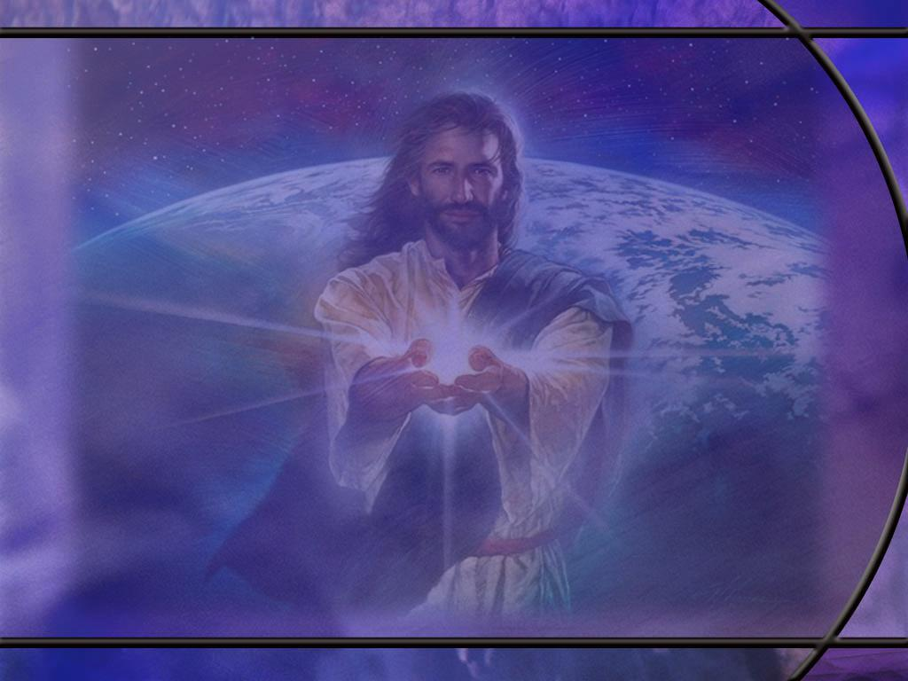
Psalm 46:1-3, 6 ESV
God is our refuge and strength, a very present help in trouble. ² Therefore we will not fear though the earth gives way, though the mountains be moved into the heart of the sea, ³ though its waters roar and foam, though the mountains tremble at its swelling. ... ⁶ The nations rage, the kingdoms totter; he utters his voice, the earth melts. [R]
Notes:
Q1: What kinds of turmoil and disasters may face us in this fallen world?
1. Jesus said:
John 16:33 KJV - In the world ye shall have tribulation: but be of good cheer; I have overcome the world.
2. We all face difficulties and troubles of many kinds.
3. Here the psalmist portrays our troubles as natural disasters that are far beyond our control.
4. We have no reason to fear even though the earth gives way, the mountains are cast into the sea, the tornadoes and hurricanes roar, the earthquakes break the mountains, the nations rage, the kingdoms fall, and the earth melts.
Q2: Where can we find refuge from such troublous times?
1. We go back to the first words of the psalm: [read again].
2. When we are secure in the arms of Jesus, nothing can separate us from His love.
3. The apostle Paul ends Roman chapter 8 with these words:
Romans 8:38-39 KJV - For I am persuaded, that neither death, nor life, nor angels, nor principalities, nor powers, nor things present, nor things to come, Nor height, nor depth, nor any other creature, shall be able to separate us from the love of God, which is in Christ Jesus our Lord.

Slide 19
Psalm 46:7-11 ESV
The LORD of hosts is with us; the God of Jacob is our fortress. ⁸ Come, behold the works of the LORD, how he has brought desolations on the earth. ⁹ He makes wars cease to the end of the earth; he breaks the bow and shatters the spear; he burns the chariots with fire. ¹⁰ "Be still, and know that I am God. I will be exalted among the nations, I will be exalted in the earth!" ¹¹ The LORD of hosts is with us; the God of Jacob is our fortress. [R]
Notes:
1. Notice that the first and last lines of this stanza are exactly the same.
2. Between these two bookends we have a description of the power of God to intervene in the affairs of men.
3. This psalm is the inspiration for Martin Luther’s hymn, “A Mighty Fortress is Our God.”
Q1: What is God’s objective in intervening in the affairs of mankind?
1. His ultimate objective is to bring peace.
2. He will be the final victor in the long war against God.
3. In the end of the earth, he will make wars cease.
4. The implements of war will be destroyed.
5. Jesus will come…
2 Thessalonians 1:8-9 KJV - In flaming fire taking vengeance on them that know not God, and that obey not the gospel of our Lord Jesus Christ: ⁹ Who shall be punished with everlasting destruction from the presence of the Lord, and from the glory of his power;
Q2: What is God’s council to us here in verse 10 as we face the trials of life?
1. “Be still and know that I am God.”
2. What do you think that means?
3. “Don’t worry. Be calm. Trust in Me. Be confident that I will win in the end.
4. I will be the ultimate victor in the great controversy and will be exalted in the earth.”

Slide 20
Psalm 125:1-2 NIV
Those who trust in the LORD are like Mount Zion, which cannot be shaken but endures forever. ² As the mountains surround Jerusalem, so the LORD surrounds his people both now and forevermore. [R]
Notes:
Q1: How long is Mt. Zion expected to endure?
1. Forever.
2. Mt. Zion is the dwelling place of God, and the dwelling place of God will endure forever since God endures forever.
3. The Mt. Zion that endures forever will be the ultimate fulfillment of God’s dwelling place, the New Jerusalem.
4. The city of David will pass away; physical Jerusalem will pass away; but New Jerusalem will be our city home for eternity.
Q2: Who are like Mt. Zion according to the opening words of this psalm?
1. Those who trust in the Lord.
2. So here we have the assurance that those who trust in the Lord will endure forever.
3. This is a promise that we can claim.
4. And the promise is reminiscent of the great gospel promise of John 3:16.
“that whosoever believeth in Him shall not perish but have everlasting life.”

Slide 21
Psalm 125:3-5 NIV
The scepter of the wicked will not remain over the land allotted to the righteous, for then the righteous might use their hands to do evil. 4 LORD, do good to those who are good, to those who are upright in heart. 5 But those who turn to crooked ways the LORD will banish with the evildoers. Peace be on Israel. [R]
Notes:
1. While these verses find their primary application in the land allotted to the children of Israel, they also can be prophetic of the land allotted to the redeemed saints of the ages.
Q1: What land is allotted to the righteous, to those who are redeemed by the blood of Christ and have His righteousness imputed to them?
1. The land allotted to the righteous is the new earth the Lord will create.
2. Jesus said “The meek shall inherit the earth.”
3. Peter writes this in:
2 Peter 3:11-13 KJV - Seeing then that all these things shall be dissolved, what manner of persons ought ye to be in all holy conversation and godliness, 12 Looking for and hasting unto the coming of the day of God, wherein the heavens being on fire shall be dissolved, and the elements shall melt with fervent heat? 13 Nevertheless we, according to his promise, look for new heavens and a new earth, wherein dwelleth righteousness.
4. In the new earth, the scepter of the wicked will not remain.
5. Satan, sinners, and sin have been banished.
6. The great tempter has been destroyed.
7. And the righteous now will not be tempted to use their hands to do evil.
Q2: How does the psalmist describe those who remain and those who are banished?
1. Those that remain in the land allotted to the righteous are the good and upright in heart.
2. Those with crooked ways are banished with the evildoers.
3. In the judgment, God separates the good from the evil, the righteous from the unrighteous.
4. Our only hope of being among the righteous is to have the perfect righteousness of Christ imputed to our account and have our sins forgiven by His blood.
5. Those who refuse the grace of God and the pardon for sin that He offers in Christ, will be banished.
6. So we return to the question of several weeks past:
7. Will you fall on the Rock before the Rock falls on you?

