Slide 1
Psalms
Lesson 12
Worship that Never Ends

Slide 2
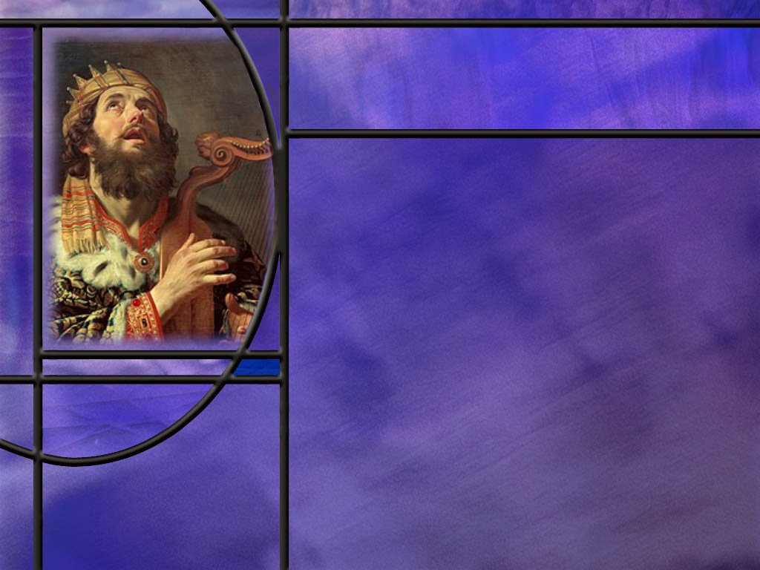
Memory Text
Psalm 104:33 NKJV
I will sing to the LORD as long as I live; I will sing praise to my God while I have my being.
In this memory text, what form of poetry is the psalmist using?
For how long does the psalmist anticipate singing praises to the Lord?
What about our commitment to the Lord? How long do you anticipate singing praise to the Lord?
What comes after the last breath for those who love the Lord?
Notes:
B2:
1. Remember that Hebrew poetry is written in parallelisms.
2. What type of parallelism do we have here?
3. Is it synonymous (saying the same)? Is it antithetical (contrasting)? Is it synthetic (adding new thoughts)? Or is it climactic (summarizing the idea)?
4. This is synonymous parallelism.
5. The second phrase repeats the idea of the first using different words.
6. As a result, we get a better picture of what the psalmist is saying.
7. We have two shots at the meaning rather than one.
8. In this verse we see that the singing in the first line is singing praises in the second.
9. We see that they are sung to Yahweh (LORD) in the first line and “to my God” in the second.
10. The psalmist will sing as long as he lives in the first and while he has being in the second.
B3:
1. For as long as he lives; while he retains consciousness and has being.
2. The NLT renders the second line: “I will praise my God to my last breath!”
3. His commitment to faith in the Lord is a lifelong commitment.
4. And he doesn’t give any conditions.
5. He doesn’t say “If the Lord blesses me, or answers my prayers, or provides for my needs, or saves my children, I’ll sing His praise.”
6. No! He knows the goodness of God, and will sing praise because the Lord is worthy of praise for what He has done already and what He is planning to do in the future.
B4:
1. Same as the psalmist here: As long as I live.
2. When we receive Jesus as our Savior and Lord, it is not a temporary arrangement.
3. We are born again and live a new live in Him.
4. And, as Paul writes, nothing can “separate us from the love of God which is in Christ Jesus our Lord”… Not even death!
5. The only thing that can separate us from Christ is our decision to turn back.
6. Jesus said in:
Matthew 24:13 KJV - 13 But he that shall endure unto the end, the same shall be saved.
7. And the writer to the Hebrews puts it his way:
Hebrews 10:39 NIV - But we do not belong to those who shrink back and are destroyed, but to those who have faith and are saved.
8. We too need to endure to the end and sing praise to the Lord.
9. We don’t believe in “once saved always saved” regardless of how you live or what you believe.
10. But we can say that we do believe in “once saved always saved as long as you stay saved.”
11. And we stay saved by having a saving relationship with Jesus in which He forgives our sins and imputes His righteousness to us.
12. As the apostle John put it in:
1 John 5:11-12 ESV - And this is the testimony, that God gave us eternal life, and this life is in his Son. ¹² Whoever has the Son has life; whoever does not have the Son of God does not have life.
13. Do you have the Son of God as your Savior?
14. Then let’s follow the lead of this psalmist and say: “I will praise my God to my last breath!”
B5:
1. Jesus said:
John 11:25 KJV - I am the resurrection, and the life: he that believeth in me, though he were dead, yet shall he live:
2. There is more breath coming when Jesus comes back.
3. And when we rise again with eternal life, it will be our joy and privilege to sing the praises of our God through eternal ages.
4. And so we circle back to the title of our lesson today: Worship that Never Ends.

Slide 3
Overview
The psalms in our lesson this week focus on worshipping God and give us some insights into the attitudes and actions that are appropriate in true worship. These psalms challenge us to be faithful in both corporate and individual worship that God may be glorified and we may be blessed.
  Worship and Worshipers
  Worship as Evangelism
  Worship as More than Sacrifice
  Summary

Slide 4
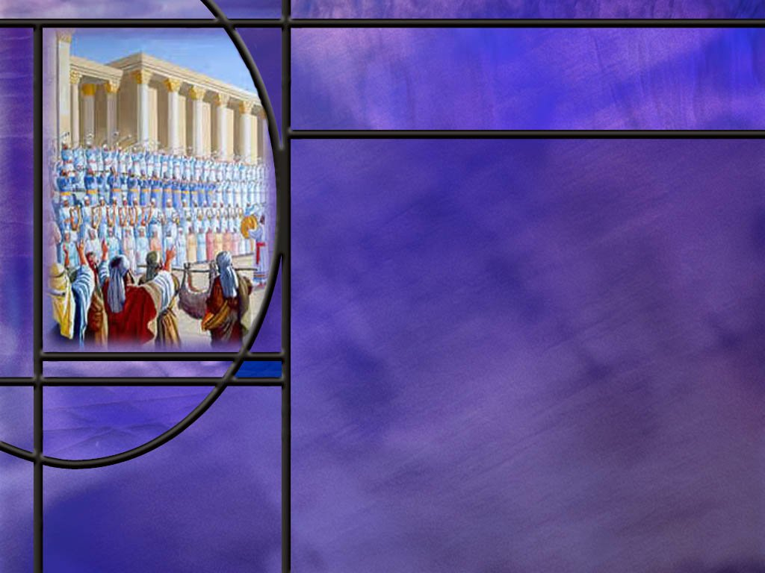
Worship and Worshipers
What is worship? How would you define it?
What insight to worship does Ps 134 give us? (Ps 134)
Many of these very old psalms encourage us to sing a new song to the Lord. What do you think that means?
What does Psalm 15 tell us about God’s expectations for those who worship Him? (Ps 15:1-5)
What does Psalm 24 add to the qualification of those who would worship at the temple? (Ps 24:3-6)
Notes:
B1:
1. The word worship comes from an old English word that contains the ideas of honor and worth.
2. When we worship God, we’re honoring Him. We’re recognizing His value.
3. Like the angels in heaven, all true worshipers say, “You are worthy, our Lord and God, to receive glory and honor and power” (Rev. 4:11).
4. The American Heritage Dictionary defines worship as follows.
1.a. The reverent love and devotion accorded a deity, an idol, or a sacred object.
1.b. The ceremonies, prayers, or other religious forms by which this love is expressed:
2. Ardent admiration or love; adoration; e.g., the worship of celebrities.
5. The SDA Bible Dictionary gives this helpful definition:
The attitude of humility, reverence, honor, devotion, and adoration that properly mark the relationship of created beings to their Creator, especially in His presence.
6. So we can see worship as an act of bowing our hearts, and at times our heads and our knees, in the presence of God and surrendering our hearts and our lives to Him as our Creator and Redeemer, expressing our love, and praise, and honor, and adoration for who He is and what He has done.
7. Corporate worship is when we do this together as believers, meeting together on the Sabbath.
8. Individual worship is when we do this in our private devotional life in meditation upon the Word and especially communing with God in prayer.
9. Both corporate and individual worship are essential disciplines in the Christian life that build our relationship with the Lord and make us useful in His service.
B2:
[See notes on linked slide.]
B3:
1. Singing a new song can be a challenge for those who cannot read music.
2. Writing a new song can be an even greater challenge.
3. Generally speaking, we enjoy singing the hymns that we know, not the new ones that we’ve never heard before and that we struggle to sing.
4. So maybe we can understand this in a more figurative way.
5. Maybe it’s a call for us to have a deeper and more meaningful experience with the Lord and find new reasons to praise Him.
6. Answers to prayer may be a good time for a new song from the heart.
7. Forgiveness of sin or victory over sin may be a good time for a new song.
8. Appreciation for the ultimate deliverance offered us in Christ may illicit an new song from your heart.
9. It may not be very poetic; it may not be sung out loud; but it must express a deeper appreciation for the goodness and grace of God.
10. Or maybe it’s a call to be open to new songs or hymns we don’t have in our hymnal but that express new insights into the grace of God.
11. One that comes to my mind is the modern hymn “In Christ Alone.”
12. This is a beautifully written hymn with worship-appropriate music and rich harmony that stirs the heart and gives glory to God.
13. I wish it were in our hymnal.
14. So maybe this is a challenge to be open to new Christian hymns and worship songs through which we can express new reasons for praise to God.
15. Or could it be that this is a call to find new meaning and appreciation in the old hymns we love.
16. Sing the old songs with a new appreciation.
17. It is easy to fall into the rut of singing the words we know without allowing them to really impact our appreciation for what they say.
18. So we can continue to sing the hymns we love, but sing them from the heart, focus on their meaning, make the words personal.
“Amazing grace, how sweet the sound, that saved a wretch like me.
I once was lost but now am found, ‘twas blind but now I see.”
19. A “new song” can be a new expression of our love and appreciation for what God has done for us.
B4:
[See notes on linked slide.]
B5:
[See notes on linked slide.]

Slide 5

Worship as Evangelism
How does Psalm 96 describe God’s desire to see the truth about God proclaimed to the ends of the earth? (Ps 96:2-3,10)
What elements in our own worship service can be considered evangelism in the sense of promoting outreach to the lost?
Notes:
B1:
[See notes on linked slide.]
B2:
1. Our worship in prayer is preceded by a time of open sharing of prayer requests and testimonies of praise.
2. Prayer requests often include prayers for family and friends particularly family members that need the Lord.
3. Our prayer time should also include prayers for our community and our outreach efforts to reach the lost.
4. Our prayers at worship should also include the mission of the worldwide church in its outreach efforts to complete the great commission.
5. Our giving of tithes and offerings invests in God’s work around the world.
6. Our mission offering in SS goes directly to mission extension.
7. Mission reports and Mission Spotlight encourages giving to evangelism and outreach.
8. Our sermons are often evangelistic in encouraging us to be a faithful witness for the Lord in our daily life and to get involved in making disciples for Jesus.
9. Right now our local community outreach is focused on our Discover Bible School that we are advertising on social media.
10. We have about a dozen new Bible study interests as a result of this advertising.

Slide 6
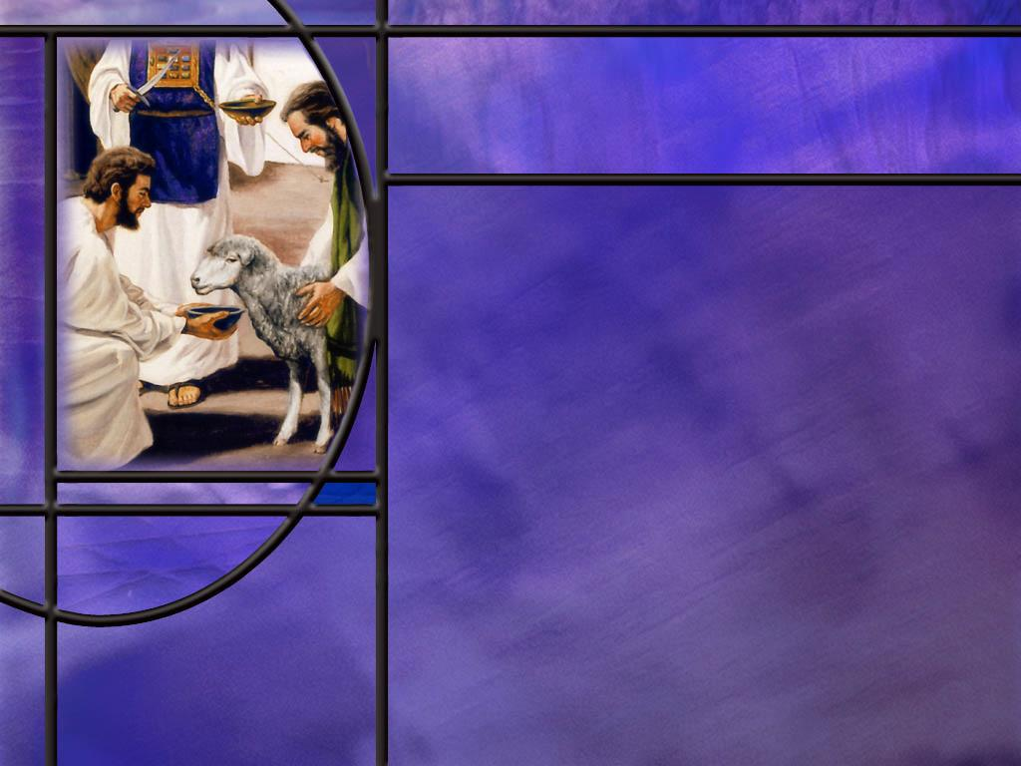
More than Sacrifice
What do some passages in the psalms have to say about sacrifices that are not pleasing to God?
  Ps 40:6-8
  Ps 51:16-19
What sacrifice did the apostle Paul admonish us, as Christians, to give to the Lord? (Rom 12:1-2)
Notes:
B1:
[See notes on linked slide.]
B2:
[See notes on linked slide.]

Slide 7

Summary
Worship is a recurring theme in the book of Psalms.
Worship, involves both our attitude and our actions: it is the attitude of reverence and adoration, as well as the action of humble, loving service to the God who is worthy.
Ps 134 is a very short psalm that calls us as servants to bless or praise the Lord in a corporate setting and ends with the Lord’s blessing coming back to us in response.
Ps 15 is the opening gatekeeper psalm which seeks to question the character of those who would enter the sanctuary to worship.
David gives 10 characteristics of acceptable worshipers, which echo the Ten Commandments in defining righteousness in the lives of believers.

Slide 8
Summary
Ps 24 is the ending gatekeeper psalm that asks similar questions of those who would worship and answers with additional characteristics of acceptable worshippers based on the commandments.
These psalms challenge us to examine our lives and confess our sins before we come to worship.
Jesus also taught that we should be reconciled to our brethren before we come and offer our gift at worship.
Ps 96 includes evangelism in corporate worship and contains some of the same elements as the first angel’s message of Revelation 14.
Our worship also needs to be faithful to God’s call to make disciples for Christ.

Slide 9
Summary
Several psalms indicate that God is not as interested in sacrifices as He is in a broken spirit and a broken and contrite heart.
Rites, rituals, and forms do not impress Him; what goes on in our hearts does.
He is looking for those who will worship Him in spirit and truth.
Paul defines our spiritual worship as presenting our bodies to the Lord as a living sacrifice holy and acceptable to God.
As we surrender to the Lord, the Holy Spirit will renew our mind and conform us to the likeness of Jesus.
Seeing the importance of both individual and corporate worship, will you make worship a priority in your life, both daily and weekly?

Slide 11
Psalm 134:1-3 ESV
[A Song of Ascents] Come, bless the LORD, all you servants of the LORD, who stand by night in the house of the LORD! 2 Lift up your hands to the holy place and bless the LORD! 3 May the LORD bless you from Zion, he who made heaven and earth! [R]
Notes:
1. This is the whole psalm, only 3 verses.
2. This is the last of the Songs of Ascents which are a group of psalms especially composed for the pilgrimage feasts in Jerusalem.
3. This could refer to a closing evening service in the temple to end a pilgrimage feast.
Q1: How does the psalmist refer to the worshippers here?
1. “All you servants of the Lord.”
2. We see this in a number of other psalms as well that we studied this week.
3. This describes the worship relationship: The Lord is God and we worship Him as His servants.
4. We bow down before Him, we give Him honor and praise and adoration, we submit to His commandments with reverence and respect.
5. The word servant also implies the action of serving the Lord.
6. So worship is more than an attitude, it includes action.
7. Worship is the attitude of reverence and adoration, as well as the action of humble, loving service to the God who is worthy.
Q2: How is worship described here in verses 1 and 2? What do the worshippers do to worship the Lord?
1. In both verses, they bless the Lord.
Q3: What does it mean to bless the Lord?
1. We know what it means for the Lord to bless us.
2. He supplies all of our needs.
3. He is the beneficent God who is gracious unto us and saves us.
4. But how do we bless God?
5. We do so be recognizing Him as the source of our blessing and praising Him as our gracious and merciful Lord.
6. So blessing the Lord is equivalent to praising the Lord for His greatness and goodness.
Q4: What physical action accompanies the praise of these worshipers?
1. They lift up their hands to the holy place.
2. Is that something most Adventist are comfortable with?
3. Probably not.
4. Maybe we don’t want to be associated with the Pentecostals.
5. Maybe we’re a little too reserved in our worship.
6. Maybe we don’t want to seem too emotional.
7. But here it is in scripture as an act of worship!
Q5: What is the result of worship here in verse 3?
1. It is a prayer for the Lord’s blessing to come upon us from His dwelling place, Zion.
2. “The Lord bless you” are the exact words of the famous Aaronic blessing in Numbers 6.
3. It goes like this:
Numbers 6:24-26 ESV - The LORD bless you and keep you; ²⁵ the LORD make his face to shine upon you and be gracious to you; ²⁶ the LORD lift up his countenance upon you and give you peace.
4. So as we bless the Lord in our worship, He blesses us in response.

Slide 12
Psalm 15:1-5 ESV
[A Psalm of David.] O LORD, who shall sojourn in your tent? Who shall dwell on your holy hill? 2 He who walks blamelessly and does what is right and speaks truth in his heart; 3 who does not slander with his tongue and does no evil to his neighbor, nor takes up a reproach against his friend; 4 in whose eyes a vile person is despised, but who honors those who fear the LORD; who swears to his own hurt and does not change; 5 who does not put out his money at interest and does not take a bribe against the innocent. He who does these things shall never be moved. [R]
Notes:
1. Just to give you some background on this psalm from the Andrews Bible Commentary.
2. There are ten psalms in this section of scripture: Psalm 15 – 24 arranged in chiastic structure around Psalm 19.
3. The first psalm (Psalm 15) and the last psalm (Psalm 24) are called the Gatekeeper Psalms that ask rhetorical questions about who can stand before the Lord.
4. We will come back to Ps 24 later.
5. But in reference to Psalm 15, the commentary says this:
“It is conceivable that these questions served to gain entrance to the Holy Place. In response the psalm lists ten characteristic of the person who is eligible to be admitted into the court of the sanctuary, reminiscent of the Ten Commandments.”
Q1: What question does this psalm seek to answer?
1. There are two rhetorical questions here.
2. First, Who shall sojourn in your tent?
3. The sojourner is a temporary occupant, and the tent was the tabernacle before the temple was built by Solomon.
4. Second, Who shall dwell on your holy hill?
5. The dweller settles down, and the holy hill would refer to Zion God’s dwelling place.
6. So these are questions of what kind of people should be allowed into the sanctuary for worship.
Q2: What are the 10 characteristics that David lists of the worthy worshipper.
1. He who walks blamelessly,
2. Who does what is right,
3. Speaks truth in his heart,
4. Does not slander with his tongue,
5. Does no evil to his neighbor,
6. Does not reproach his friends,
7. Despises the vile, but honors those who fear the Lord,
8. Does not go back on his word,
9. Does not charge interest to the poor,
10. Does not take a bribe against the innocent.
11. So these 10 characteristics describe the life of a person living out the principles of love found in the 10 commandments.
12. Verse two describes the essential characteristics of righteousness and truth.
13. These result in kind words and deeds in verse 3.
14. In verse 4, the righteous person is able to discern right from wrong and side with the right, even though it is to his disadvantage.
15. In verse 5, the righteous refrain from dishonest economic practices and exploitation of the weak.
16. So those who come to worship should examine their lives in the light of the Ten Commandments and see if there are any sins that need to be confessed before they seek to worship God.
Q3: What did Jesus say about coming to worship when things were not right between us and our brother?
Matthew 5:23-24 ESV - 23 So if you are offering your gift at the altar and there remember that your brother has something against you, ²⁴ leave your gift there before the altar and go. First be reconciled to your brother, and then come and offer your gift.
1. So if we want our worship to be acceptable when we come before God, what do we need to do?
2. We need to confess our sins and ask for forgiveness.
3. Be reconciled to God and to our fellow brethren, then come and worship the Lord.

Slide 13
Psalm 24:3-6 ESV
Who shall ascend the hill of the LORD? And who shall stand in his holy place? 4 He who has clean hands and a pure heart, who does not lift up his soul to what is false and does not swear deceitfully. 5 He will receive blessing from the LORD and righteousness from the God of his salvation. 6 Such is the generation of those who seek him, who seek the face of the God of Jacob. [R]
Notes:
1. Like Psalm 15, the opening gatekeeper psalm of this series, this is another psalm written by David and is the closing gatekeeper psalm.
Q1: What two questions does the gatekeeper here ask the approaching worshipper?
1. This is very similar to the two questions asked in Psalm 15. [Read v 3 again]
Q2: What four characteristics does David list here in answer to these questions?
1. He who has clean hands,
2. He who has a pure heart,
3. Who does not worship what is false,
4. Who does not swear deceitfully.
5. The NIV translates verse 4 as follows:
Psalm 24:4 NIV - 4 The one who has clean hands and a pure heart, who does not trust in an idol or swear by a false god.
6. The NLT renders it:
Psalm 24:4 NLT - 4 Only those whose hands and hearts are pure, who do not worship idols and never tell lies.
Q2: Where do we find the commandments that would regulate these character qualities?
1. A pure heart comes from an inner disposition to love the Lord.
2. And if we love the Lord, we will keep His commandments (John 14:15)
3. So here we can go back to Jesus’s summary of the first table of the law quoted from Deut 6:5
Deuteronomy 6:5 ESV - You shall love the LORD your God with all your heart and with all your soul and with all your might.
4. Clean hands denote the outward actions that come from a pure heart.
5. Hands that are dirty denote sinful actions, and it is in God’s moral law that we find God’s standard of righteousness.
6. Sin is the transgression of the law.
7. The last two characteristics of the acceptable worshipper come from the ten commandments as well.
8. Lifting up our soul to what is false is worshiping false gods, prohibited by the first and second commandments.
9. And swearing deceitfully is prohibited by the third and ninth commandments.
10. So again, the doorkeeper questions are designed to make the worshippers examine their hearts to see if there are any attitudes or actions that need to be confessed and forgiven before they seek to worship the Lord.

Slide 14
Psalm 96:2-3, 10 ESV
Sing to the LORD, bless his name; tell of his salvation from day to day. 3 Declare his glory among the nations, his marvelous works among all the peoples! ... 10 Say among the nations, "The LORD reigns! Yes, the world is established; it shall never be moved; he will judge the peoples with equity.“ [R]
Notes:
Q1: What reason does verse 2 give us for singing to the Lord and praising His name?
1. We are to “tell of His salvation from day to day.”
2. This is our message and our primary reason for praise: Jesus saves!!
Q2: How far is this message of salvation to go according to verse 3?
1. We are to declare the glory of God among the nations and to all the peoples.
2. When we give glory to God we make Him look good.
3. And what better ways do we have of making God look good than to share his marvelous works of creation and redemption.
4. Verse 2 speaks of His salvation, and verse 10 speaks of His creation.
5. So worship includes the task of sharing the truth about our God with all the peoples of the earth.
Q3: What elements do you see in these verses that remind you of the first angel’s message of Rev 14:6-7
1. Let’s look at the first angel’s message on the next slide, and then come back to this question here.
[Go to next slide and return here.]
2. Let’s pick out some words and phrases that correspond.
3. Ps 96: “Tell of His salvation from day to day.”
4. Rev 14:6:“having the everlasting Gospel to preach to them that dwell on the earth”
5. The everlasting gospel is the gospel of salvation by grace through faith.
6. Ps 96: “Declare His glory among the nations, his marvelous works among all the peoples!”
7. Rev 14:7 “Saying with a loud voice, Fear God and give glory to Him.”
8. Rev 14:6 “to every nation, and kindred, and tongue, and people.”
9. Ps 96: The Lord reigns! Yes, the world is established.”
10. Rev 14:7 “Worship Him that made heaven, and earth, and the sea, and the fountains of waters.”
11. Ps 96: “He will judge the peoples with equity.”
12. Rev 14:7 “For the hour of His judgment is come.”
13. So we find these common threads: the gospel of salvation, peached to all nations, giving glory to God, worshipping God as Creator, and God’s fairness in judgment.
14. So we find in this psalm many of the same elements that God gives his last day remnant church in their commission to sound God’s last call.

Slide 15
Revelation 14:6-7 KJV
And I saw another angel fly in the midst of heaven, having the everlasting gospel to preach unto them that dwell on the earth, and to every nation, and kindred, and tongue, and people, 7 Saying with a loud voice, Fear God, and give glory to him; for the hour of his judgment is come: and worship him that made heaven, and earth, and the sea, and the fountains of waters.
Notes:
1. Ok. Let’s fix these verses in our mind and go back to the previous slide.

Slide 16
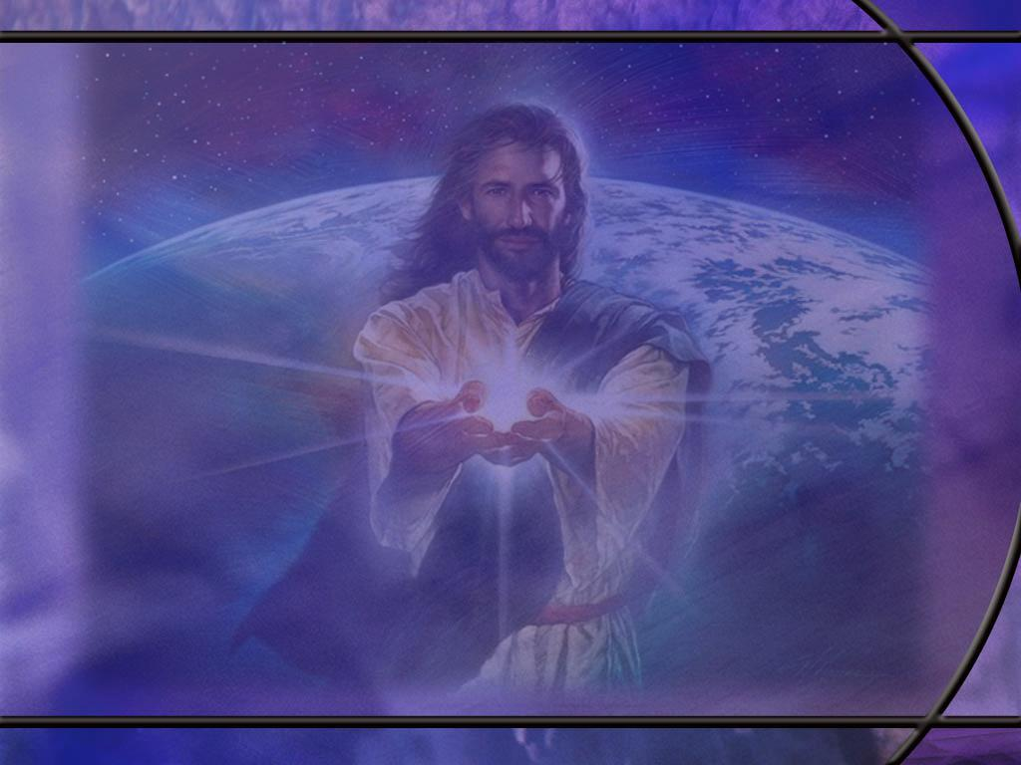
Psalm 40:6-8 ESV
In sacrifice and offering you have not delighted, but you have given me an open ear. Burnt offering and sin offering you have not required. 7 Then I said, "Behold, I have come; in the scroll of the book it is written of me: 8 I delight to do your will, O my God; your law is within my heart.“
Notes:
Q1: What is better than sacrifice in this text?
1. Obedience is better than sacrifice.
2. Having a heart tuned to the will of God and delighting in it.
3. Having God’s law written on our hearts is what God is looking for in each believer.
4. He wants to make the law an internal guiding principle of love.
5. So under the new covenant He sends the HS to put God’s law in our mind and write it upon our heart.
6. The writer to the Hebrews puts it this way:
Hebrews 8:10 ESV - For this is the covenant that I will make with the house of Israel after those days, declares the Lord: I will put my laws into their minds, and write them on their hearts, and I will be their God, and they shall be my people.
[Go to next slide]

Slide 17
Psalm 51:16-17 ESV
For you will not delight in sacrifice, or I would give it; you will not be pleased with a burnt offering. ¹⁷ The sacrifices of God are a broken spirit; a broken and contrite heart, O God, you will not despise. [R]
Notes:
Q1: Who is the author of this psalm and what sin was he confessing in writing it?
1. David after he was convicted of his sin with Bathsheba.
Q2: What kind of sacrifice is God looking for when we have sinned?
1. He is looking for an attitude of humility, of repentance, of confession, of admission of guilt.
2. He is looking for sorrow for sin and a broken heart because we broke the heart of God.
3. He is looking for a longing desire to be forgiven and restored to fellowship.
4. Rituals and external forms won’t cut it with God who looks not on the outward appearance but on the heart.
5. God desires not forms and rituals but loving relationship and devotion.
6. As Jesus said to the woman at the well.
John 4:24 ESV - God is spirit, and those who worship him must worship in spirit and truth.“

Slide 18
Romans 12:1-2 ESV
I appeal to you therefore, brothers, by the mercies of God, to present your bodies as a living sacrifice, holy and acceptable to God, which is your spiritual worship. 2 Do not be conformed to this world, but be transformed by the renewal of your mind, that by testing you may discern what is the will of God, what is good and acceptable and perfect. [R]
Notes:
Q1: How does Rom 12:1 help us understand what worshipping in spirit and truth is?
1. Here Paul says, this is spiritual worship: presenting your body as a living sacrifice, holy and acceptable to God.
2. That is the sacrifice that is truly acceptable to God.
3. When we trust in Jesus as our Savior and Lord, we are justified by faith and God sets us apart for a holy use.
4. And our spiritual worship is realized when we surrender to Him again at the beginning of each day to be the instruments of His grace.
5. As we surrender to the Lord, the HS will renew our mind and conform us to the likeness of Jesus.
6. And give us wisdom to discern the will of God and avoid being conformed to this sinful world.

