Slide 1
Psalms
Lesson 13
Wait on the Lord

Slide 2
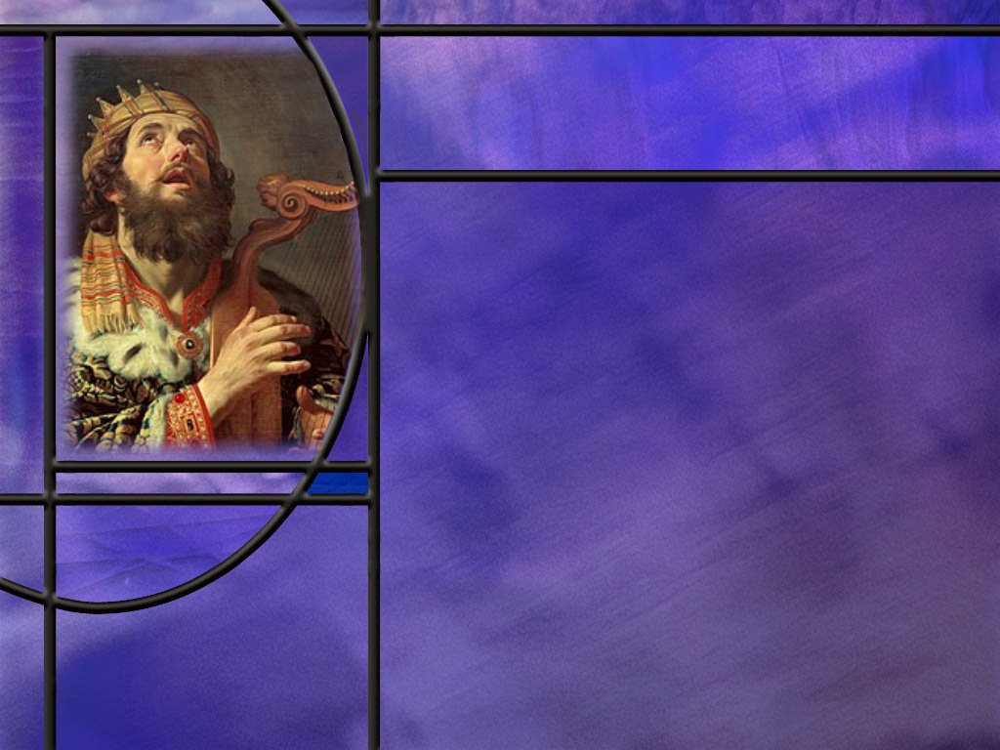
Memory Text
Psalm 27:14 NKJV
Wait on the LORD; Be of good courage, And He shall strengthen your heart; Wait, I say, on the LORD!
What do you think it means here to “wait on the Lord?”
What goes along with waiting on the Lord in this psalm?
Notes:
B2:
1. I remember about a month ago waiting at the doctor’s office for an appointment that was to occur at 2:20 in the afternoon.
2. I didn’t get to see the doctor until about 3:05 pm, 45 minutes later.
3. I spent 45 minutes waiting on the doctor who was running behind schedule.
4. With every minute that passed, I got more and more frustrated and angry.
5. And when I finally got to see the doctor, I was ready to explode.
6. Waiting can be a very frustrating experience.
7. Whether we are waiting in the checkout line at the store or waiting in a traffic jam, waiting is not a favorite thing to do.
8. In a society that values instant gratification, waiting for anything is going to be a hard sell.
9. How does waiting for the Lord differ from waiting for the doctor?
10. Well, first of all, the Lord is never late.
11. The plans and purposes of God know no hastening and no delay.
12. God is always on time, even if we wish the hands of the divine clock would move faster.
13. When we know that the Lord is in control of the future, we can wait on the Lord without frustration and anger.
14. To wait on the Lord means to live in confident expectation of His promises.
15. It means to live in faith and trust that He will bring His plans for His creation to fruition.
16. It means to live in hope of His victory over evil and of the inauguration of His kingdom of glory on this earth.
17. It means to persevere in the faith and hold onto our relationship with Jesus, so that we can be part of His eternal kingdom.
18. Rather than twiddling out thumbs as we wait, it means to be active in obeying the Lord’s commission to take the everlasting gospel to every nation, kindred, tongue, and people, beginning with our families and friends.
19. Paul describes our waiting in:
1 Corinthians 15:58 KJV - Therefore, my beloved brethren, be ye steadfast, immoveable, always abounding in the work of the Lord, forasmuch as ye know that your labor is not in vain in the Lord.
20. To wait on the Lord is to live in the blessed hope and confident expectation that our Lord will return and save us in His kingdom as He promised.
B3:
1. Courage and strength.
2. When we are waiting on the Lord, we don’t have to be afraid.
3. We can have good courage because the almighty God is on our side.
4. David, the author of this psalm, is well aware of the power of God to deliver.
5. We see in the Bible all the ways that God delivered David.
6. From Saul, who was constantly trying to kill him, from the lion and bear that attacked his sheep, from Goliath that towered over him in battle, from Absolom, his own son: God delivered him.
7. But in all of these conflicts, David did his part: he defended himself from Saul and Absolom, he fought off the lion and bear, he went out with his sling against Goliath.
8. So we too can have courage and inner strength to do our part in the battles with the foes we face.
9. The ESV translates this verse as follows:
Psalm 27:14 ESV - 14 Wait for the LORD; be strong, and let your heart take courage; wait for the LORD!
10. Strength and courage together reminds me of Joshua 1:9
Joshua 1:9 KJV - 9 Have not I commanded thee? Be strong and of a good courage; be not afraid, neither be thou dismayed: for the LORD thy God is with thee whithersoever thou goest.

Slide 3
Overview
The psalms in our lesson this week focus on what it means to wait on the Lord and find the hope, the peace, the joy, the rest, and the satisfaction that comes from trusting the Lord and living for Him.
  Waiting for Redemption
  Childlike Faith
  Beauty for Ashes
  Summary

Slide 4
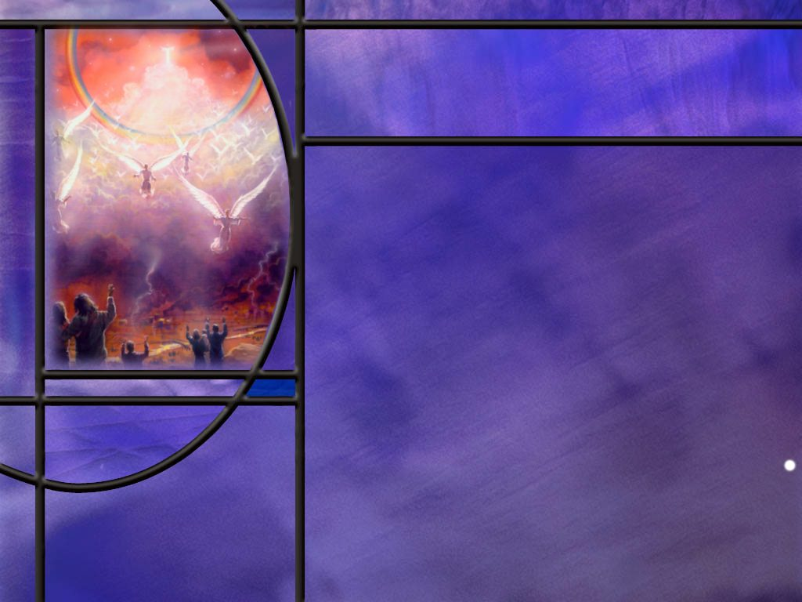
Waiting for Redemption
How does the apostle Paul pick up on the theme of waiting on the Lord, that is so prevalent in many psalms? (Rom 8:22-25)
Before ending Ps 27 with a call to wait on the Lord, how does David model doing this? (Ps 27:4,6,8,10)
Notes:
B1:
[See notes on linked slide.]
B2:
[See notes on linked slide.]

Slide 5
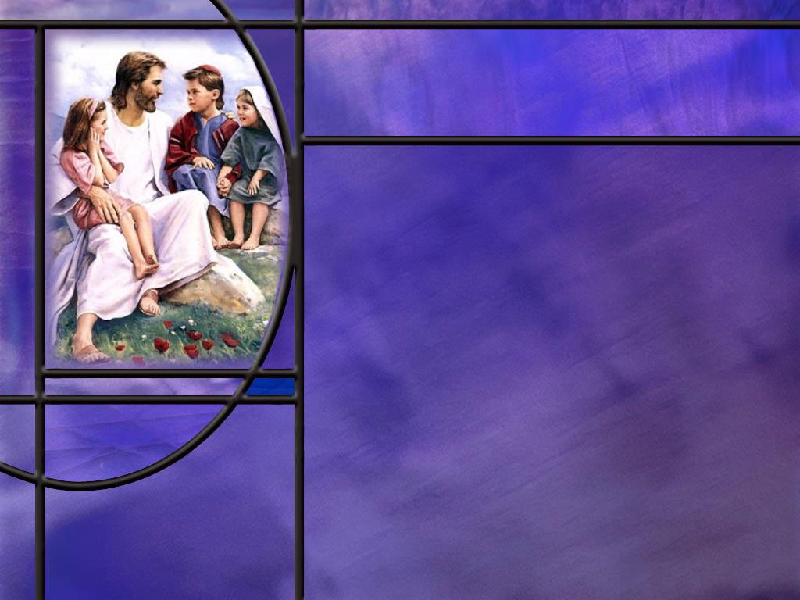
Childlike Faith
What picture of saving faith does David paint in Ps 131? (Ps 131:1-3)
What did Jesus say about the necessity of childlike faith? (Matt 18:1-4)
What are some of the qualities of a little child that should exemplify those who belong to the kingdom of grace?
What does Jesus’ love for little children tell you about the love of God?
Notes:
B1:
[See notes on linked slide.]
B2:
[See notes on linked slide.]
B3:
1. We’ll start with the one that Jesus mentioned.
2. Humility. A little child knows very little, but he is an avid learner.
3. A little child knows that he is not in charge; he knows he needs to be taken care of.
4. His only method of getting care is to cry, hoping someone well meet his need.
5. He recognizes that the source of everything good is outside of himself.
6. So humility leads to trust in another rather than in self.
7. Trust. A little child is trusting.
8. They find security and comfort in the arms of a parent.
9. They trust their parents to provide for them in every way.
10. I used to throw my kids up into the air as high as I could, and they loved it.
11. They trusted me to catch them when they came down, and I never dropped them.
12. We need that kind of total trust in the Lord Jesus Christ.
13. Innocence. Little children have a simple innocence.
14. Yes, we all have fallen natures, and even babies express their selfishness and impatience.
15. But there is a refreshing purity about a little child who always tells the truth, who misses the double entendre, who is unashamed of his nakedness, who implicitly obeys his parents…
16. Forgiving. A child is quick to forgive and forget.
17. It is usually the parents that carry a grudge long after the kids have made up.
18. Kids are particularly forgiving of their parents.
19. Un-hypocritical. A little child is himself. He’s unpretentious.
20. He’s real. He doesn’t pretend he is something he is not.
21. Loving. There is something special about a little child’s love.
22. Their love is innocent, not based on sexual attraction or good looks.
23. A child reciprocates the love he receives like we do with God’s love.
B4:
1. Sometimes our relationship with others are based on what we think we can get in return.
2. A little child has nothing to give you except his heart.
3. So too, we have nothing of value to give to God except our hearts.
4. And that’s all that God really wants from us.
5. God loves us all like His little children, not because we’re always lovable, but because He’s always loving.

Slide 6
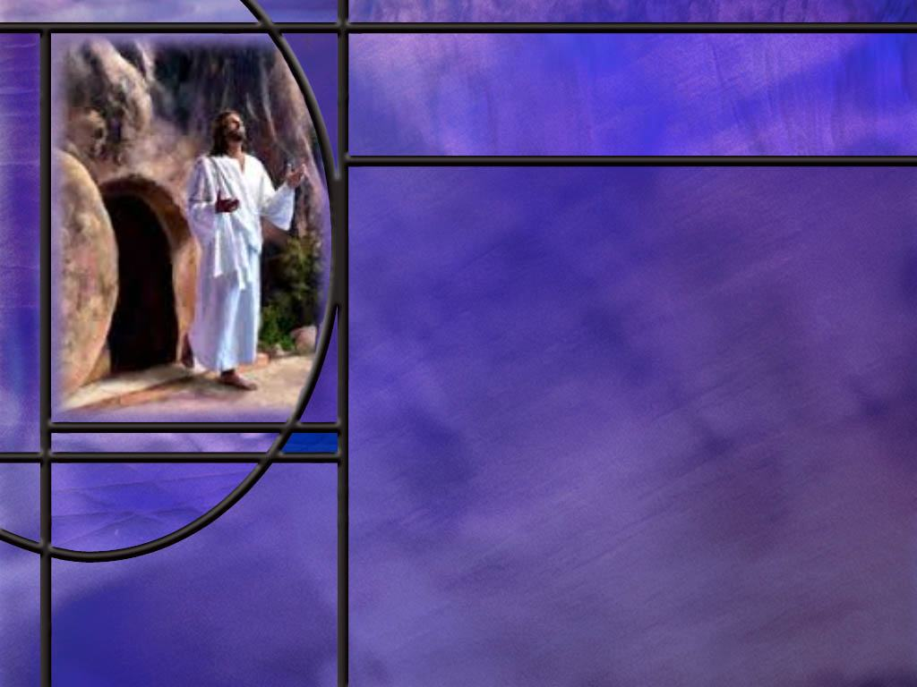
Beauty for Ashes
How did the Lord turn the tears of His people to joy and laughter in Ps 126?
How do the psalms express the morning as a time when the Lord acts to dispel the darkness that we go through? (Ps 30:5)
What prophecy did Isaiah give about how the Messiah would dispel the sorrow and sadness of those who believe? (Isa 61:1-3)
How does the resurrection of Jesus impact your view of the power of God to raise you from the dead?
Notes:
B1:
[See notes on linked slide.]
B2:
[See notes on linked slide.]
B3:
[See notes on linked slide.]
B4:
1. If God can raise Jesus from the dead, He can raise us from the dead too.
2. Paul wrote this in:
2 Corinthians 4:14 ESV - 14 knowing that he who raised the Lord Jesus will raise us also with Jesus and bring us with you into his presence.
3. And when we are raised we will have immortal bodies like the Lord Jesus had.
Philippians 3:20-21 ESV - 20 But our citizenship is in heaven, and from it we await a Savior, the Lord Jesus Christ, 21 who will transform our lowly body to be like his glorious body, by the power that enables him even to subject all things to himself.
4. Paul goes into great detail in the great resurrection chapter of 1 Cor 15.
5. Christ is the first fruits of the resurrection, and this guarantees the resurrection of all who are His at His coming.
6. Our eternal future depends on the resurrection of the body and the resurrection of Jesus demonstrates that it is indeed possible.
1 Corinthians 15:13-14 ESV - 13 But if there is no resurrection of the dead, then not even Christ has been raised. 14 And if Christ has not been raised, then our preaching is in vain and your faith is in vain.
7. The flip side of that is also true:
8. If Christ has been raised from the dead then the dead can be resurrected.
9. Then our preaching is true and your faith is not in vain.
10. Our hope for the future is tied directly to the resurrection of the Lord Jesus Christ.
11. We can boldly proclaim, The Lord is risen! He is risen indeed!!

Slide 7

Summary
Waiting on the Lord does not imply an idleness that leads to frustration and anger.
Instead it describes a life of faith and steadfast confidence in the promises of God, knowing that He is in control and will work out His plans for His creation.
Rather than being idle we are to occupy the time by growing in grace, building a relationship with the Lord that will endure, and living in obedience to His word.
The apostle Paul writes that the whole creation is groaning under the curse of sin, and believers wait eagerly for adoption as sons, and the redemption of our bodies.
He encourages us to hold onto the blessed hope with steadfast endurance as we wait for the redemption of our bodies.

Slide 8
Summary
In Ps 131, David uses a metaphor which describes his peace with God as a weaned child with its mother.
This implies growth in a love relationship where he has matured from demands of crying to requests of asking.
Jesus said that the kingdom of heaven is only for those who become like little children.
This implies being born again and developing child-like character traits such as humility, trust, innocence, forgiveness, compassion, and love.
Ps 126 celebrates the joy and laughter of the return of exiles from Babylonian captivity.

Slide 9
Summary
This was made possible by God calling Cyrus to fulfill His purpose and free His people.
What begins in weeping and sorrow, God can turn to joy and laughter.
While weeping may endure for a night joy comes in the morning when the Sun of Righteous arises with healing in His wings.
Isaiah prophesied that the Messiah would bring beauty for ashes, joy for mourning, and praise for despair.
This was literally fulfilled by Jesus on the day of His resurrection as His disciples went from despair to joy.
Knowing that God is in control and that His promises are sure, will you wait on the Lord as you live this week, standing in steadfast hope on the promises that cannot fail.

Slide 11
Romans 8:22-25 ESV
For we know that the whole creation has been groaning together in the pains of childbirth until now. ²³ And not only the creation, but we ourselves, who have the firstfruits of the Spirit, groan inwardly as we wait eagerly for adoption as sons, the redemption of our bodies. ²⁴ For in this hope we were saved. Now hope that is seen is not hope. For who hopes for what he sees? ²⁵ But if we hope for what we do not see, we wait for it with patience. [R]
Notes:
Q1: In addition to believers, what else is waiting for redemption at the return of the Lord?
1. As the apostle Paul describes it, the whole creation is groaning together under the curse of sin.
2. Eden was originally a place of love and life and peace and joy.
3. But when Adam and Eve sinned, God’s good creation was cursed.
4. Under the curse, it would take the sweat of Adam’s brow to fight the thorns and thistles.
5. Instead of life, there was the sentence of death, instead of love, contention and strife, instead of peace, fear, and instead of joy, sorrow and tears.
6. The whole creation was cursed and has since been groaning as if in labor looking for redemption.
Q2: Of course, fallen human beings are central to the curse. What are we looking for as we also groan inwardly?
1. Paul says we look eagerly for the adoption as sons, the redemption of our bodies.
2. When do we receive the adoption as sons?
3. When we trust Jesus as our Savior and Lord.
4. Paul explains in Gal 4:4-6
Galatians 4:4-6 ESV - 4 But when the fullness of time had come, God sent forth his Son, born of woman, born under the law, 5 to redeem those who were under the law, so that we might receive adoption as sons. 6 And because you are sons, God has sent the Spirit of his Son into our hearts, crying, "Abba! Father!“
5. So we are adopted when we trust in Jesus and receive the HS which is our guarantee or downpayment on eternal life.
6. Here in Rom 8 Paul refers to believers as those who have the first fruits of the Spirit.
Q3: What are we still hoping for that we have not yet received?
1. We are still hoping for the redemption of our bodies.
2. Are you still hoping for that?
3. The older we get, the more we need it.
4. What a joy to be able to look forward to what Jesus will do for us at the resurrection.
Philippians 3:21 KJV - Who shall change our vile body, that it may be fashioned like unto his glorious body, according to the working whereby he is able even to subdue all things unto himself.
5. Paul says here in verse 24 that we were (past tense) saved in this hope, but we still hope for the future change that will occur at the resurrection.
6. But because we are confident in the promises of God, we wait for the redemption of our bodies with patience.
7. The Greek for patience here is hypomonē (hoop-om-on-ay’) which means steadfast endurance.
8. We hold on to the promises of God and never give up.

Slide 12
Psalm 27:4, 6, 8, 10 ESV
One thing have I asked of the LORD, that will I seek after: that I may dwell in the house of the LORD all the days of my life, to gaze upon the beauty of the LORD and to inquire in his temple. ... 6 And now my head shall be lifted up above my enemies all around me, and I will offer in his tent sacrifices with shouts of joy; I will sing and make melody to the LORD. ... 8 You have said, "Seek my face." My heart says to you, "Your face, LORD, do I seek." ... 10 For my father and my mother have forsaken me, but the LORD will take me in. [R]
Notes:
Q1: How do these verses model or explain what it means to wait on the Lord?
1. Let’s look at verse 4 first: Where does David want to dwell?
2. This is very similar to his ending of Psalm 23.
3. He wants to dwell in the house of the Lord all the days of his life.
4. He wants to be near the Lord; he wants to pray or inquire in the temple.
5. This all points to having a relationship with the Lord, being close to the Lord, communing with the Lord in prayer.
6. What is David doing in verse 6?
7. It looks like he is worshiping the Lord.
8. He is there in the tabernacle offering sacrifices and singing and making melody to the Lord.
9. This again points to a relationship between David and his creator in which worship and adoration are ways of expressing his love for God.
10. What is David doing in verse 8?
11. God has called us to seek His face; and David has responded by doing just that.
12. We seek the face of God in prayer and meditation on God’s word.
13. We take time to be alone with Him and grow to love and respect Him.
14. Finally, what is happening in verse 10?
15. Even if his father and mother should forsake him, where does he find refuge?
16. He says “the Lord will take me in.”
17. So when David reaches the end of this psalm and calls on us to wait on the Lord, he has given us at least 4 wonderful verses that describe how to do that.
18. We wait on the Lord by growing in grace, strengthening our relationship with Him through prayer and meditation on the word, worshiping Him with praise and adoration, of seeking the face of the Lord in personal devotions and corporate worship, by building a close personal relationship with Him that would take the place of mother and father.
19. Are you waiting on the Lord like that?
20. Let’s use the means of grace that the Lord has given us to grow in grace and hold on with steadfast endurance until Jesus comes.

Slide 13
Psalm 131:1-3 ESV
[A Song of Ascents. Of David.] O LORD, my heart is not lifted up; my eyes are not raised too high; I do not occupy myself with things too great and too marvelous for me. 2 But I have calmed and quieted my soul, like a weaned child with its mother; like a weaned child is my soul within me. 3 O Israel, hope in the LORD from this time forth and forevermore. [R]
Notes:
1. This is the entire psalm, only three verses.
Q1: What is David’s purpose in verse 1 of this psalm. What attitude is he expressing as he sings this to the Lord?
1. He is confessing his own humility as he thinks about the greatness of God.
2. His heart is not lifted up, meaning he sees the proper relationship between himself and God.
3. God is our creator and redeemer; we are His creatures that He has redeemed.
4. God is holy and sinless; we are sinners saved by grace.
5. We have no goodness that His holiness can accept, but He accepts us in the Beloved because of what Christ has done for us in forgiving our sins.
6. David’s eyes are not raised too high looking for some elevated position like Lucifer did when pride led him to covet the position of the Son of God.
7. While he recognizes the wonders of creation he does not occupy himself trying to figure them out with human wisdom.
8. The wisdom and knowledge of God are beyond our understanding.
Q2: What has brought peace and quiet to David’s soul in verse 2?
1. Here David compares his relationship to God to a weaned child with its mother.
2. When a child is weaned, he is no longer dependent upon his mother for milk.
3. This took place in the Jewish culture at about three years of age.
4. At that age, the child is learning to speak and no longer needs to cry to tell his mother that he is hungry and wants to nurse.
5. He can now speak to her and tell her what he wants and she can provide it or suggest an alternative.
6. No more crying to be fed; now calm and quiet.
7. In the same way, we grow in our relationship with the Lord.
8. The more we know Him the more we love Him, and the more we can rest in peace on His everlasting arms, knowing he has our best interest in mind.
Q3: What is David’s challenge to Israel in verse three?
1. Put you hope in the Lord from now on.
2. Biblical hope is not wishful thinking; it is confident expectation that God will do what He says.
3. Hope is standing firm on the promises of God.

Slide 14
Matthew 18:1-4 ESV
At that time the disciples came to Jesus, saying, "Who is the greatest in the kingdom of heaven?" 2 And calling to him a child, he put him in the midst of them 3 and said, "Truly, I say to you, unless you turn and become like children, you will never enter the kingdom of heaven. 4 Whoever humbles himself like this child is the greatest in the kingdom of heaven. [R]
Notes:
Q1: What does Jesus say we need to do in order to enter the kingdom of heaven?
1. We need to be converted and become as little children.
Q2: Does this remind you of anything Jesus said to Nicodemus?
John 3:3 (NKJV) Jesus answered and said to him, “Most assuredly, I say to you, unless one is born again, he cannot see the kingdom of God.”
1. So being converted and becoming as little children is equivalent to being born again.
Q3: What character attribute of children does Jesus point to in verse 4?
1. Humility.
Q4: How would you define humility?
1. Humility is recognizing that God is everything and I am nothing without Him.
2. Humility puts God on the throne and kneels before Him.
3. Humility recognizes that we have nothing to recommend ourselves to God.
4. We cannot boast of good works to save us but must trust the righteousness of Christ.
5. So humility is the essential quality of entering the Kingdom of heaven because we are saved by grace through faith.
6. In humility, we admit that our righteousness is “filthy rags” and we trust the blood and righteousness of our Savior who saves us by grace.

Slide 15
Psalm 126:1-6 NLT
[A song for pilgrims ascending to Jerusalem.] When the LORD brought back his exiles to Jerusalem, it was like a dream! 2 We were filled with laughter, and we sang for joy. And the other nations said, "What amazing things the LORD has done for them." 3 Yes, the LORD has done amazing things for us! What joy! 4 Restore our fortunes, LORD, as streams renew the desert. 5 Those who plant in tears will harvest with shouts of joy. 6 They weep as they go to plant their seed, but they sing as they return with the harvest. [R]
Notes:
Q1: What great event in the life of the Jews does this psalm celebrate?
1. This psalm celebrates the return from Babylonian captivity after 70 years.
2. What joy there must have been among the returning exiles.
3. It was like a dream come true.
4. After Belshazzar’s defeat and death, God softened the heart of Cyrus whose decree in 538 BC allowed the Jews to return home and rebuild the temple.
5. In fact, in Isaiah, God called Cyrus His shepherd 150 years before he defeated Babylon.
Isaiah 44:28 ESV - 28 who says of Cyrus, 'He is my shepherd, and he shall fulfill all my purpose'; saying of Jerusalem, 'She shall be built,' and of the temple, 'Your foundation shall be laid.’”
6. Wow! Another amazing prophecy fulfilled by the intervention of God.
7. And this same Cyrus was the one who allowed the Jews to return from their captivity.
Q2: What agricultural image does the psalmist use to express the dramatic change from sorrow to joy?
1. They planted with tears, but rejoiced in the harvest.
2. I’m not sure I grasp the metaphor.
3. I get the rejoicing in the harvest, but why the planting with tears?
4. Perhaps there is anxiety and uncertainty as the seed is cast to the ground if there will be a harvest.
5. This psalm is the inspiration for Bringing in the Sheaves in our hymnal #369.
6. The KJV of verse 6 is:
Psalm 126:6 KJV - He that goeth forth and weepeth, bearing precious seed, shall doubtless come again with rejoicing, bringing his sheaves with him.
7. The third verse of Bringing in the Sheaves goes like this:
Going forth with weeping, sowing for the Master,
Though the loss sustained our spirit often grieves,
When our weeping’s over, He will bid us welcome,
We shall come rejoicing, bringing in the sheaves.
8. Applying this to ourselves as gospel workers, we may weep over those who reject the gospel message, but we will rejoice over the good soil that produces sheaves of grain for the harvest.

Slide 16
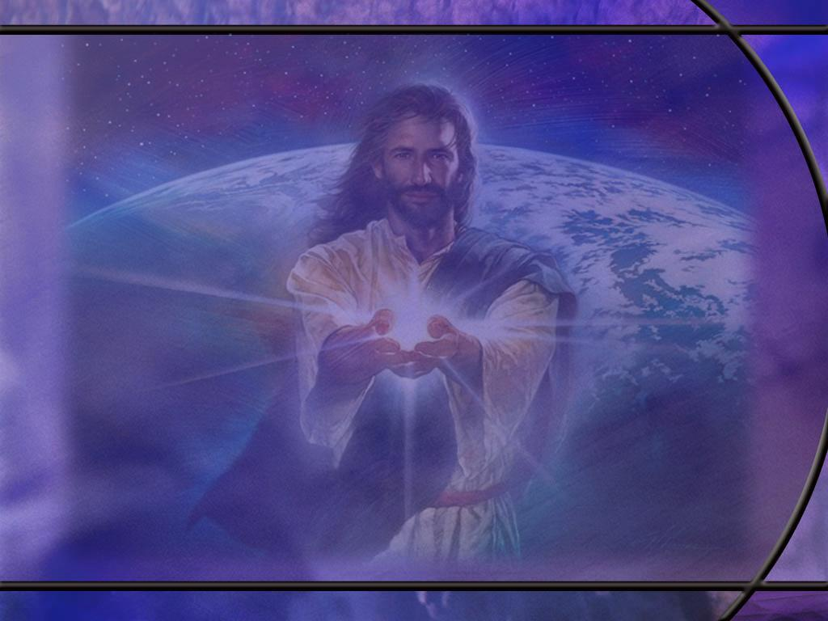
Psalm 30:5 ESV
For his anger is but for a moment, and his favor is for a lifetime. Weeping may tarry for the night, but joy comes with the morning. [R]
Notes:
Q1: What figurative meaning could we place on “night” and “morning” in this verse?
1. When we are weeping we are in in a state of disappointment and discouragement.
2. We are focusing on the difficulties that are pressing upon us.
3. Even though it may be day time, we are in a metaphorical darkness where we cannot perceive the sunshine of God’s love and care for us.
4. The morning that brings us joy may not be at sunrise but when we see beyond the clouds of our difficulties and perceive the sunshine of God’s love and care.
5. So we can think of the morning as a metaphorical term: that moment when we put our trust in God to lift our burdens and dispel our darkness.
6. This metaphorical morning often coincides with our decision to lay our burdens on the Lord and praise Him regardless of what we are going through.
7. There is power in Praise and thanksgiving to turn our weeping to joy.

Slide 17
Isaiah 61:1-3 NIV
The Spirit of the Sovereign LORD is on me, because the LORD has anointed me to proclaim good news to the poor. He has sent me to bind up the brokenhearted, to proclaim freedom for the captives and release from darkness for the prisoners, 2 to proclaim the year of the LORD's favor and the day of vengeance of our God, to comfort all who mourn, 3 and provide for those who grieve in Zion--to bestow on them a crown of beauty instead of ashes, the oil of joy instead of mourning, and a garment of praise instead of a spirit of despair. They will be called oaks of righteousness, a planting of the LORD for the display of his splendor. [R]
Notes:
1. This is the fifth and final Suffering Servant song that Isaiah writes.
2. We recognize verses 1 and 2 immediately as the section of Isaiah that Jesus quoted at His hometown synagogue in Nazareth.
3. Then He sat down and said:
Luke 4:21 NIV - 21 "Today this scripture is fulfilled in your hearing."
4. So this is very clearly a Messianic prophecy fulfilled in the ministry of Jesus.
5. But we want to focus for a minute on verse 3.
Q1: What kind of a change will the Messiah bring to those who grieve with ashes on their heads and garments of mourning and a spirit of despair?
1. He will bring a crown of beauty for ashes, the oil of joy for mourning, a garment of praise for a spirit of despair.
2. And I am wondering how this verse was fulfilled in the ministry of Jesus.
3. Perhaps it is fulfilled in two ways.
4. First for all those who grieve for their sins, who mourn and repent and are in sorrow and despair, Jesus brings assurance of forgiveness.
5. His blood and His righteousness are sufficient to cover every sin committed by every individual and provide a righteous from God that truly saves.
6. Joy comes with the assurance of salvation.
7. But perhaps there is a second application.
8. When Jesus died, He died in Zion or Jerusalem, and it was there that His disciples grieved and mourned and had a spirit of despair.
9. Recall the disciples on the road to Emmaus:
Luke 24:21 NIV - 21 but we had hoped that he was the one who was going to redeem Israel.
10. It was on the resurrection morning that their ashes of grief were turned to a crown of beauty, their mourning was turned to joy, and their spirit of despair to a garment of praise.

