Slide 1
The Great Controversy
Lesson 3
Light Shines in the Darkness

Slide 2
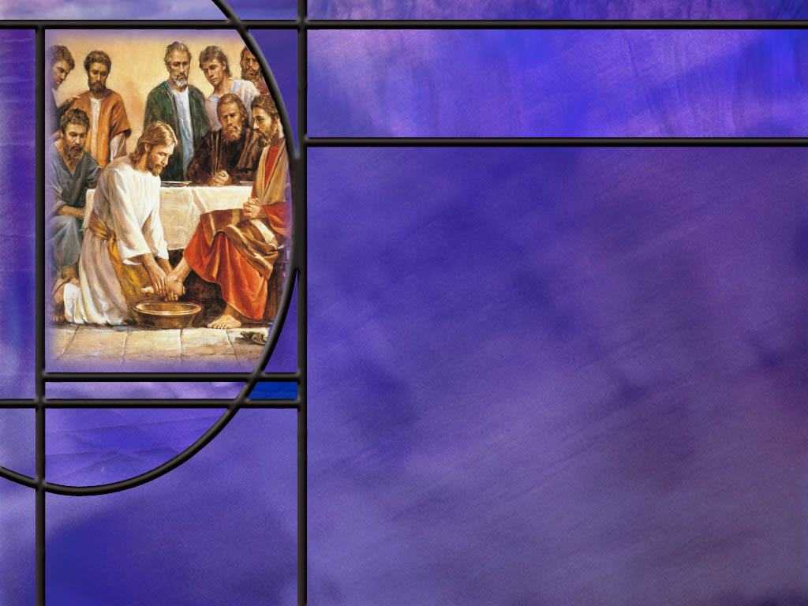
Memory Text
John 12:35 NKJV
Then Jesus said to them, "A little while longer the light is with you. Walk while you have the light, lest darkness overtake you; he who walks in darkness does not know where he is going.”
What is the light to which Jesus refers in this verse?
John repeatedly uses light vs. darkness as a metaphor in his gospel. What does light and darkness represent?
What is Jesus’ command in this verse and what do you think it means?
How does the Light of the World continue to shine on our pathway today?
Notes:
B2:
1. This is obviously a reference to Himself as the light.
2. And the little while longer that He will shine among them is the little time He has left to be with them before He is crucified.
3. Back in John 8:12, Jesus had said:
John 8:12 ESV - "I am the light of the world. Whoever follows me will not walk in darkness, but will have the light of life."
B3:
1. This would be a fascinating study to look at all the ways John uses light and darkness in his writings.
2. But I think we can say that light represents truth, goodness, righteousness, and holiness while darkness represents error, sinfulness, unrighteousness, and evil.
3. Christ is the minister of light that brings salvation; Satan is the minister of darkness that brings damnation.
4. Right from the beginning of his gospel as John introduces Jesus as the Word, he writes:
John 1:4-5 ESV - In him was life, and the life was the light of men. ⁵ The light shines in the darkness, and the darkness has not overcome it.
5. Light and darkness, good and evil, truth and error, righteousness and unrighteousness, a fitting metaphor for the two sides in the GC.
B4:
1. His command is to walk while you have have the light.
2. Well, if Jesus is going to die in a couple of days here, that doesn’t give them long to walk!
3. Walk is another metaphor that means to live in a certain way of progressing toward a goal.
4. And if you are walking in the light of Christ, following His teaching and being His disciple, you are walking toward His kingdom.
5. And Jesus is encouraging us to do that as long as the light of truth is shining on our pathway.
6. So what Jesus may be saying here is what Paul said:
2 Corinthians 6:2 KJV - behold, now is the accepted time; behold, now is the day of salvation.
7. Don’t put off to tomorrow the choice you can make today to “follow Me.”
B5:
1. Fortunately the light of truth didn’t go out when Jesus died, rose again, and ascended to heaven.
2. He sent the Holy Spirit to be His representative and our Helper.
3. The HS inspired the followers of Jesus to record the Testimony of Jesus in the NT writings that continue to shine the light of God’s truth on our pathway.
4. Thank God for His inspired word!
5. How little we would know without it.
6. We would truly be in spiritual darkness without the Bible.

Slide 3
Overview
Following the apostolic age and the time of Roman persecution, Christianity was accepted in the empire under Constantine, and Satan embarked on a new strategy of compromise and counterfeit designed to lead Christianity into darkness, error, blasphemy, and hatred. Our only safety is a return to the apostolic faith once and for all delivered to the saints as found in God’s word.
  Early Warnings
  Man of Sin
  Constantine and Compromise
  Finding Light
  Summary

Slide 4
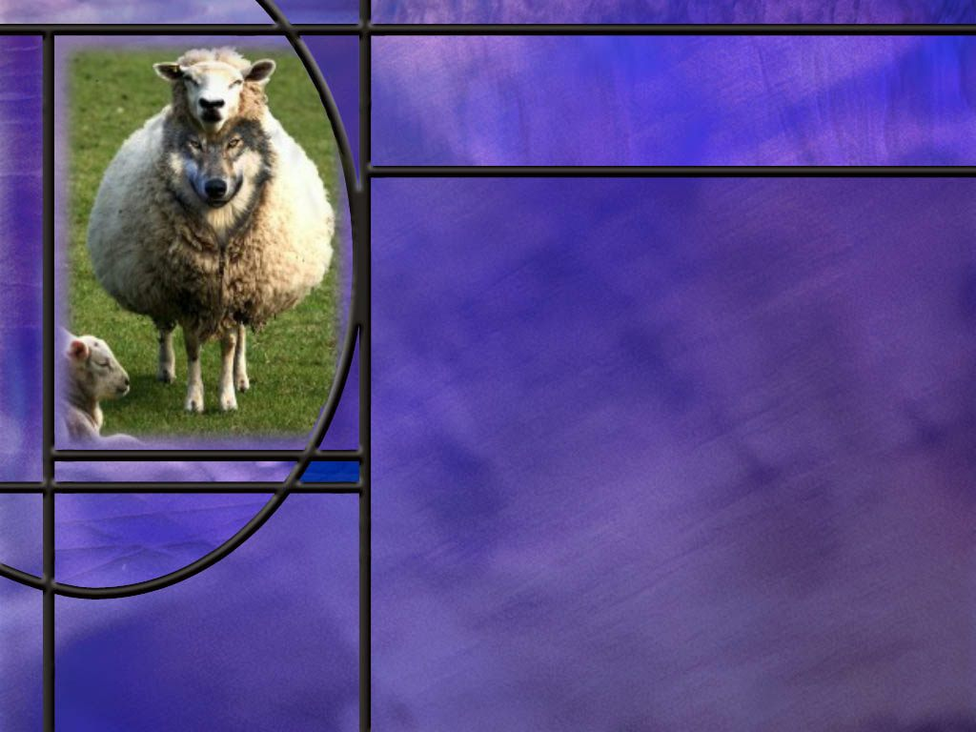
Early Warnings
What warnings did Jesus give His disciples about wolves among the flock? (Matt 7:15-16)
What warning did the apostle Paul give to elders at Ephesus about the dangers of false teachers? (Acts 20:29-32)
What warning did Paul give to Timothy about false teachers dividing the flock? (1 Tim 4:1-2; 2 Tim 4:2-4)
Notes:
B1:
[See notes on linked slide]
B2:
[See notes on linked slide]
B3:
[See notes on linked slide]
B4:
1. False Christs and false prophets deceiving many, wars and rumors of war, famines, pestilences, earthquakes, tribulation, hatred, and death for Christians, apostasy, betrayal, hatred, lawlessness.
2. But then Jesus says,
Matthew 24:13 (NKJV)
¹³ But he who endures to the end shall be saved.
3. Apparently Jesus never heard of the health and wealth gospel preached by some TV preachers today.
4. For His disciples in the 1st century and for many down through the ages, Jesus predicts tribulation.
5. But He encourages us to “hold on.” Salvation’s coming!
B5:
1. In 70 AD, the Roman general Titus laid siege to Jerusalem in the spring of the year when it was full of people who had come to celebrate the Passover.
2. By August, the people were starving to death and fighting gangs for scarce resources.
3. Josephus (a Jewish historian) records that one starving mother ate her baby.
4. The Jews refused to surrender, thinking that God would yet deliver His temple.
5. The Romans eventually set fire to the gold plated walls of the temple and burned the city to the ground.
6. Josephus claims that 1.1 million people were killed during the siege, of which a majority were Jewish, and that 97,000 were captured and sold into slavery, some in Egypt.
7. His numbers are disputed by modern scholars, but virtually everyone in the city was either killed or enslaved.
8. Others estimate the Jewish losses at a quarter million.
9. The gold in the temple melted with the heat and ran into the cracks between the stones.
10. It is no wonder then that the stones were all removed by those looking for gold.

Slide 5

Man of Sin
What warning did the apostle Paul give the church at Thessalonica about the coming apostasy? (2 Thes 2:3-4)
From Daniel 7 and 8, what are the identifying marks of the Little Horn Power? [Little Horn]
Notes:
B1:
[See notes on linked slide.]
B2:
[See notes on linked slide.]

Slide 6
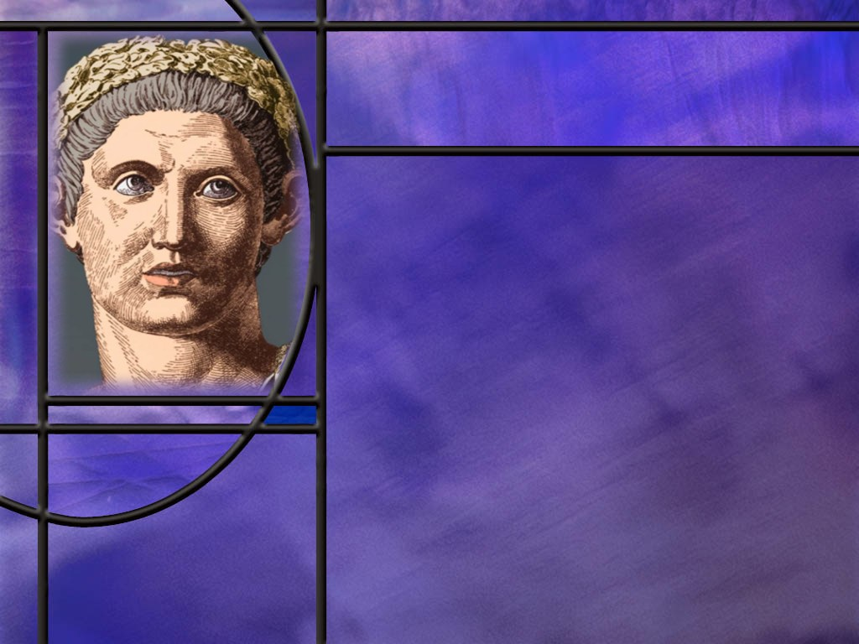
Constantine and Compromise
Who was Constantine and what did he do to stop Christian persecution in the Roman empire?
What are some of the ways the papal system has compromised the apostolic faith and brought error into their practice of Christianity?
Notes:
B1:
1. Constantine claimed to be a Christian, and he did much to end the persecution of the Christian church and make it the preferred church of the empire.
2. He became emperor in the west in 306 AD, and the exclusive emperor of the entire empire in 324 AD.
3. In 313 AD, Constantine in the west and Licinius in the East issued the Edict of Milan.
4. This edict marked the end of the 10 year period of persecution of Christians.
5. Note this entry from Wikipedia[?]:
“In 313, the Western emperor, Constantine, met with his rival and counterpart, the Eastern emperor, Licinius, in the city of Milan, Italy. As part of their discussions, they issued a joint statement, later known as the Edict of Milan. This proclamation protected full rights for Christian citizens of the Empire, restoring their property, releasing them from prisons, and effectively banning government persecution of their faith.”
6. It was Constantine that was the motivating force behind this edict.
7. Some question whether or not he was a true convert, for one reason, because he was not baptized until he was on his deathbed.
8. But, as emperor, he would have to be in charge of shedding blood, so it is believed he may have waited until his worst sins were behind him before being baptized.
9. In any case, he clearly promoted Christianity during his reign.
10. We all recall his first Sunday decree in 321 AD.
11. And we can see the forces of evil at work as he attempts to make Christianity comfortable to the pagan religions of the empire with their idols and temples.
12. On March 7, 321 AD, Constantine approved the “day of the sun” as a day of rest for the Western Roman Empire. It was a law enacted to honor the sun god by requiring rest for those who lived in the city. Those in the country were exempt from it.
13. But it would support the Church in Rome, which appears to be the first to abandoned the Sabbath in order to distance themselves from the Jews, who were always getting in trouble with the Romans.
14. Constantine was the start of a great period of compromise with paganism that eventually resulted in the bishop of Rome being elevated to the Pope.
15. Constantine provided the power of the state to promote a type of Christianity that he thought would unify the empire.
B2:
1. The underlying apostasy of the papal system is that it has left the authority of the word of God and has placed the traditions of the church and the decrees of popes above the authority of the Word of God.
2. So we want to look at statements from bona fide Roman Catholic Sources.
3. As we read some of these quotations, think about the identifying marks of the little horn power who speaks great words against the most high and the man of sin that “exalteth himself above all that is called God or that is worshipped so that he as God sitteth in the temple of God showing himself that he is God.”

Slide 7
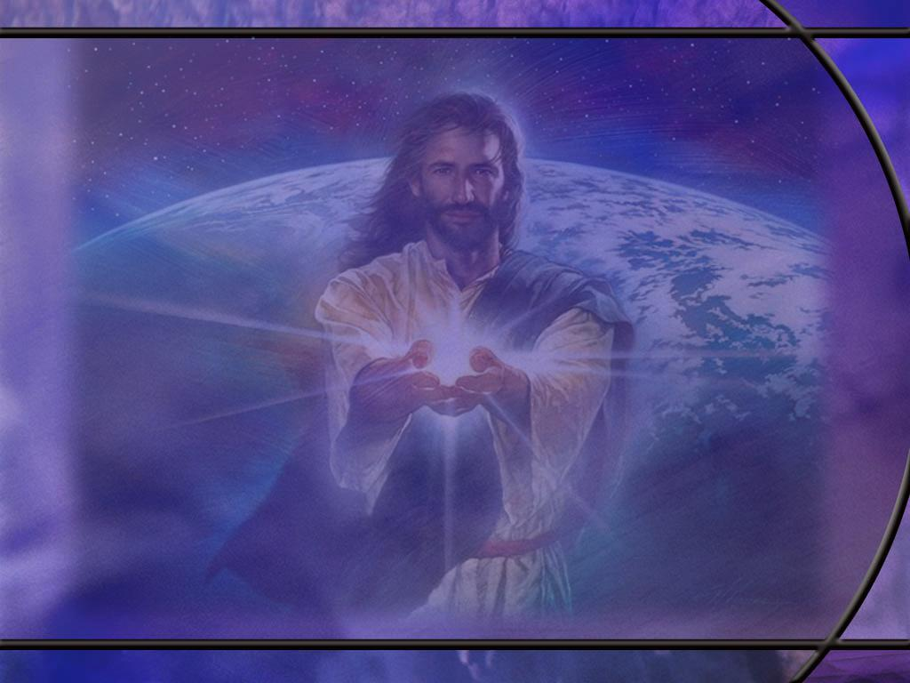
Quotes from Catholic Sources
The Pope and God are the same, so he has all power in heaven and earth. Pope Pius V quoted in Barclay chapter XXVII p 218
We hold upon this earth the place of God Almighty. Pope Leo XIII, Encyclical Letter of June 20, 1894
For thou art the shepherd, thou art the physician, thou art the director, thou art the husbandman, finally, thou art another God on earth. Labbe and Cossart’s “History of the Councils,” Vol XIV, Col 109

Slide 8
Quotes from Catholic Sources
“Our Lord God the Pope.” Extravagantes of Pope John XXII, title 14 Chapter 4.
Holy Father
Vicar of Christ
Vicar of the Son of God
Most divine of all heads
Christ by Unction (by anointing)
Key-bearer of the Kingdom of Heaven

Slide 9
Quotes from Catholic Sources
“And God himself is obliged to abide by the judgment of his priest and either not to pardon or to pardon, according as they refuse or give absolution, provided the penitent is capable of it." Liguori, Duties and Dignities of the Priest, p.27
The priest holds the place of the Savior himself, when by saying ‘Ego te absolvo,’ he absolves from sin. Liguori, ibid., p 34

Slide 10
Quotes from Catholic Sources
In a letter dated Oct. 28, 1894, Cardinal Gibbons wrote these words: “Of course the Catholic Church claims that the change from Sabbath to Sunday was her act...And the act is a mark of her ecclesiastical power and authority in religious matters.”
Notes:
1. Is it any wonder that Adventists have pointed to Sunday sacredness as the visible mark of the Beast?

Slide 11
Quotes from Catholic Sources
  “The sacred and holy Sacrifice of the Mass is not a Sacrifice of praise and thanksgiving only, or a mere commemoration of the Sacrifice performed on the cross, but also truly a propitiatory Sacrifice, by which God is appeased and rendered propitious to us.” Catechism of the Council of Trent for Parish Priests, 258-259
Notes:
Propitiation means an atoning sacrifice by which sins are forgiven.

Slide 12
Eight Catholic Inventions that Replace God’s truth
1. The papal system has substituted a false sacrifice, the Mass, for the once and for all sacrifice of Christ.
2. They have substituted a false mediator (Mary and the saints) for the One Mediator between man and God (Jesus Christ).
3. They have substituted a false method of forgiveness, confession and absolution by a priest, in place of the divine forgiveness of Christ in the heavenly sanctuary.
4. They have substituted a false method of salvation, mixing justification, sanctification, and the sacraments of the church, in place of righteousness by grace alone through faith alone in Christ alone, nothing else being necessary.
Notes:
(Bible Truth)
1. Hebrews 9:28 KJV - 28 So Christ was once offered to bear the sins of many; and unto them that look for him shall he appear the second time without sin unto salvation.
2. 1 Timothy 2:5 KJV - 5 For there is one God, and one mediator between God and men, the man Christ Jesus;
3. 1 John 1:9 KJV - 9 If we confess our sins, he is faithful and just to forgive us our sins, and to cleanse us from all unrighteousness.
4. Ephesians 2:8-9 KJV - 8 For by grace are ye saved through faith; and that not of yourselves: it is the gift of God: 9 Not of works, lest any man should boast.

Slide 13
Eight Catholic Inventions that replace God’s truth
5. They have substituted a man, the pope, as the head of the church in place of Christ the true head of the church, and they call him the “vicar of Christ” and claim he stands in the place of Jesus Christ and possess His authority in the church.
6. They have substituted the baptism of babies for the baptism of believers.
7. They have substituted the pope’s Sabbath (Sunday) for the true Sabbath of God.
8. They have substituted the infallibility of the pope for the infallibility of the word of God.
Notes:
(Bible Truth)
5. Ephesians 4:15 KJV - 15 But speaking the truth in love, may grow up into him in all things, which is the head, even Christ:
6. Romans 6:3-4 KJV - 3 Know ye not, that so many of us as were baptized into Jesus Christ were baptized into his death? 4 Therefore we are buried with him by baptism into death: that like as Christ was raised up from the dead by the glory of the Father, even so we also should walk in newness of life. (Only immersion can symbolize death, burial, and resurrection.)
7. Exodus 20:10 KJV - 10 But the seventh day is the sabbath of the LORD thy God:
8. 2 Timothy 3:16 KJV - 16 All scripture is given by inspiration of God, and is profitable for doctrine, for reproof, for correction, for instruction in righteousness:
1. These are just the major points of heresy.
2. We could cite many other non-biblical doctrines such as the immortality of the soul, eternal torment in hell, the immaculate conception (the idea the Mary was conceived without sin), the assumption of Mary (bodily resurrected to heaven), prayers to Mary and the saints, the rosary, purgatory, the sale of indulgences, celibacy for priests and nuns, and many others.
3. Certainly Satan has been busy bringing compromise and counterfeits into the Christian church.

Slide 14

Finding Light
What principle of Protestantism will help us avoid the pitfalls of compromise?
If all Protestant churches claim to go by the Bible, why are there so many different Protestant denominations?
What do we need to do to make sure we come to a proper understanding of Scripture?
What texts of scripture give you confidence in the sola scriptura principle?
How does Paul encourage the Ephesians to walk? (Eph 5:8)
Notes:
B1:
1. The guiding principle of the Reformation led by Martin Luther was Sola Scriptura.
2. The Bible and the Bible only is our rule of faith and practice.
3. Our only safety is fidelity to the word of God.
4. Because all scripture is inspired, it is an infallible guide to our faith and practice.
5. Popes and church councils are not inspired and are subject to errors, self-contradictions, and the influence of nefarious forces and motivations.
6. So if we are faithful to the Bible, we will not be led into counterfeits and compromise by the devil in his battle for our minds.
B2:
1. Many of the churches have not fully reformed from the papal system.
2. Many still hold to infant baptism, or the immortality of the soul or eternal torment, or other doctrines invented by the Roman church.
3. Some churches have an honest difference in opinion on what the word of God teaches.
4. So we must each make up our own mind where the Lord wants us to take a stand.
5. I grew up in the Presbyterian church, but I came to see that I could not reconcile a number of its teachings with the Bible.
6. So I began searching for truth, and my search led me to the SDA Church.
B3:
1. We need to pray for the HS to fill us and guide us into all truth.
2. That is the promise that Jesus gave us.
John 16:13 KJV - Howbeit when he, the Spirit of truth, is come, he will guide you into all truth:
3. Since the HS inspired the Word of God, He can reveal its truth to our hearts.
4. We need to study the word and pray that God will guide us into truth.
5. Today we have wonderful resources in concordances and commentaries that can help us come to a knowledge of the truth.
6. But the Bible is the objective standard by which all spiritual truth must be judged.
B4:
1. Here are a few that come to mind:
2 Timothy 2:15 KJV - 15 Study to shew thyself approved unto God, a workman that needeth not to be ashamed, rightly dividing the word of truth.
2 Timothy 3:16-17 KJV - 16 All scripture is given by inspiration of God, and is profitable for doctrine, for reproof, for correction, for instruction in righteousness: 17 That the man of God may be perfect [or equipped], thoroughly furnished unto all good works.
2 Peter 1:21 KJV - 21 For the prophecy came not in old time by the will of man: but holy men of God spake as they were moved by the Holy Ghost.
2 Timothy 4:2 KJV - 2 Preach the word; be instant in season, out of season; reprove, rebuke, exhort with all longsuffering and doctrine.
Jude 1:3 KJV - 3 Beloved, … it was needful for me to write unto you, and exhort you that ye should earnestly contend for the faith which was once delivered unto the saints.
Isaiah 8:20 KJV - 20 To the law and to the testimony: if they speak not according to this word, it is because there is no light in them.
Psalm 119:105 KJV - 105 Thy word is a lamp unto my feet, and a light unto my path.
Psalm 119:11 KJV - 11 Thy word have I hid in mine heart, that I might not sin against thee.
Isaiah 40:8 KJV - 8 The grass withereth, the flower fadeth: but the word of our God shall stand for ever.
Matthew 5:18 KJV - 18 For verily I say unto you, Till heaven and earth pass, one jot or one tittle shall in no wise pass from the law, till all be fulfilled.
2. These verses give us confidence that the inspired word of God is our source of spiritual truth.
3. Let us never compromise on the essentials of the Christian faith.
4. Satan would like nothing more than to lead us into darkness and error.
B5:
[See notes on linked slide.]

Slide 15

Summary
The Bible often uses the metaphor of light vs. darkness to describe the spiritual battle between good and evil.
Both Jesus and His apostles warned of false prophets and false teachers as wolves in sheep’s clothing coming to devour the flock.
Satan is the father of lies and a master of deceit appearing as an angel of light to lead souls to apostasy and eternal death using human instrumentalities and institutions.
The Spirit impressed on the apostle Paul the reality of these spiritual forces saying that in the latter times, some would depart from the faith giving heed to seducing spirits, and doctrines of devils;
We can identify many today that have succumbed to this fate.

Slide 16
Summary
Before the Lord returns, Paul describes the apostasy of an antichrist “man of sin” who opposes and exalts himself against God, and sits in the temple of God showing himself that he is God.
Historicist expositors have identified this man of sin as the Little Horn power of Dan 7 & 8.
The papal system that held power during the middle ages fits all the identifying marks of this antichrist power.
We can see the development of this apostate religious power when Constantine became a Christian, ended the persecution of Christians, and used the power of the state to promote “Christian” practices that compromised the apostolic faith.

Slide 17
Summary
The papal system places tradition above the word of God and has devised a number of counterfeits that qualify as false doctrines that abandon the apostolic faith.
In due time, God established the Protestant Reformation based on the principle of sola scriptura.
This principle is supported by Scripture which, being inspired, becomes an infallible guide to faith and practice.
The Adventist church remains on the cutting edge of the Reformation seeking to restore all the truth of the apostolic faith.
Knowing Satan’s plan to blind your eyes to the truth and confine you to darkness, will you walk in the light of God’s word refusing the counterfeits and compromise?

Slide 19
Matthew 7:15-16 KJV
Beware of false prophets, which come to you in sheep's clothing, but inwardly they are ravening wolves. ¹⁶ Ye shall know them by their fruits. [R]
Notes:
Q1: What does a wolf in sheep’s clothing imply?
1. It implies someone who is sneaky and deceptive.
2. They want to look like the sheep and be accepted by the sheep, but they are wolves that want to eat the sheep.
3. This describes the craftiness of the devil who wants the destroy the sheep and is willing to lie and deceive and hide his real intentions until it is too late.
4. So Jesus warns us to beware of these false prophets.
5. And a false prophet doesn’t have to claim to be a prophet.
6. Anyone that leads us away from the truth of God is a false prophet.
Q2: Do we have any modern false prophets?
1. I think if you tune into the religious TV network that promotes the health and wealth “gospel” you will find some.
2. These are the preachers that tell people it is a sin to be sick and that God wants all His children to be rich like them.
3. These preachers wear $5,000 suits, a Rolex, and drive a Rolls Royce. They take in millions.
4. At the height of his ministry in the 80’s Robert Tilton was taking in $80 million a year.
5. He was exposed along with two other televangelists in 1991 by ABC’s Primetime Live with Diane Sawyer.
6. He would spend most of his airtime encouraging people to make a $1,000 vow to God, send the $1,000 to him, and assured them that God would bless them way beyond what they sent in. [Emerson Olsen…]
7. Benny Hinn is another false prophet. He also takes in millions.
8. He prophesied that Castro would be dead before the year 2,000. (He actually died 11/25/2016)
9. Add to these Jim Baker who fleeced his flock for millions while he had gold faucets in his house and an air conditioned dog house. He ended up in jail.
10. Other names that come to mind are Kenneth Hagin, Kenneth Copeland, Rodney Howard Brown, Joel Osteen, T.D. Jakes and others.
12. And we cannot forget the cult leaders who have led unsuspecting followers to their death.
13. Remember Jim Jones of the People’s Temple in Jonestown, Guyana where over 900 people died in a mass murder-suicide in 1978.
14. And even closer to home is David Koresh and the Branch Davidians of Waco Texas who were off-shoots of the SDA church.
15. Their Mt. Carmel compound was raided and sieged by the ATF and FBI and some 80 cult members died in the ensuing fire on April 19, 1993.
16. Look closely and I think you will discover some pretty rotten fruit in these false prophets.
17. But look at their popularity!! Satan is truly at work as a wolf in sheep’s clothing, devouring the flock.

Slide 20
Acts 20:29-32 ESV
I know that after my departure fierce wolves will come in among you, not sparing the flock; 30 and from among your own selves will arise men speaking twisted things, to draw away the disciples after them. ³¹ Therefore be alert, remembering that for three years I did not cease night or day to admonish every one with tears. ³² And now I commend you to God and to the word of his grace, which is able to build you up and to give you the inheritance among all those who are sanctified. [R]
Notes:
Q1: What is Paul’s concern for the churches in Asia Minor after he leaves?
1. He is concerned that false teachers will come in and divide the flock.
2. He is concerned that the churches will lose the unity that Paul has worked so hard to establish.
3. Hence, his letter to the Ephesians stresses the importance of unity in the church.
Q2: What remedy for division does Paul recommend here in verse 32?
1. He entrusts them to God and to the word of His grace.
2. Paul was the great preacher of salvation by grace through faith.
3. We are not saved by the works of the law.
4. This was probably the heresy he was most concerned about in the early church.
5. From experience he knew that the Judaizers would come in telling the flock that faith was not enough, works of the law were necessary for salvation too.
6. So unity must be based on the apostolic faith once and for all delivered to the saints.

Slide 21
1 Timothy 4:1-2 NIV
The Spirit clearly says that in later times some will abandon the faith and follow deceiving spirits and things taught by demons. ² Such teachings come through hypocritical liars, whose consciences have been seared as with a hot iron.
Notes:
Q1: Who is it that is pushing the abandonment of the faith here?
1. It is deceiving spirits and doctrines of devils it says in the KJV.
2. These teachings are being pushed by demonic forces.
3. Here we see clearly that the GC is a battle for the mind, and Satan is waging war in the church.
Q2: What is Paul’s source of information for this insight into the latter times?
1. Here the apostle has an expressly revealed truth from the Holy Spirit.
2. Particularly in the latter times there will be a departure from the faith.
3. When he speaks of the faith, he is speaking about the apostolic faith.
4. In writing to the believers, Jude says:
Jude 1:3 KJV …ye should earnestly contend for the faith which was once delivered unto the saints.
5. So “the faith” is the body of Christian doctrines that Christ delivered to His church.
6. They are the doctrines we find in the NT.
7. In the latter times there will be a departure from biblical apostolic truth.
8. And this departure will be promoted by seducing spirits promoting doctrines or teachings of devils.
[Go to next slide.]

Slide 22
2 Timothy 4:2-4 NKJV
Preach the word! Be ready in season and out of season. Convince, rebuke, exhort, with all longsuffering and teaching. 3 For the time will come when they will not endure sound doctrine, but according to their own desires, because they have itching ears, they will heap up for themselves teachers; 4 and they will turn their ears away from the truth, and be turned aside to fables. [R]
Notes:
Q2: Do you think the time has come when professed Christians have itching ears?
1. The RC church has long ago formally abandoned the word of God as their authority.
2. Instead they place the traditions of the church and the decrees of popes above the word of God.
3. There are all kinds of fables in the Catholic church that people believe instead of the word of God.
4. Many churches have abandoned the belief in the Genesis account of creation for the idea of billions of years and some form of compromise with evolution.
5. Evolution is another fable people are itching to hear.
6. We have the doctrine of devils: eternal torment that paints a grotesque picture of the character of God.
7. Then there are the fables of infant baptism, Sunday sacredness, the secret rapture, the immortal soul, and a host of others.
8. Our only safety is to “preach the word.”

Slide 23
2 Thessalonians 2:3-4 NKJV
Let no one deceive you by any means; for that Day [of Christ’s return] will not come unless the falling away comes first, and the man of sin is revealed, the son of perdition, ⁴ who opposes and exalts himself above all that is called God or that is worshiped, so that he sits as God in the temple of God, showing himself that he is God. [R]
Notes:
Q1: Who is this man of sin?
1. Those of us who hold to the historicist school of prophetic interpretation see the man of sin as the same power as Daniel sees in his visions of Daniel 7 and 8.
2. Those visions reveal the Little Horn as an apostate persecuting power that shall think to change times and laws.
3. That alone is sufficient to identify the Little Horn as the “man of lawlessness” (as some translations have it) or as the “man of sin.”
4. We know that the Little Horn power is the papal system that combined church and state to persecute the saints during the period of papal supremacy from 538 to 1798 AD.
5. We’ll take a look at the evidence for that in just a second.

Slide 24
Identification of the Little Horn
Arises among the 10 horns of the 4th beast
Three horns to be plucked up before it.
Has eyes like a man.
Has a mouth speaking great things against the Most High
Persecutes the saints of the Most High
Has dominion for a period of 3.5 times
Attempts to change times and laws
Destroyed by end time divine judgment. [R]
Notes:
So let’s see if the medieval Papal system fits all of these identifying marks.
1. Does it arise out of Rome as the Roman empire is breaking up? Yes!
2. Does it defeat, with the help of Clovis’ and Justinian’s military, three of the other horns? Yes!
3. Does the papal system have a man at its head? Yes! The pope!
4. Has his mouth spoken great things and pompous words against the Most High? Absolutely. Even the titles that the pope takes for himself are blasphemous. (“Vicar of Christ.” “Holy Father”)
5. Has the papal system persecuted Protestant believers? Absolutely. Millions have been tortured, put on the rack, burned at the stake, martyred for believing the word of God instead of the pope.
6. Did the papal system retain power for 3.5 times or 1260 years? Yes 538 to 1798. Yes, indeed!
7. Has the papal system attempted to change times and laws? They openly admit to transferring the day of worship from Sabbath to Sunday. Also in their catechism they have changed the Ten Commandments, eliminating the second commandment against the worship of images and dividing the tenth commandment against coveting into two.
8. Just like the iron of Rome extended down to toes of the image, so the Little Horn continues until the divine judgment of God brings him to his end in the end times. The papal system still exists in a revived form today.
Q1: Does the Pope fit the description of the Man of Sin that the apostle Paul describes?
1. Yes!
2 Thessalonians 2:3-4 KJV - ³ Let no man deceive you by any means: for that day shall not come, except there come a falling away first, and that man of sin be revealed, the son of perdition; ⁴ Who opposeth and exalteth himself above all that is called God, or that is worshipped; so that he as God sitteth in the temple of God, shewing himself that he is God.
2. Jesus said:
Matthew 23:9 KJV - 9 And call no man your father upon the earth: for one is your Father, which is in heaven.
3. And the pope takes the title of “Holy Father.”

Slide 25
Ephesians 5:8 ESV
for at one time you were darkness, but now you are light in the Lord. Walk as children of light. [R]
Notes:
1. Here we return to the metaphor of light and darkness, this time used by Paul.
2. Before we received Jesus we were not just in darkness, we were darkness.
3. We were sinners; we were unrighteous; we were without hope.
4. But Jesus has made all the difference.
5. In the Lord, we are light; we are forgiven, we are justified, we are righteous in Him.
6. So walk as children of light.
7. Progress each day toward the goal of your heavenward call in Christ.

